Slide 1
MALIGNANT AND BENIGN SKIN LESION IMAGES FOR
FEATURE GLCM USING ANN CLASSIFICATION AND
ABCD RULE TUMOR SEGMENTATION

Slide 2
CONTENTS
ABSTRACT
EXISTING SCHEME
EXISTING SCHEME DISADVANTAGES
EXISTING SCHEME BLOCK DIAGRAM
PROPOSED SCHEME BLOCK DIAGRAM
WORKING PRINCIPLE OF PROPOSED SYSTEM
SOFTWARE TOOLS USED AND ITS FEATURES
OUTCOME AND RESULTS
CONCLUSION
FUTURE SCOPE
CONCLUSION
REFERENCES
2

Slide 3
ABSTRACT
Skin lesion is defined as a superficial growth or patch of the skin that is visually different than its surrounding area.
Skin lesions appear for many reasons such as the symptoms indicative of diseases, birthmarks, allergic reactions, and so on.
ASLD involves five steps including image acquisition, pre-processing to remove occluding artifacts (such as hair), and segmentation to extract regions of interest, feature selection and classification.
ABCD rules (Asymmetry, Border irregularity, Color variegation, Diameter) used in image segmentation.
The ABCD rules have successfully GLCM& ANN Classification using Skin lesion Tumor Segmentation for Implemented MATLAB2014v.
3

Slide 4
EXISTING SCHEME
The Existing methodology is to design and develop a computer vision based system for segmentation and classification of skin lesions along with extraction of discriminating set of features from skin lesions for efficient classification.
The segmentation performance is measured with different well known measures and the results are appreciable.
Subsequently, the extracted lesion areas are represented by color and texture features.
Dermatoscopy score (TDS) and k-NN classifiers are used along with their fusion for the classification using the extracted features.
4

Slide 5
EXISTING SCHEME DISADVANTAGES
Accuracy low.
Dermatoscopy score (TDS) Classification Result Mismatched.
REFERENCE :
E. de Vries, L. V. van de Poll-Franse, W. J. Louwman, F. R. de Gruijl, and J. W. Coebergh, 2005 “Predictions of skin cancer incidence in the Netherlands up to 2015,” Br. J. Dermatol., vol. 152, no. 3, pp. 481-488

Slide 6
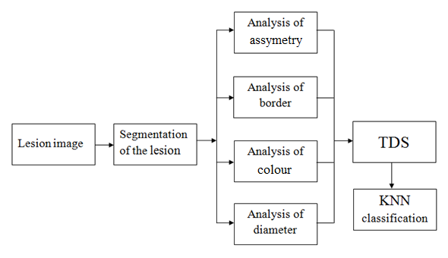
EXISTING SCHEME BLOCK DIAGRAM
6

Slide 7
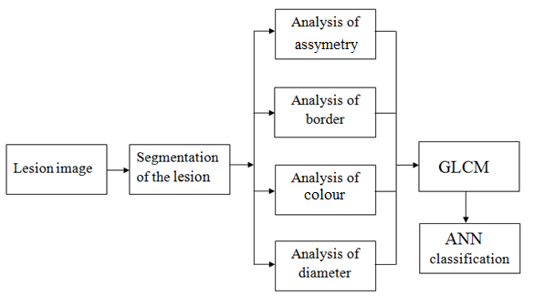
PROPOSED SCHEME BLOCK DIAGRAM
7

Slide 8
WORKING PRINCIPLE OF
PROPOSED SYSTEM

Slide 9
SOFTWARE TOOLS USED AND ITS FEATURES
SOFTWARE TOOL USED :
MATLAB 2012b
FEATURES :
High level language for scientific and engineering computing
Graphics for visualizing data and tools for creating custom plots
Interface to c / c++, Java, .NET, Python, SQL
Tools for building applications with custom user interfaces

Slide 10
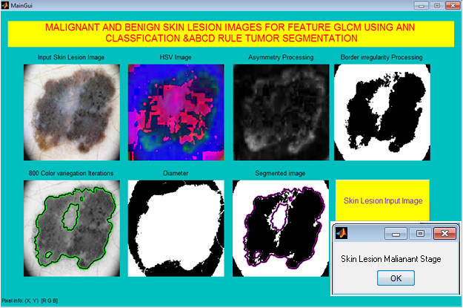
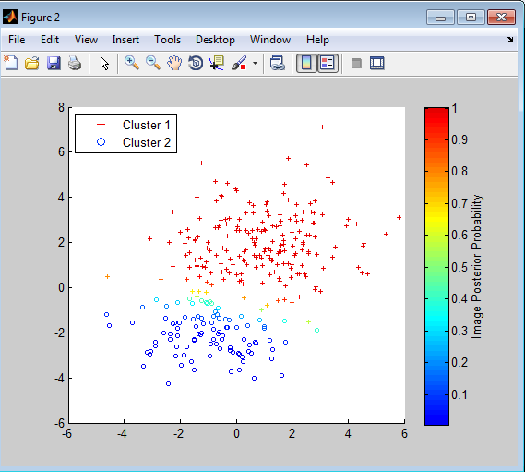
OUTCOME AND RESULTS
Lesion Analysis GLCM Feature extraction
Contrast =5
Energy =55
Homogeneity =97
Feature Score = 1.5700
Type: Skin Lesion Malianant Stage
Sensitivity = 75
Specificity =75
Recognition ACCURACY =95

Slide 11
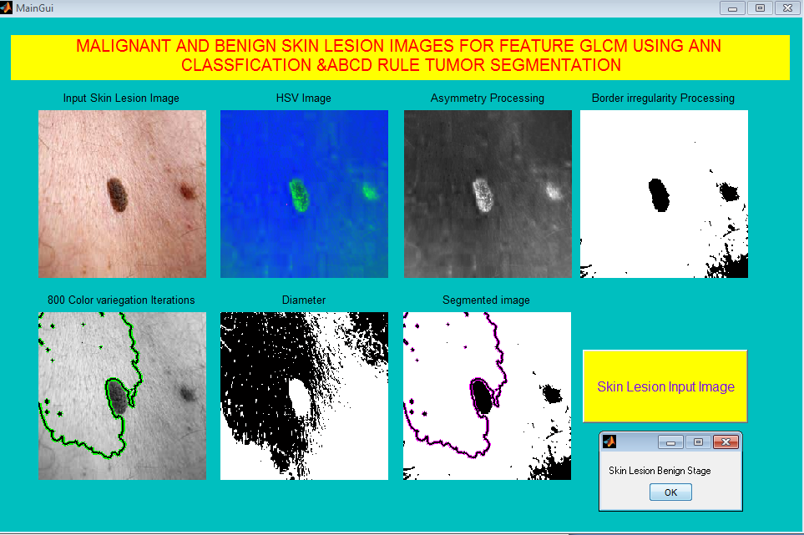
OUTCOME AND RESULTS
Lesion Analysis GLCM Feature extraction
Contrast =7
Energy =33
Homogeneity =97
Feature Score = 1.3700
Type: Skin Lesion Benign Stage
Sensitivity = 75
Specificity =75
Recognition ACCURACY =95

Slide 12
CONCLUSION
This project presents some analysis of automated segmentation method namely the ABCD rules (Asymmetry, Border irregularity, Color variegation, Diameter) to recognize skin lesion images.
The ABCD segmentation rules has successfully classify the images using GLCM & ANN.
The results show promise for enhancing the capability of computer-aided skin lesion ANN classiﬁcation malignant tumor and Benign Using MATLAB System.

Slide 13
FUTURE SCOPE
This system extracts all type of Lesion Tumor analysis and texture features of the selected image to perform classification.
Other features such as color, shape, Affected Area etc can be extracted to get better classification output which can be done as a future work.

Slide 14
REFERENCES
[1] E. de Vries, L. V. van de Poll-Franse, W. J. Louwman, F. R. de Gruijl, and J. W. Coebergh, 2005 “Predictions of skin cancer incidence in the Netherlands up to 2015,” Br. J. Dermatol., vol. 152, no. 3, pp. 481-488,
[2] A. Jemal, M. Saraiya, P. Patel, S. S. Cherala, J. Barnholtz-Sloan, J. Kim, 2011 “Recent trends in cutaneous melanoma incidence and death rates in the United States, 1992-2006,” J. Am. Acad. Dermatol. vol. 65, no. 5, pp. S17.e1-S17.e11,
[3] F. Bath-Hextall, J. Leonardi-Bee, C. Smith, A. Meal, and R. Hubbard, 2007 “Trends in incidence of skin basal cell carcinoma. Additional evidence from a UK primary care database study,” Int. J. Cancer, vol. 129, no. 9, pp.235-321.
[4] C. M. Balch, A. C. Buzaid, S. J. Soong, M. B. Atkins, N. Cascinelli, D. G. Coit, 2001 “Final version of the American Joint Committee on Cancer staging system for cutaneous melanoma,” J. Clin. Oncol., vol. 19, no. 16, pp. 3635-3648.
14

Slide 15
REFERENCES
[5] R. C. Brooke, 2005 “Basal Cell Carcinoma,” Clinical Medicine, vol. 5, no. 6, pp. 551-554.
[6] R. Marks, “An overview of skin cancers: incidence and causation, 1995” Cancer Supplement, vol. 75, no. S2, pp. 607-612.
[7] G. Argenziano, H. P. Soyer, S. Chimenti, R. Talamini, R. Corona, F. Sera, 2003 et al., “Dermoscopy of pigmented skin lesions: results of a consensus meeting via the Internet,” J. Am. Acad. Dermatol., vol. 48, no. 5, pp. 679-693.
[8] J de Leeuw, N. van der Beek, W. D. Neugebauer, P. Bjerring, and H. A. Neumann, 2009 “Fluorescence detection and diagnosis of non-melanoma skin cancer at an early stage,” Lasers in Surgery and Medicine, vol. 41, no. 2, pp. 96-103.

Slide 16
THANK YOU

