Slide 1
  ELECTRIC SHOCK PREVENTION FOR HUMAN
  SAFETY USING EMBEDDED SYSTEM

Slide 2
CONTENTS
Introduction
Abstract
Existing scheme
Proposed scheme
Block diagram
Software tools
Application
Results
Conclusion
Reference

Slide 3
INTRODUCTION
A device providing for discharging static electricity between a person and an grounded object to prevent un pleasant static shock to the person
An electric shock preventer provides electrical shock protection for human, which consist of shock sensing element and transceiver module.
A current sensing circuit includes a power transistor, a sensing transistor configured to copy a current flowing through the power transistor at a predetermined ratio, a current sensing resistor configured to detect a voltage from the current copied by the sensing transistor.

Slide 4
ABSTRACT
An electric shock is the effect of passing an electric current through the body. The minimum current a human can feel is thought to be about 1(mA).
The effect can range from minor tingling to muscle spasms, tissue damage, fibrillation of the heart, loss of consciousness, and even death. Death caused by an electric shock is referred to as electrocution.
To avoid injury by an electric shock, the embedded based shock preventer is used where it controls the total power unit of a factory or department which prevents human life from electric shock.

Slide 5
EXISTING SCHEME
  An ELCB (earth leakage circuit breaker) in that they are intended to trip when the current is not confined to the current carrying conductors. Another name used is current balance circuit breaker. These are all used with grounded power supplies.
In the existing system to prevent shock we have mainly used the non
conductor of electricity such as wood, plastics, rubber gloves, rubber
slippers to avoid electric shock. Since it is not a proper or completed
solution.
F. Yang, J. Yang, Z. Zhang et al., “Analysis on the dynamic responses of a prototype line from iced broken conductors,” Eng. Fail. Anal., vol. 39, no. 0, pp. 108-123, 2014.

Slide 6
PROPOSED SCHEME
To avoid injury by an electric shock, the embedded based shock preventer is used where it controls the total power unit of a factory or department which prevents human life from electric shock.
The object of this project is to describe methods of detection of unsafe electrical conditions with respect to the grounding of electrically operated mining equipment. it also includes a discussion of prototype instruments which effectively monitor the condition of the grounding safety devices currently in use on mining equipment and warn of dangerous conditions as soon as they appear.

Slide 7
PROPOSED SYSTEM WITH BLOCK DIAGRAM:
TRANSMITTER SIDE:
POWER SUPPLY
Human
PIC MICRO
CONTROLLER
POTENTIAL SENSOR
ZIGBEE

Slide 8
RECEIVER SIDE:
.
POWER SUPPLY
PIC MICRO
CONTROLLER
ZIGBEE
LCD
RELAY
UNIT1
RELAY
UNIT2
RELAY
UNIT 3

Slide 9
WORKING PRINCIPLE OF
PROPOSED SYSTEM
This invention relates generally to electrically powered systems of the kind which may present various hazardous electrical shock risk conditions when operating in their intended environment. The invention relates more particularly to an electric shock prevention method and system when any one or more of its associated electrical shock risk conditions exist.
PIC16F874A/877A
Potential sensor
Encoder
Zigbee TX & RX
Decoder
Pic micro controller
Transformer-3 arms
Relay
5v-power supply
Lamp load

Slide 10
WORKING PRINCIPLE WITH FLOW CHART
no yes
start
Zigbee pair
If >12
If<12
Unit 1
Unit 2
Unit 3
stop

Slide 11
SOFTWARE TOOLS USED AND ITS FEATURES
Embedded C keil 8051
The embedded c keil program development tools in microcontroller.
The keil 8051 development of tools are designed to solve the complex problems facing embedded software developers.
Keil c is macro assemblers, debugger, real time kernels, single board computers.

Slide 12
APPLICATIONS
Protect Your Family & Industry against Shock, Electrocution, Electrical Fires, and Overload & Short Circuits. It deals In Every Electrical Installation Including,
Industrial
Home
Department
Machine Tools
Air conditioners
Electronic Power Supplies

Slide 13
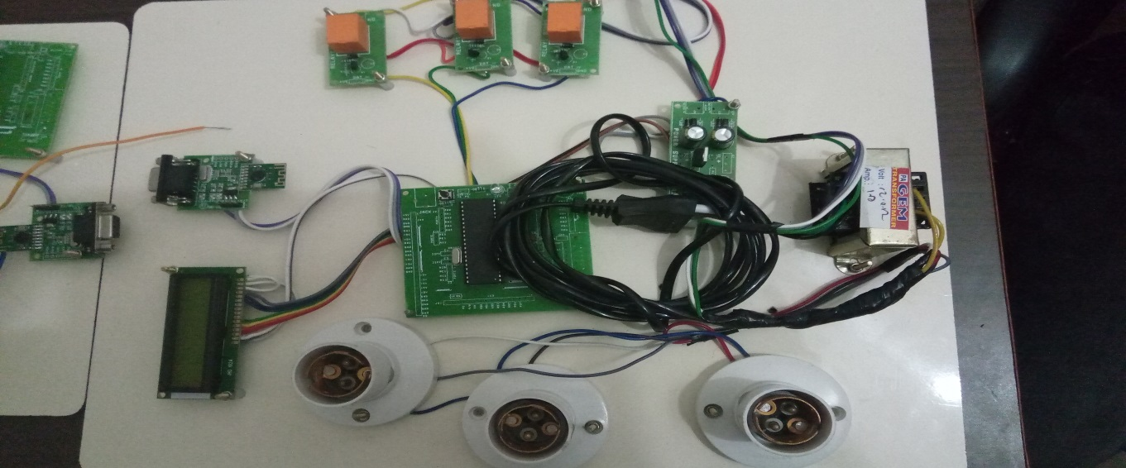
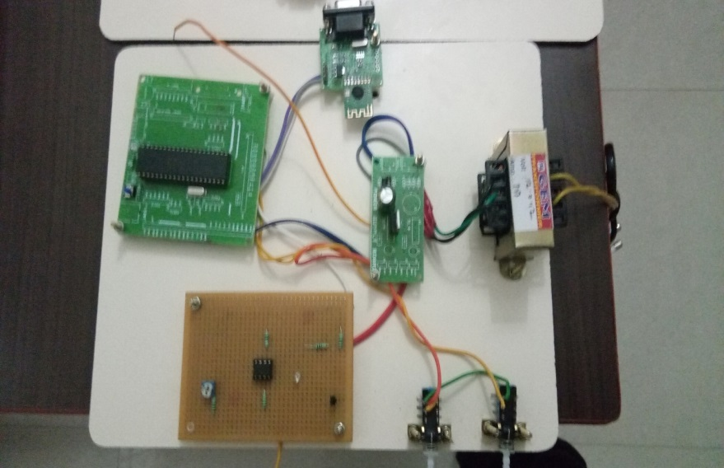
OUTCOMES AND RESULTS
In this project electric shock is avoided by using zigbee to prevent the life of human beings.
If the voltage is below 12v it should not sensed by the electric potential Sensor.
If the voltage is above 12v entire unit will be off.
receiver side transmitter side

Slide 14
CONCLUSION AND FUTURE SCOPE
The effect of electric shock depends on a variety of factors ,including the strength of the current, the area of the body through which current passes ,and whether the person is grounded or insulated from the ground. Death caused by an electric shock is referred to as electrocution.to avoid injury by an electric shock, the embedded based shock preventer is used where it controls the total power unit of a factory or department which prevents human life from electric shock.
In future it can be implemented in such a way that instead of shutting down the entire unit, finding proper way to reduce improper power supply.

Slide 15
REFERENCES
K. Ji, X. Rui, L. Li, A. Leblond, and G. McClure, “A novel ice-shedding model for overhead power line conductors with the consideration of adhesive/cohesive forces,” Comput, Struct, vol. 157, pp. 153-164, 2015.
G. McClure, K. Ji, and X. Rui, “An Integrated Ice-Shedding Model of Electric Transmission Lines with Consideration of Ice Adhesive/Cohesive Failure,” Proc. 9th Int. Conf. on Structural Dynamics, pp. 3731-3736, June30-July 02, 2014.
X. Meng, L. Hou, L. Wang et al., “Oscillation of conductors following ice-shedding on UHV transmission lines,” Mech. Syst. Signal Pr., vol. 30, pp. 393-406, 2012.
H. Landis Floyd II, PE, CSP, CMRP, Fellow IEEE(2014)”Leading Edge Developments in Advanced Safety Management and Applications to Electrical Safety” No.19.

Slide 16
REFERENCES
Floyd, A.H.L. and Floyd, H.L(2013),”Cultural Drift and the Occlusion of Electrical Safety, IEEE IAS Electrical Safety Workshop, Dallas, TX.
F. Mirshafiei, G. McClure, and M. Farzaneh, “Modelling the Dynamic Response of Iced Transmission Lines Subjected to Cable Rupture and Ice Shedding,” IEEE Trans. Power Del, vol. 28, no. 2, pp. 948-54, 2013.
F. Yang, J. Yang, Z. Zhang et al., “Analysis on the dynamic responses of a prototype line from iced broken conductors,” Eng. Fail. Anal., vol. 39, no. 0, pp. 108-123, 2014.
L. B. Gordon and L. Cartelli, (2009), “A complete electrical hazard classification system and its application,” in Proc. IEEE IAS Electrical Safety Workshop, St. Louis, MO, Feb. 2–6,2009, pp. 62–74.
Cawley J.C., Brenner, B.C.(2009),”Analyzing on the Job Electrical Injuries, a Survey of Selected U.S. Ocupational Electrical Injuries” IEEE Industry Applications, Magazine, May/June 2013.

Slide 17
THANK YOU

