Slide 1
  Design of Horn Feed for Parabolic Reflector Antenna

Slide 2
CONTENTS
Abstract
Existing scheme
Literature survey
Problems identified in existing scheme
Proposed scheme
Architecture and mathematical model of antenna
HFSS
Work done so far
Application
Work to be completed
References

Slide 3
ABSTRACT
Wireless technology is one of the main area of research in the world of communication systems today
Antenna is the important part of wireless technology
There are different types of antenna available
The proposed system involves design and analysis of horn feed for parabolic reflector antenna using HFSS
To reduce the cross polarization

Slide 4
EXISTING SCHEME
Kirti Chaurasiya, Satish Kumar Student of Master of Technology, Dept. of ECE, “Design and Analysis of Parabolic Reflector Using MATLAB ”,International Journal of Advanced Research in Electrical, Electronics and Instrumentation Engineering Vol. 4, PP-26, Issue 3, March 2015

Slide 5
EXISTING SCHEME Cont..
Parabolic reflector antenna -“Tri-mode feed”
Tool - MATLAB
List of parameters analyzed
          Centre frequency = 2.79GHz
          Focal length = 14.4mm
          Dish diameter = 26.9mm
Advantage– Gives better response
Drawback – Tri-mode feed is not much efficient

Slide 6
PROPOSED SYSTEM WITH BLOCK DIAGRAM
Input
Feeder
Feed Horn
Focus
Vertex
Parabolic Dish

Slide 7
WORKING PRINCIPLE OF
PROPOSED SYSTEM
Parabolic reflector antenna –“Multi mode Horn feed”
Tool - HFSS
By using multimode horn feed cross polarization can be minimized
Cross polarization depends on
          Focal length
          Diameter
          Frequency

Slide 8
WORKING PRINCIPLE WITH FLOW CHART
Open and make a new project
Draw objects
Assign material property
Define boundary condition
Solve
Display result

Slide 9
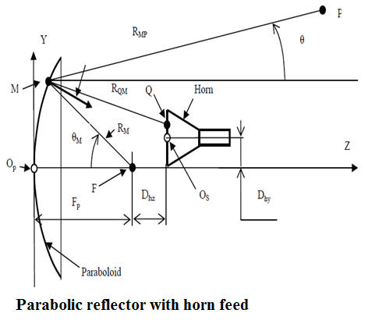
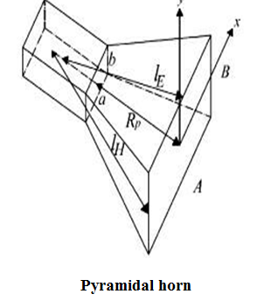
MATHEMATICAL MODELING

Slide 10
MATHEMATICAL MODELING
Cont..

Slide 11
SOFTWARE TOOLS USED AND ITS FEATURES
HFSS – High frequency structure simulator
Developed by prof.zoltan cendes
It is a 3D EM simulators
It uses FEM(finite element method) – large structure is divided into small element and then solved independently

Slide 12
SOFTWARE TOOLS USED AND ITS FEATURES Cont..
HFSS results are close to experimental results with more insight into the structure available
It is used for,
1.Antenna analysis and design
2.RF circuit analysis and design

Slide 13
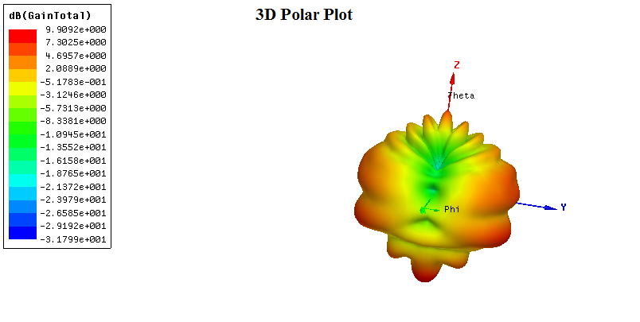
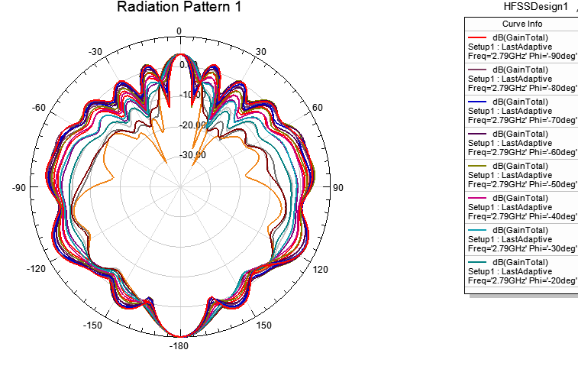
OUTCOMES AND RESULTS

Slide 14
CONCLUSION AND FUTURE SCOPE
The cross polarization is reduced by using the multi mode horn feed.
The parabolic reflector with multimode horn feed can be further improved as dome shaped radar antenna which yields higher bandwidth and efficiency.

Slide 15
REFERENCES
Kirti Chaurasiya , Satish Kumar Student of Master of Technology, Dept. of ECE, “Design and Analysis of Parabolic Reflector Using MATLAB ”,International Journal of Research in Electrical, Electronics and Instrumentation Engineering Vol. 4,PP-26, Issue 3, March 2015
Zohair Mohammed Elhassan Hussein1, Abdel rasoul gabbarkizar elzibaidi ,” Design and implementation of a controlled gain parabolic antenna”, International organization of Scientific Research 24 ,Vol.04, Issue 11(November. 2014),PP 24-28
M. Naranjo, A. Montesano, F. Monjas, M. Gomez, R. Manrique, F. Heliere and K. Van’t Klooster, “Biomass Pband SAR reflector antenna-feed S7S breadboarding”, International Journal of Advanced Research in Electrical, Electronics and Instrumentation Engineering EUSAR 2014, Berlin, Germany, June 2014 ,PP-88 to 90

Slide 16
REFERENCES Cont..
Dhruv H. Jadeja, Ila D. Parmar Balvant Makwana Dept. of Electronics & Communication Dept. of Electronics & Communication Parul Institute of Engg. & Technology,“Cross Polarization Reduction in Offset Reflector Antenna using Multimode Horn Feed”, International Journal of Advanced Research in Computer Science and Software Engineering Volume 4, Issue 2, February 2014,PP-35 to 40
Chuan Liu , Shiwen Yang and Zaiping Nie, “Design of a parabolic reflector antenna with a compact splash-plate feed”, IEEE Cross Strait Quad Regional Radio Science and Wireless Technology Conference (CSQRWC), vol 3,PP-38,issue 1,2013

Slide 17
REFERENCES Cont..
A.Moreira , I. Hajnsek , G. Krieger, M. Eineder, F.De Zan, M. Younis and M. Werner, "TandemL: Monitoring the Earth's dynamics with insar and polinsar", International Workshop on Applications of Polarimetry and Polarimetric Interferometry (PolInSAR), Frascati, Italy, January 2009
Hartzell S.D. Tran, T.M. Black, J.T. Marhefka and R.J. Terzuoli, “Analysis and feed design of a sparse aperture parabolic reflector” in IEEE Radio Science Meeting, 2013
Jagdish. M. Rathod Member, IACSIT and Y.P.Kosta, Senior Member IEEE, “Development of Conical Horn Feed For Reflector Antenna”, International journal of engineering and technology –vol:1,page 120 2009
Leo Diaz, Thomas Milligan, “Antenna Engineering Using Physics Optics” – Textbook

Slide 18
THANK YOU

Slide 19
ANY QUERIES !!??

