Slide 1
  Design Of Closed Control Loop For Boiler Air Flow System using Embedded system

Slide 2
CONTENTS
ABSTRACT
INTRODUCTION
EXISTING SCHEME
GENERAL LAYOUT OF THERMAL POWER PLANT
PROPOSED SYSTEM
PROPOSED SYSTEM WITH OPERATION
WORKING PRINCIPLE OF PROPOSED SYSTEM
OUTCOMES AND RESULTS
CONCLUTION AND FUTURE SCOPE
REFERENCES

Slide 3
ABSTRACT
In this project, a new steam boilers Oxygen and Air flow monitoring device for real-time measurement of Oxygen and Air flow rates is presented.
In Proposed system our project has been designed for Steam Boiler which monitoring the air flow
It will monitor and control the normal -Abnormal level of air automatically by PIC Based systems in forced draft fan.
It will generate high power by filling coal and inlet air pressure into the boiler with more accuracy.

Slide 4
INTRODUCTION
In this frame work, it is required to optimize the boiler efficiency which in turn helps to generate maximum amount of power in an optimized environment.
Boiler efficiency can be increased by reducing losses inside the boilers which are done using good quality fuels(coal) & air.
The main function of the boiler is to generate steam at desire pressure and desired steam generation rate.
  Types of fan in boiler operation
Types of fan | Operation | SYSTEM
Primary Air fan | Supply coal | Automatic
Induced Draft fan | Exit unwanted smoke in boiler furnace | Automatic
Forced Draft fan | Supply Air flow | Manual

Slide 5
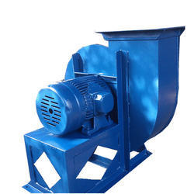
EXISTING SCHEME
Forced draft(FD) fan:
    It is controlled manually in the existing boiler system.
    It provides air to the closed vessel of furnace.
    Its is not easy to control the flow of air in FD fan,
    because it is dependent upon the coal of nature

Slide 6
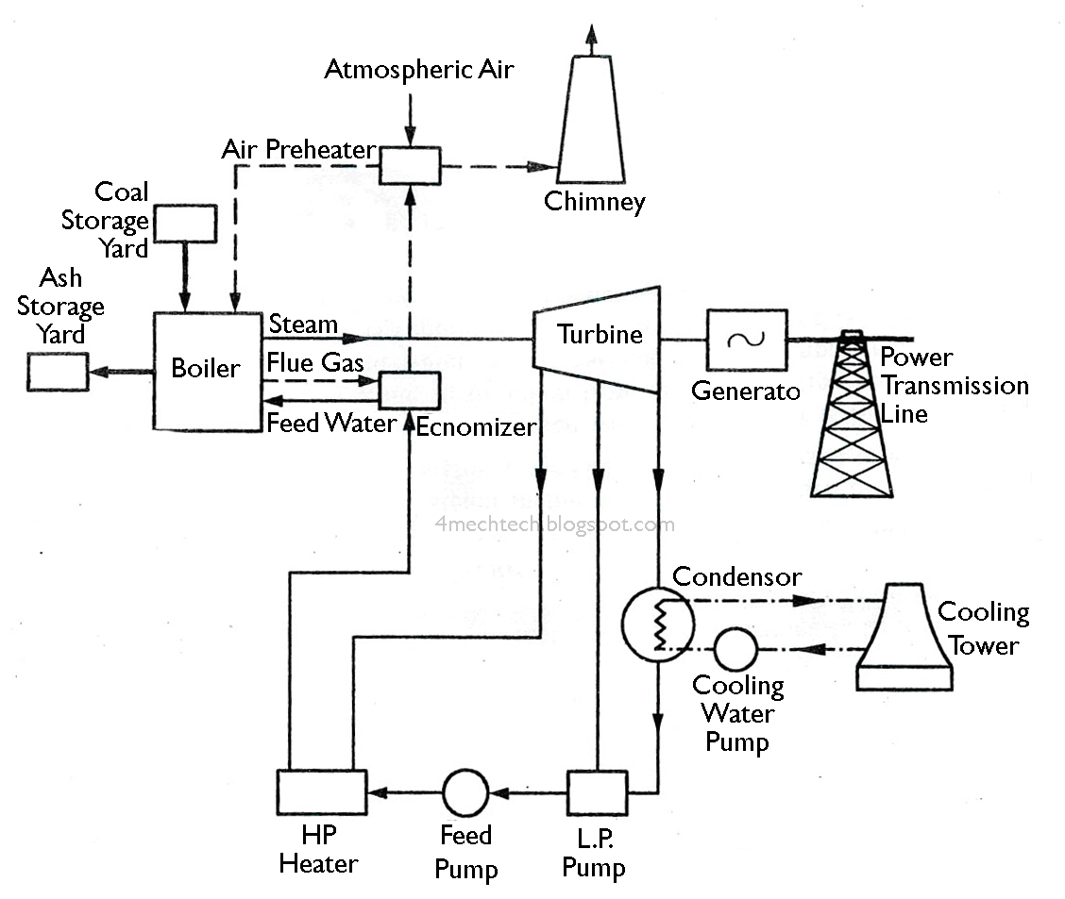
GENERAL LAYOUT OF THERMAL POWER PLANT

Slide 7
PROPOSED SYSTEM
In Forced Draft Fan it is a manual operation it will be change into automatic through simulation
In this fan do not supply air flow due to coal’s nature it will make serious problem it will be overcome by closed control loop for air flow system

Slide 8
PROPOSED SYSTEM OPERATION
Atmosphere
Oxygen
Orifice
Boiler
Forced Draft Fan
Vane / Damper Arrangement
Coal
Differential pressure
Actuator
ADC
ADC
ADC
PIC
H 5000M
Relay
LCD
Relay
8

Slide 9
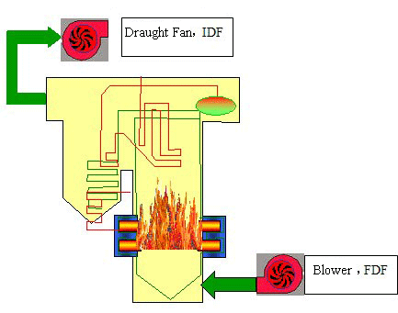
WORKING PRINCIPLE OF
PROPOSED SYSTEM

Slide 10
WORKING PRINCIPLE
This project work proposes a prototype of closed loop air damper control method used where the air supply can be controlled with the help of actuator, microcontroller through simulation
The main function of the boiler is to generate steam at desire pressure and desired steam generation rate in boiler system

Slide 11
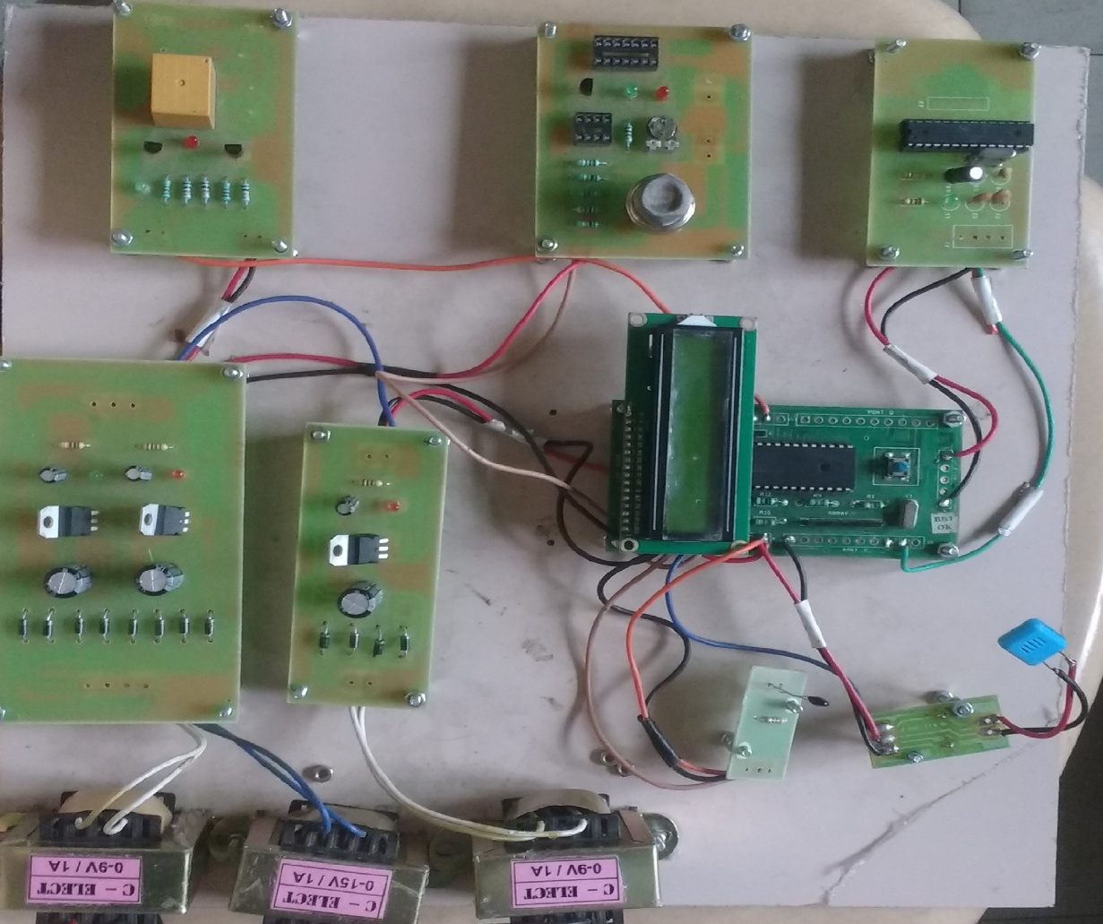
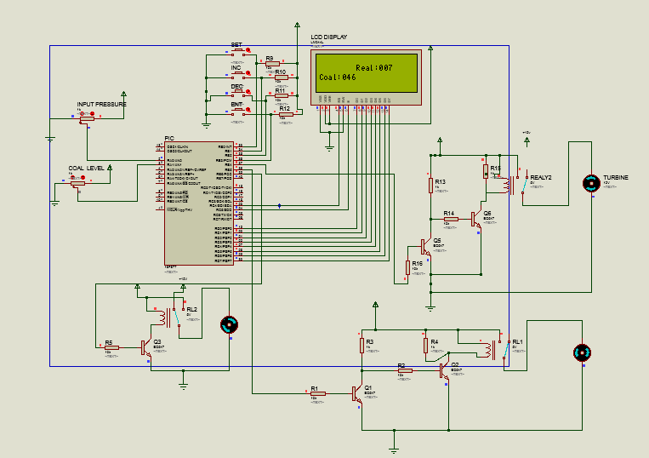
OUTCOMES AND RESULTS

Slide 12
CONCLUSION
Boiler or steam generator is an integral part of most of the core industries like power plant, steel plant etc. as machines are always susceptible to damages, any problem related to boiler will hampers the total process of production or service in an industry.
From the project we have learned basic ideas about industries, individual parts and their functions and the means to improve the efficiency of the boiler while maintaining the environmental laws and pollution act.
Overall it has been a great learning experience and gains a lot of experience and gain a lot of experience which we can utilize in practical field in future.

Slide 13
FUTURE SCOPE
Future emission scenarios for the period upto 2020-2021 are generated based on the estimates o2 and air flow combination in boiler system from thermal power plant have increased from 323474.858Gg for the percentage of boiler load, nitrogen content in the coal, and rate of gas cooling it makes a large power production for the environment.

Slide 14
REFERENCES
R.Hari Krishnan, V.Ramprasath-“Controlling power plant boiler and draft fan using lab view IEEE boiler fan simulation circuits”, vol. 27, no. 9 pp.476-487, Sep 2011.
Rhys Thompson, Dane Wong-IEEE, “Boiler induced draft fan optimization” page no-16-22, published in the year of 2011.
Juio, Maria p.caton “Controlling power plant boiler &draft fan” in 2014.
Goyal, IEEE state journal “Design of boiler fan and its operation under control system” IEEE state journal published in the year of 2009.

Slide 15
REFERENCES Cont..
Mcgraw hill “Heating boiler operator’s manual maintanance operation and repair” published in the year of 2014
C.S.Wallace,”Operation of boiler fan controlling for the power plant” page no, 560-568, published in the year of 2014.
http://www.atmel.com/
http://www.microchip.com/

Slide 16
THANK YOU !!!

