Slide 1
  CROWD SIZE ESTIMATION USING MATLAB

Slide 2
CONTENT
ABSTRACT
EXISTING SCHEME
PROPOSED SCHEME
FLOW CHART
BLOCK DIAGRAM
SOFTWARE METHODOLOGY
SOFTWARE TOOL AND FEATURES
OUTCOME & RESULTS OF IMPLEMENTION
CONCLUSION AND FUTURE SCOPE
REFERENCES

Slide 3
ABSTRACT
Crowd density and size estimation is very important in intelligent crowd monitoring
In this project, a new approach of crowd density estimation is proposed video processing method
This method combines the advantage of pixel statistical feature and texture analysis, and reduces the impact of perspective distortion by dividing the region of interest
-Continue

Slide 4
Estimate the crowd size (the range of numbers) for high density and extremely high density crowd
Experiment results show that the proposed method has a relatively high accuracy in the whole density range

Slide 5
EXISTING SCHEME
Subburaman.V.B, Descamps.A and Carincotte.C Counting People in the Crowd Using a Generic Head Detector Proceedings of 2012 IEEE 9th International Conference on Advanced Video and Signal-Based Surveillance (AVSS): September 18-21, 2012 Beijing, China, pp-470-475, 2012
Mark Marsden, Kevin McGuiness, Suzanne Little, and Noel E O’Connor Fully Convolutional Crowd Counting On Highly Congested Scenes In The International Conference on Computer Vision Theory and Applications, pp-2547–2554, 2017

Slide 6
PROPOSED SCHEME
Combination of Pixel and Texture statistical method
Reduces run time
More accuracy possible in results

Slide 7
FLOW CHART
Video
Gaussian Mixture Mode
Foreground Image
Filtering & Morphological Action
Pixel Statics Method
Texture Statics Method
To Attain Crow density
Crow Estimation and Analysis

Slide 8
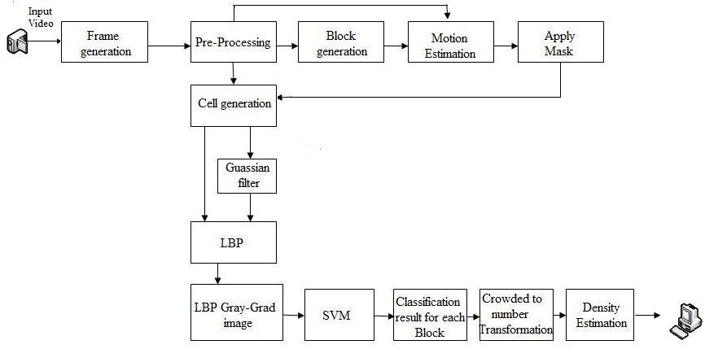
BLOCK DIAGRAM OF PROPOSED SCHEME

Slide 9
APPLICATIONS
It can be used by multiple businesses including shopping malls, supermarkets, Railway station ticket counter and so on
It is widely used in computer vision technology based video surveillance applications
-Continue

Slide 10
It will be able to rival existing surveillance and monitoring systems by providing more in depth details and information to the concerned personnel involved in the running of the institute

Slide 11
SOFTWARE METHODOLOGY
Video is the input and extracting the foreground image through filtering method
Then processing with pixel and Texture statistic method
The input video will convert colour code into gray code level

Slide 12
SOFTWARE TOOLS USED AND ITS FEATURES
SOFTWARE TOOL USED :
MATLAB R2014a
FEATURES :
High level language for scientific and engineering computing
Graphics for visualizing data and tools for creating custom plots
Interface to c / c++, Java, .NET, Python, SQL
Tools for building applications with custom user interfaces

Slide 13
OUTCOME & RESULTS OF IMPLEMENTION
Prediction of crowd to manage the violence
Obtaining a accuracy of whole density range of crowd

Slide 14
CONCLUSION AND FUTURE SCOPE
By implementing this method we can analysis the crowd size and also control the crowd
It will help to reduce the violence rate

Slide 15
REFERENCES
Subburaman.V.B, Descamps.A and Carincotte.C Counting People in the Crowd Using a Generic Head Detector Proceedings of 2012 IEEE 9th International Conference on Advanced Video and Signal-Based Surveillance (AVSS): September 18-21, 2012 Beijing, China, pp-470-475, 2012
Mark Marsden, Kevin McGuiness, Suzanne Little, and Noel E O’Connor Fully Convolutional Crowd Counting On Highly Congested Scenes In The International Conference on Computer Vision Theory and Applications, pp-2547–2554, 2017

Slide 16
THANK YOU

