Slide 1
  Convergence of IPv6 Networks Through IPv4 Network Using Dual stack And Tunneling Mechanism

Slide 2
CONTENTS
Abstract
Existing Scheme
Proposed System
Block Diagram
Working principle
Hardware/Software components and Tools used
Outcome and Results
Conclusion and Future scope
References

Slide 3
ABSTRACT
The internet is a worldwide publicly accessible system of interconnected computer networks, since IPv4 in network enables data sharing.
All IPv4 addresses had vanished and now we are going for IPv6.
Migration technique to IPv6 network is used in this project that overcomes all the limitations available in existing IPv4 network.
Dual stack and tunnelling concept is used to converge the IPv6 network through IPv4 ISP network .

Slide 4
EXISTING SCHEME
S. Aravind and G. Padmavathi.,Migration to Ipv6 From IPV4 by Dual Stack and Tunneling Techniques, International Conference on Smart Technologies and Management, 6 - 8 May 2015. pp.107-111.
Colitti L., Roma Tre University, Di Battista G., Patrignani M. (2012) IPv6-in-IPv4 Tunnel Discovery: Methods and Experimental Results, Network and Service Management IEEE transactions 12 September 2012 Vol 1, pp 30-38.

Slide 5
Limitations
The existing IPv4 network has the following limitations
more latency
less security
less address space
No auto configuration facility.

Slide 6
Proposed System
IPv6 is also known as IPng, IP next generation. IPv6 was developed by the Internet Engineering Task Force (IETF) to deal with this long-anticipated IPv4 address exhaustion.
IPv6 is used by less than 1% of the networks, while IPv4 is still in use by the remaining 99%.
So replacing the entire core network(IPv4 network) into IPv6 is practically not Possible.

Slide 7
PROPOSED SYSTEM WITH BLOCK DIAGRAM
Core ISP network
(IPv4)
Dual stack router Dual stack router
Dual stack technique
R2
IPv6
Network
R1
R4
IPv6
Network
R3

Slide 8
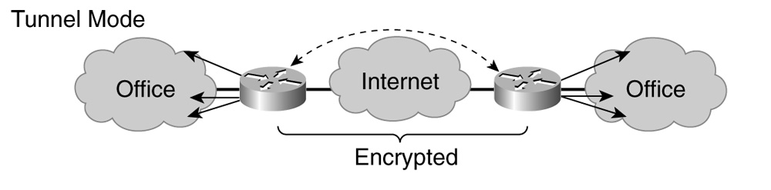
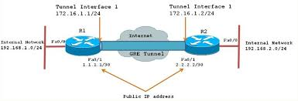
Tunneling Technique

Slide 9
WORKING PRINCIPLE OF
PROPOSED SYSTEM
When any organization wants to implement IPv6 network in their service area, it is not possible to implement all of a sudden. It needs slow migration from IPv4 to IPv6 without affecting the existing service much.
Design of dual stack technique is done for transferring of data from IPv4 network to IPv6 network in both static and dynamic routing.

Slide 10
WORKING PRINCIPLE
A router can be installed with both IPv4 and IPv6 addresses configured on its interfaces.
The dual stack routers can communicate with both IPv4 and IPv6 networks
The tunnelling concept is to transmit IPv6 packets through IPv4 network that enables and achieves fully in IPv6 network. In order to reach the IPv6 Internet, an isolated host or network must use the existing IPv4 infrastructure to carry IPv6 packets

Slide 11
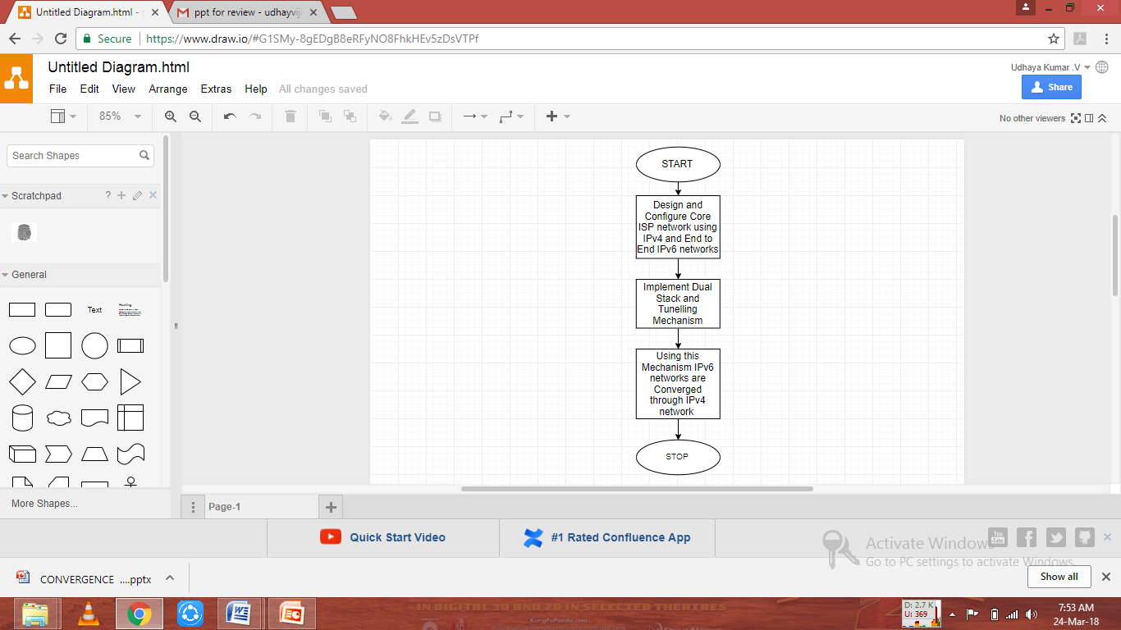
FLOW CHART

Slide 12
SOFTWARE
Cisco Packet Tracer 7.1 is an excellent tool to real labs for network engineers.
It can also be used to experiment features of Cisco IOS, Juniper JunOS or to check configurations that need to be deployed on real routers

Slide 13
Features of Tool
Design of high quality and complex network topologies.
Emulation of many Cisco IOS router platforms, IPS, and firewalls, JunOS.
Simulation of simple Ethernet, ATM and Frame Relay switches.
Connection of the simulated network to the real world
Packet capture using real-time simulation .

Slide 14
Outcome
Larger Address Space: Address field in IPv6 is 128 bits. So more no.of devices can be connected to the network
Better header format: The header of IPv6 has been designed in a way to speed-up the routing process.
Security Features:To ensure IPsec confidentiality and packet's encryption and authentication options are included in IPv6.
Multicasting:The transmission of a packet to multiple destinations in a single send operation, is part of the base specification in IPv6.

Slide 15
Results of Implementation
IPv6 networks are connected through the Existing IPv4 network (ISP Networks) using these two mechanism
Dual stacking
Tunneling
With less latency, More security, Large Addressing space.

Slide 16
Conclusion
IPv6 overcomes many of the limitations of IPv4 by introducing new features and functionality.
IPv6 improves router performance issues and it is very simple to configure.
Thus increasing the address space and solving a major obstacle for the further growth of the Internet.
IPv6 also offers improvements like security support in the protocol’s definition and more flexibility and extensibility than IPv4.

Slide 17
Future scope
Thus the IPv6 has the advantages over existing IPv4,which has larger address space.
The IPv6 packets are being encapsulated over IPv4 and are converged to IPv6.
Tunneling is used to show their interoperability between the networks which are useful for the future generations to utilize the existing IPv4.
Thus the mode of tunneling eliminates the need for the manual configurations.

Slide 18
References
Sahasrabuddhe,L.H. Mukherjee,B. California Univ., Los Angeles, IEEE, international conference on Networks on feb 2000, Volume : 4 Issue:1 pp. 90-102.
Eric Grosse and Lakshman Y. N., Bell Laboratories ’Network Processors Applied to IPv4/Ipv6 Transition’, Lucent Technologies - IEEE Network July/August 2003.
Fred L. Templin – SRI International, ‘ISATAP – Intra-Site Automatic Tunnel Addressing Protocol’,IETF 51 NGTRANS
http://ipv6.com/articles/gateways/IPv6-Tunnelling.htm
http://www.cisco.com/en/US/tech/tk872/technologies_configuration_example09186a00800b49a5.shtml

Slide 19
THANK YOU

