Slide 1
AUTOMATIC STREET LAMP
USING SOLAR ENERGY EFFICIENT
BASED ON ZIGBEE NETWORK

Slide 2
CONTENTS
ABSRACT
EXISTING SYSTEM
PROPOSED SYSTEM WITH BLOCK DIAGRAM
WORKING PRINCIPLE OF PROPOSED SYSTEM
SOFTWARE TOOLS USED AND ITS FEATURES
OUTCOMES AND RESULTS
HARDWARE DESCRIPTION
CONCLUSION AND FUTURE SCOPES
REFERENCE

Slide 3
ABSTRACT
  This project presents automatic street lamp using solar energy efficiency based on ZigBee network.
  In this project, eco-friendly solar energy as source energy for street lighting system in which street lamp will glow up automatically if there is passing vehicles or human beings.
  Backup power is also available for this street lighting system, during winter season and rainy season.
  This back up power is generated by piezoelectric sensor with help of vehicle passing by it and produces energy.
  The piezoelectric will convert mechanical energy into electrical energy which will charge the battery.

Slide 4
EXISTING SCHEME
Wireless mesh network of ZigBee nodes combines advanced and traditional controlling features.
The comprises of ZigBee based mesh networked streetlamps and management software that offers real time monitoring and control of lighting system.
Each lamp is integrated with ZigBee node and the controller module along with ballast actuator.
The controller interconnects light sensor, ballast actuator and radio communication module.
The system is remotely managed through developed software that allow B operator to implement different strategies for saving as end.

Slide 5
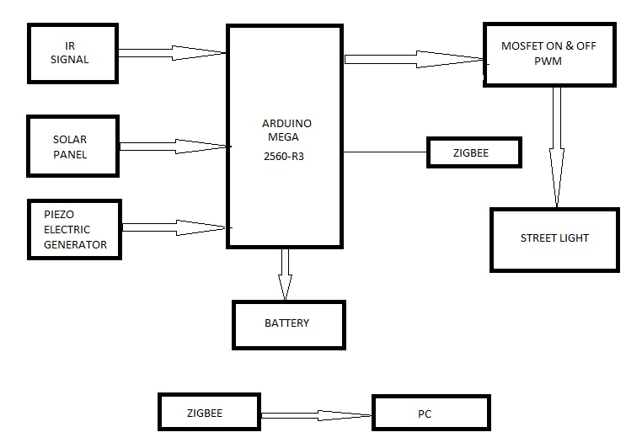
PROPOSED SYSTEM WITH BLOCK DIAGRAM

Slide 6
WORKING PRINCIPLE OF
PROPOSED SYSTEM
This project aims for saving the energy and the lamp will automatically glow on or off when vehicle or man approach near to the lamp IR sensor will detect the vehicle or man.
When far vehicle or man goes away from the lamp will automatically glow off .
This process will go on for remaining lamp. We are using piezoelectric for generating backup power during winter season or rainy season.
Both energy sources are eco-friendly.

Slide 7
SOFTWARE TOOLS USED AND ITS FEATURES
1 | ARDUINO IDE
2 | MC Programming Language: Embedded C

Slide 8
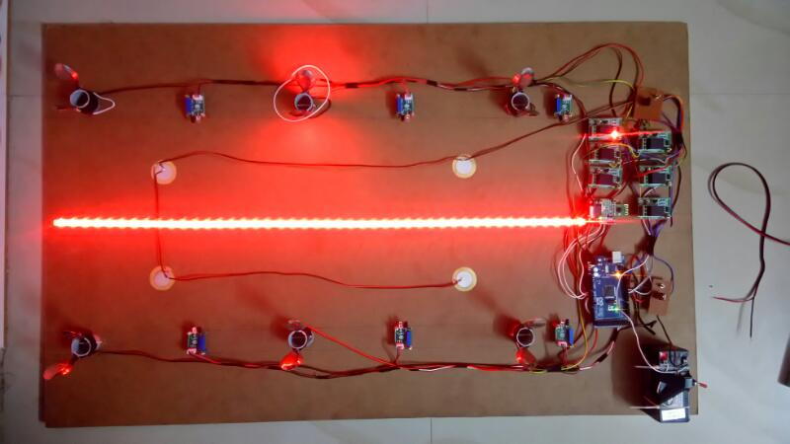
OUTCOMES AND RESULTS

Slide 9
HARDWARE DESCRIPTION
PIEZOELECRIC GENERATOR
IT CAN CONVERT MECHANICAL ENERGY INTO ELECTRICAL ENERGY.
MECHANICAL ENERGY IS PRODUCE BY PASSING BY VEHICLES.
LED
IT IS A DEVICE CONSTRUCTED FROM SEMI CONDUCTOR MATERIAL.
IT HAS LONG LASTING LIFE TIME AND CONSUMING LESS ENERGY COMPARE TO OTHER TRADITIONAL LIGHT.
IR SENSOR
IT WILL SENSE THE OBJECT WHICH IS PASSING BY THE ROAD.
SOLAR PANEL
IT GIVES THE POWER TO THE WHOLE CIRCUIT.
BATTERY
IT STORES ENERGY PRODUCE BY THE SOLAR PANEL AND PIEZO ELECTRIC GENERATOR.

Slide 10
CONCLUSION AND FUTURE SCOPE
Our project presents automatic street lamp efficient using solar energy based on ZigBee network.
Where we can control the street lamp and maintain it from one station. Additional to this idea, we use back up power which is generated by Piezo electric and this Piezo electric convert vehicles mechanical energy into electrical energy which may be useful during rainy and winter season to glow up street lamp.
On Sunny day energy for street lamp is given by solar panel. When vehicles approach near to street lamp post, the light will automatically glow up with help of detection of IR sensors, After the vehicles has passed this lamp and light will glow off.
This process will go on and consumes less energy. Both power sources to street lamp are eco-friendly to environment and cost saving to us.

Slide 11
REFERENCES Cont..
P. R. Boyce, S. Fotios, and M. Richards, "Road lighting and energy saving," Lighting Research and Technology, vol. 41, pp. 245-260, 2009.
C. Attacca¿, T. Ozcelebi, and J. J. Lukkien, "Exploring user-centered intelligent road lighting design: a road map and future research directions," Consumer Electronics, IEEE Transactions on, vol. 57, pp. 788-793, 2011.
C. Chun-An, C. Hung-Liang, L. Kun-Jheng, C. Kuan-Lin, and Y. Chun-Hsien, "A digitally wireless dimmable lighting system for two area fluorescent lamps," in TENCON 2010 - 2010 IEEE Region 10 Conference, 2010, pp. 2173-2178.
J. D. Lee, K. Y. Nam, S. H. Jeong, S. B. Choi, H. S. Ryoo, and D. K. Kim, "Development of ZigBee based Street Light Control System," in Power Systems Conference and Exposition, 2006. PSCE '06. 2006 IEEE PES, 2006, pp. 2236-2240.
J. M. Alonso, J. Ribas, J. J. D. Coz, A. J. Calleja, E. L. Corominas, and M. Rico-Secades, "Development of a distributive control scheme. for fluorescent lighting based on LonWorks technology," Industrial Electronics, IEEE Transactions on, vol. 47, pp. 1253-1262, 2000.
C. SungKwan and V. Dhingra, "Street lighting control based on LonWorks power line communication," in Power Line Communications and Its Applications, 2008. ISPLC 2008. IEEE International Symposium on, 2008, pp. 396-398.

Slide 12
THANK YOU

