Slide 1
  AUTOMATIC BUS SEATS COUNT AND RF TRACKING USING IOT

Slide 2
CONTENTS
Abstract
Existing Scheme
Block Diagram
Working principle
Hardware/Software components and Tools used
Outcome and Results
Conclusion and Future scope
References

Slide 3
ABSTRACT
This project proposes a supervisory system based on WIFI technology, to improve the operation efficiency of bus monitoring system and realize intelligent transportation system.
Using IR sensors to know the available seats in the bus.
RF TRANSCEIVER is used to track the object(ie.bus) in certain regions.
RF is used to convey the informations where is the object located.

Slide 4
EXISTING SCHEME
S. Shah and B. Singh, “RFID Based School Bus Tracking and Security System,” pp. 1481–1485, 2016.
J. Zambada, R. Quintero, R.Isijara, R.Galeana, and L. Santillan, “An IoT based scholar bus monitoring system,” 2015 IEEE 1st Int. Smart Cities Conf. ISC2 2015, 2015.

Slide 5
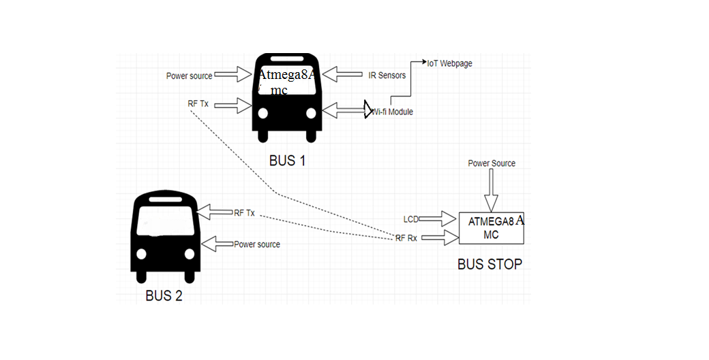
PROPOSED SYSTEM
(BLOCK DIAGRAM)

Slide 6
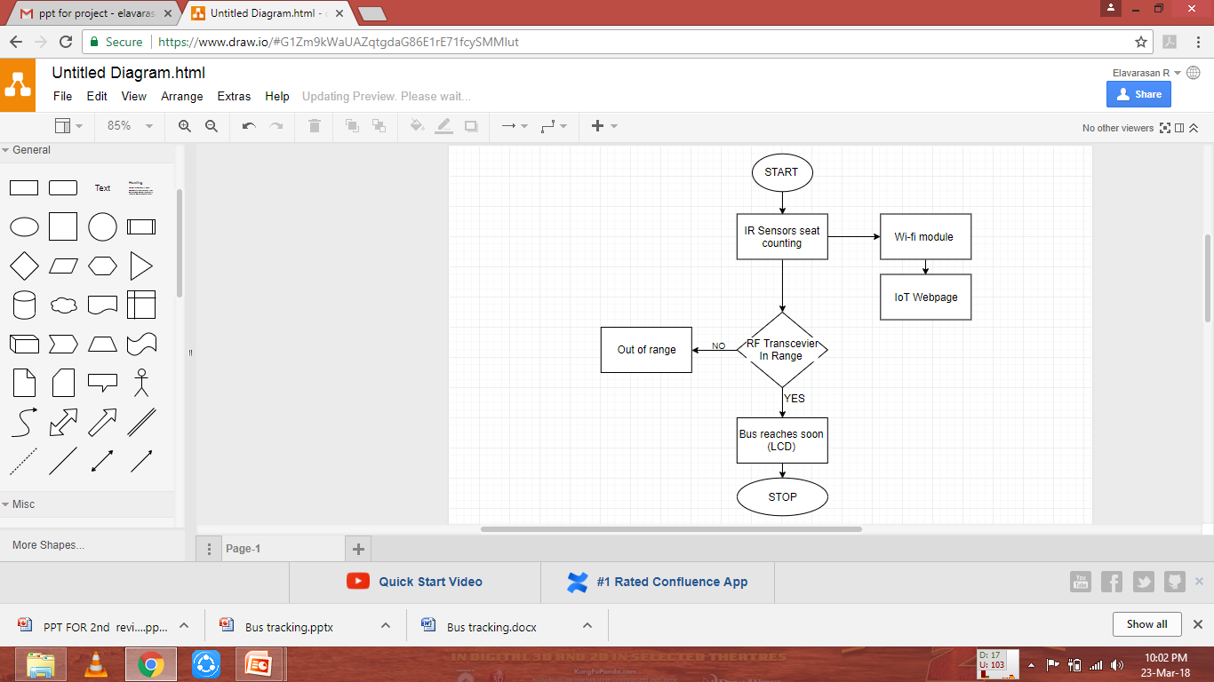
FLOW CHART

Slide 7
WORKING PRINCIPLE OF
PROPOSED SYSTEM
The main use of this project is to display the status
of the bus.
The project has several RF Transmitter sections which could be used for provide the information to bus.
During the time of running if the bus crossed across there in the relevant receiver section, the particular transmitter section indicates the relevant message to driver through RF wireless communication. From this we can display the relevant stopping.

Slide 8
Hardware
Power supply unit
Microcontroller – ATmega 8A
WIFI module
IR sensor
Drives

Slide 9
Software
Platform - AVR STUDIO
Compiler – Win AVR
Embedded C language

Slide 10
Power supply
A regulated power supply is the power supply with rectification, filtering and regulation being done on the AC mains to get a regulated power supply for microcontroller and for the other devices being interfaced in it.
A power supply can be broken down in to series of blocks, each block performs a particular function.

Slide 11
Microcontroller
ATmega8A is the microcontroller used in this project.
The controller has peripheral features like inbuilt ADC, required to get the signals from the sensors.
Maximum clock frequency is 20MHz and hence faster than 8051.
Based on RISC and Harvard architecture and hence even more faster.
Embedded C is used for programming the microcontroller.

Slide 12
Software Tool
Embedded C is generally an extension of the C language, they are more or less similar. However, some differences do exist, such as C is generally used for desktop computers, while embedded C is for microcontroller based applications. C can use the resources of a desktop PC like memory, OS, etc.

Slide 13
Features of Tool
Possesses of cross development in nature
Dependent on hardware architecture(microcontroller or other devices)
Used to limited resource like RAM,ROM and I/O peripherals on embedded controller

Slide 14
Outcome
IR sensors are used to counting the seats, which is free or not and Wifi module is used to transfer the seats availability and displayed via IoT webpage creations
RF transceiver is used to track the bus in certain range.
LCD is fixed in the bus stage and displayed wheather the bus arrival or not using RF receiver

Slide 15
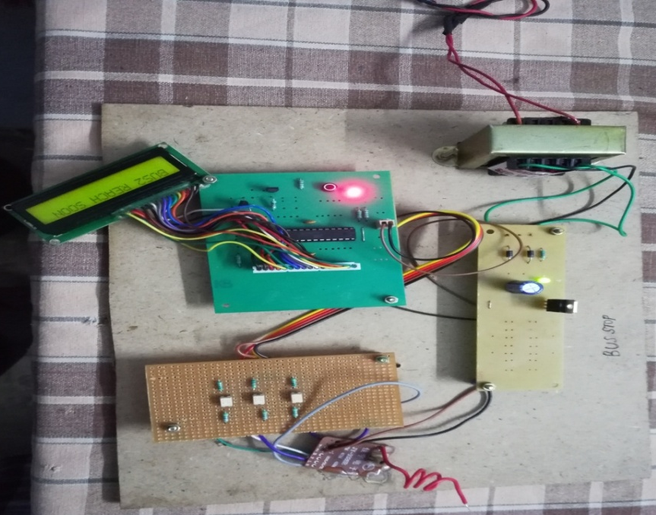
Results
RF Transceiver is used to tracking the bus to enter to the certain system and displayed using LCD display

Slide 16
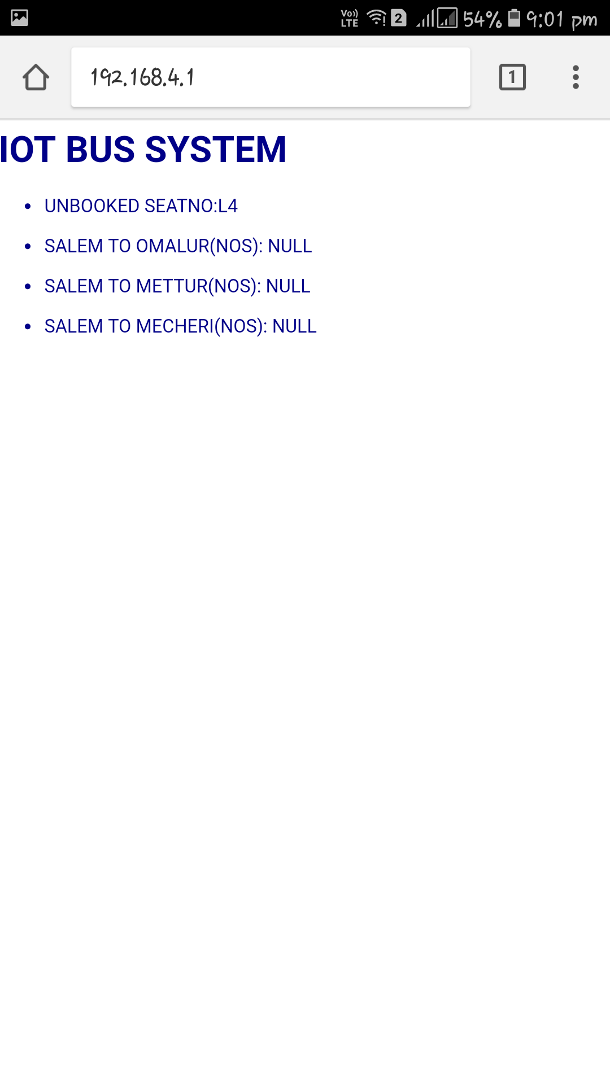

.
IR sensors used to find out the passengers are sitting on the seats or not, and the information’s displayed the webpage creation using Internet of Things via Wi-Fi module

Slide 17
Conclusion
The proposed system based on Atmega 8A microcontroller is found to be more compact, user friendly and less complex, which can readily be used in order to perform
Due to the probability of high technology (Atmega 8A microcontroller) used this” AUTOMATIC BUS SEATS COUNT AND RF TRACKING USING IOT” is fully software controlled with less hardware circuit. The feature makes this system is the base for future systems.

Slide 18
Future scope
In future ,Everywhere the smart mobile facility is available, so anyone can easily check the bus seats availability and checks the status of bus using RF wireless communication

Slide 19
References
A. F. Abidin and M. Kolberg, “Towards Improved Vehicle Arrival Time Prediction in Public Transportation: Integrating SUMO and Kalman Filter Models,” Proc. - UKSim-AMSS 17th Int. Conf.Comput. Model. Simulation, UKSim 2015, pp. 147–152, 2016.
S. Lee, G. Tewolde, and J. Kwon, “Design and implementation of vehicle tracking system using GPS/GSM/GPRS technology and smart phone application,” 2014 IEEE World Forum Internet Things,pp. 353–358, 2014.
T.Bojan, U. Kumar, and V.Bojan, “Designing vehicle tracking system - An open source approach,” 2014 IEEE Int. Conf. Veh.Electron. Safety, ICVES 2014, pp. 135–140, 2015.

Slide 20
THANK YOU

