Slide 1
  AUTOMATED TEST SOFTWARE(ATS)
  ON CLOUD

Slide 2
CONTENTS
INTRODUCTION
EXISTING SCHEME
CLOUD COMPUTING
BLOCK DIAGRAM OF PROPOSED SCHEME
WORKING PRINCIPLE OF PROPOSED SCHEME
SOFTWARE TOOLS USED AND ITS FEATURES
OUTCOMES AND RESULTS
CONCLUSION AND FUTURE SCOPE
REFERENCES

Slide 3
INTRODUCTION
This quality of automated testing has made it an essential part of software development. This has become more important than ever before given the need to accelerate software development and reduce the time to market in the fast changing business environment.
The Automated Test Software (ATS) on Cloud is developed on a Cloud based environment that automates testing of audio and video based applications/systems. Cloud computing is promising in order to enhance uniform standards and latest test application among all the test benches used to test a specific product, also at no geological boundary limits.

Slide 4
EXISTING SCHEME
Manual Testing
- Test case only needs to runs once or twice.
- To execute and Create the test cases every time tester required same amount of time.
- Manual testing is slower.
- It’s very time consuming.
Testing
Manual Testing
Automated Testing

Slide 5
EXISTING SCHEME Cont..
Desktop based
- Can’t be accessed without installing anything.
- Can’t be managed and updated by IT more easily.
- Can’t be accessed with a mobile device.
- Can’t be accessed across multiple operating systems.
Server Applications
Desktop Based Application
Web Based Application

Slide 6
TECHNOLOGY USED
CLOUD COMPUTING
# The Practice Of Using A Network Of Remote Servers Hosted On The Internet To Store, Manage, And Process Data, Rather Than A Local Server Or A Personal Computer.
Automated backups, uptime, SLA, maintenance
Multi-tenant solution provided by vendor
Automated Upgrades
Cloud Computing
Elastic, pay as you go scale up or down
Web and mobile access from anywhere
Modern web based integration

Slide 7

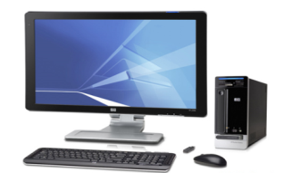

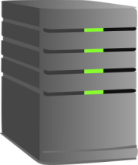
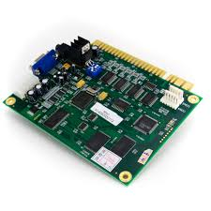

PROPOSED SYSTEM WITH BLOCK DIAGRAM
Client
Server
Database
Source
web socket
HTTP Request
DUT
REST API using JSON
JSON
Sink
HTTP Response
Client Side
Server Side

Slide 8
WORKING PRINCIPLE OF
PROPOSED SYSTEM
SOURCE – QD804 SERIES VIDEO GENERATORS
  The QA804 series Instruments Feature four HDMI Outputs .
  Multiple HDMI inputs.
DEVICE UNDER TEST (DUT) ADV7623
  ADV7623 is a high Performance 4 input, 1 output.
  HDMI Transceiver that integrates HDMI receiver.
ANALYSER - VA1809
  VA1809 is Protocol Analyzer used to Inspect/Measure Various HDMI Signal Function.

Slide 9
WORKING PRINCIPLE WITH FLOW CHART
Login
Dashboard
Administration Window
Test Designer
Runner Page
Report Page
(New + Old)
Test Case
Device Configure Window
(Source, DUT, Sink)
Test Plan
Execute
Console
+
Database
Test suit

Slide 10
SOFTWARE TOOLS USED AND ITS FEATURES
Client Side | Server Side | Database
HTML5 | Node.js | CouchDB
CSS
Polymer Library
Bootstrap

Slide 11
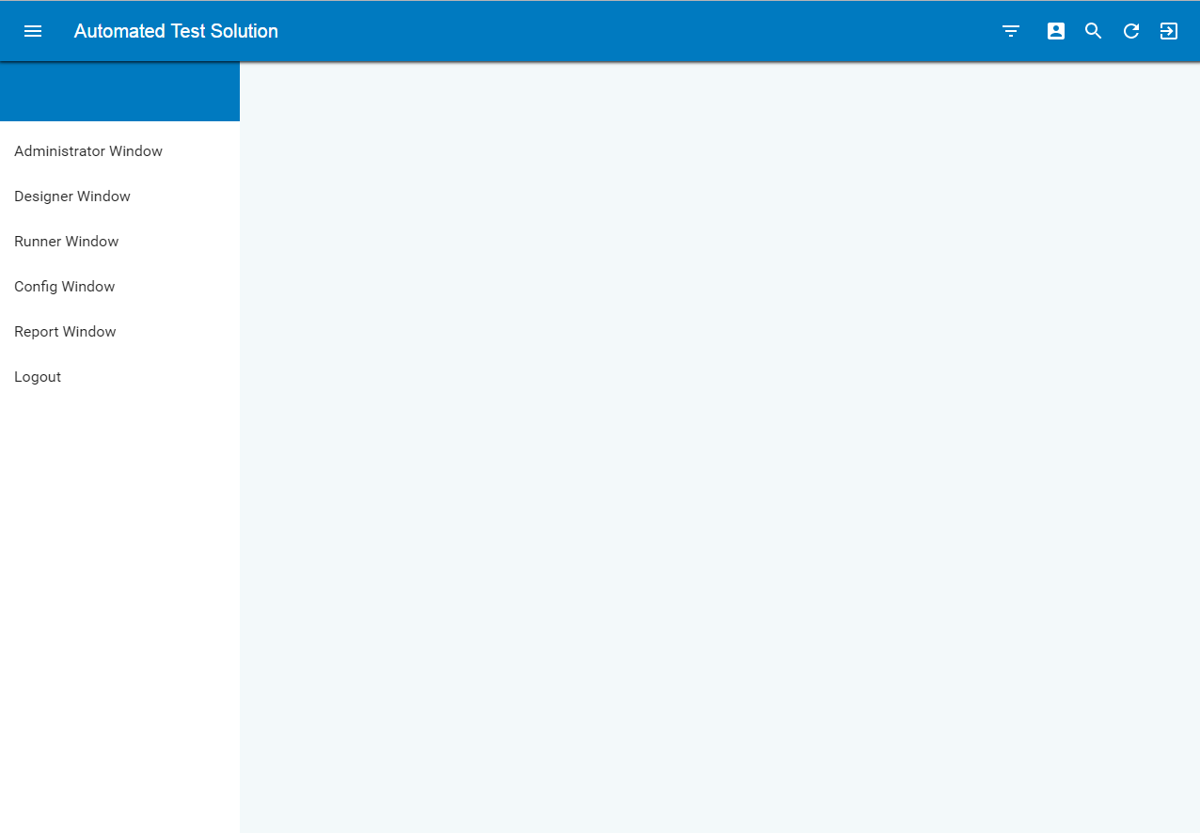
OUTCOMES AND RESULTS
ATS on Cloud – Snapshot:
Dashboard

Slide 12
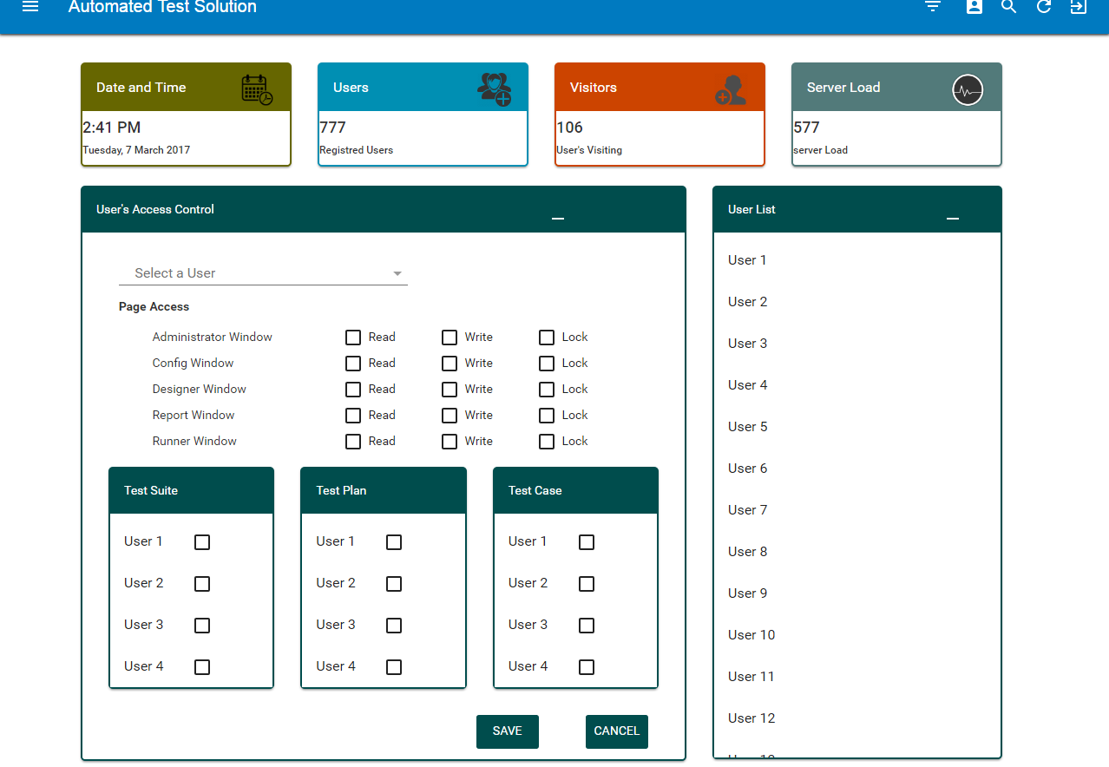
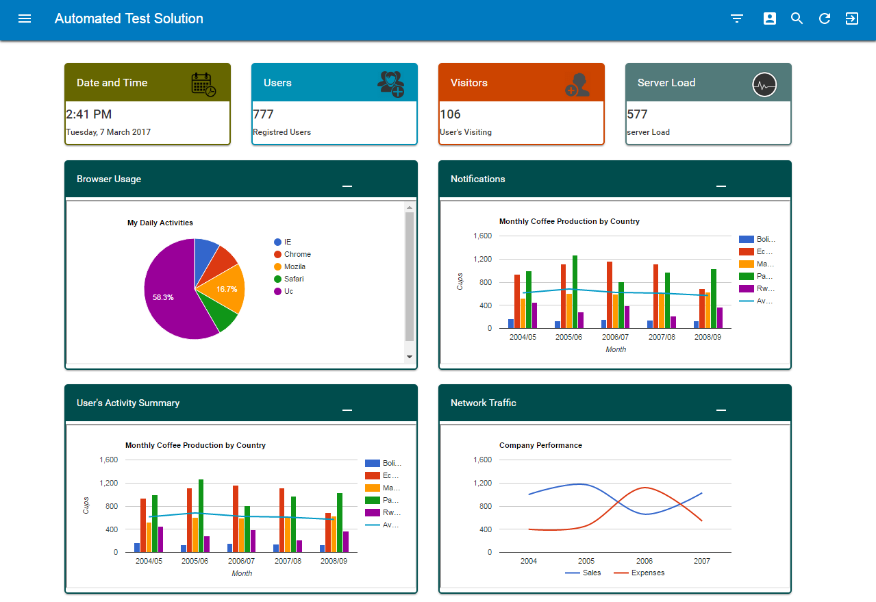
OUTCOMES AND RESULTS
ATS on Cloud – Snapshot:
Administration window

Slide 13
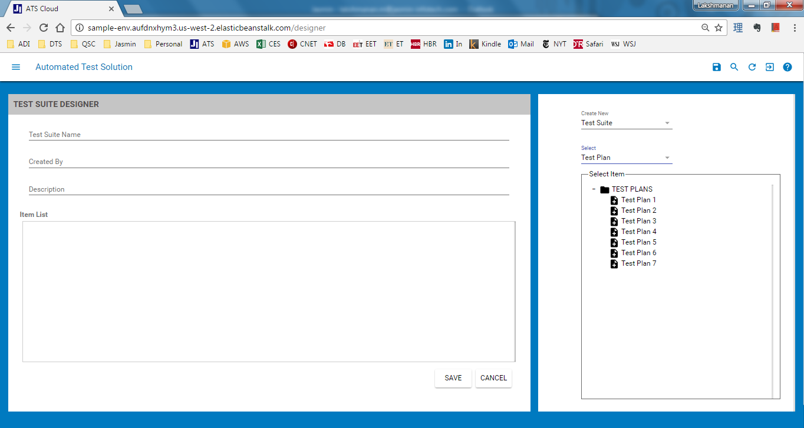
OUTCOMES AND RESULTS
ATS on Cloud – Snapshot:
Designer

Slide 14
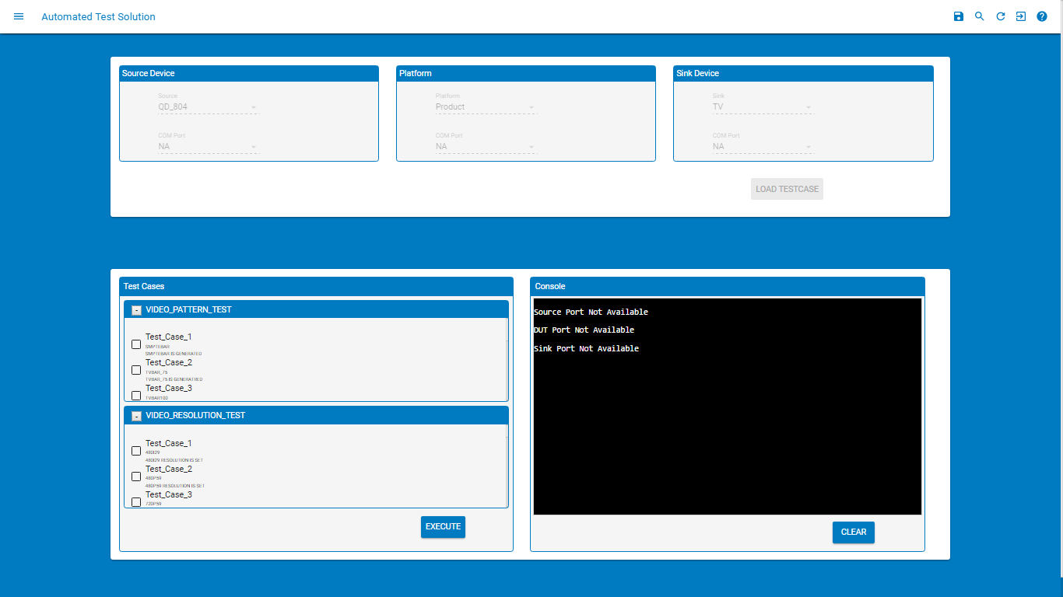
OUTCOMES AND RESULTS
ATS on Cloud – Snapshot:
Runner

Slide 15
OUTCOMES AND RESULTS
ATS on Cloud – Snapshot:
Runner

Slide 16
CONCLUSION AND FUTURE SCOPE
The development process involved the following programming languages/scripts HTML5, CSS and JAVASCRIPT. The final application developed is hosted in Amazon EC2 cloud servers that run on Linux Operating system.
Instruments/systems like Video Signal Generator, Audio Signal Generator, Video Analyzer, Audio Analyzer and Embedded Application (Device Under Test) were controlled from web applications that runs on a browser and interacts to client machine hardware devices through a client application.
The system is scalable which allows the user to add the required test instruments to test setups and respective test case in the test configurations. The existing system is capable of testing Audio as well as Video signals. Communication bus test and other future interface tests will be added to the test system as and when required.

Slide 17
REFERENCES
F.M. Aymerich, G. Fenu, and S. Surcis. An approach to a cloud computing network. Applications of Digital Information and Web Technologies, 2008. ICADIWT 2008. Pages 113 –118, August 2008.
Craig, Rick D.; Jackie, Stefan P.: Systematic Software Testing Boston: Artech House, 2012. (Artech House Computing Library). - ISBN 1-58053-508-9
D.M. Cohen, S.R. Dalal, M.L. Fredman and G.C. Patten, “The AETG System: An Approach to Testing based on Combinatorial Design”, IEEE Trans. Software Engineering, July 1997, pp. 437-444.
N.B. Ebrahimi, “On the Statistical Analysis of the number of Errors Remaining in a Software Design Document after Inspection”, IEEE Trans. Software Engineering, Aug. 2011, pp. 529-532.
Tom McGibbon, “An Analysis of Two Formal methods VDM and Z, http//www.dacs.dtic.mil, Aug. 13, 1997.
Y.K. Malaiya, N. Li, J. Bieman, R. Karcich and B. Skibbe, “The Relationship between Test Coverage and Reliability”, Proc. Int. Symp. Software Reliability Engineering, Nov. 1994, pp. 1867-195.

Slide 18
REFERENCES Cont..
J. Rosenberg, “Some Misconceptions about Lines of Code”, Proc. Int. Software Metrics Symp, Nov. 2015, pp. 137-142.
Ritu Dangwal. Public Computing, Computer Literacy and Educational Out- come: Children and Computers in Rural India, pages 59–66. IOS Press, Ams- terdam, The Netherlands, 2005.
Myers, Glenford J.: The Art of Software Testing New York: John Wiley & Sons, 1989. (Business Data Processing). - ISBN 0-471-04328-1
Myers, Glenford J.: The Art of Software Testing New York: John Wiley & Sons, 2009. (Business Data Processing). - ISBN 0-471-04328-1
H. Yin, Z. Lebne-Dengal and Y.K. Malaiya, “Automatic Test Generation using Checkpoint encoding and Antirandom Testing”, Proc. Int. Symp. Software Reliability Engineering, 1999, pp. 84-95.

Slide 19
THANK YOU

