Slide 1
  ARTIK CLOUD BASED SMART CAR PARKING
  SYSTEM

Slide 2
CONTENTS
Introduction about IoT
System Analysis
Components Used for Project
ATMEGA 328P Arduino Uno Platform
Raspberry pi 3
Ultra Sonic Module HC-SR04
IoT Cloud Integration
Communication Models and Power Supply

Slide 3
ABSTRACT
Concept of Smart cities have gained great popularity. Thanks to the evolution of Internet of things the idea of smart city now seems to be achievable.
In this paper, we proposed Smart Parking system consists of an on-site deployment of an IoT module which is combination of Raspberry pi 3 and Arduino Uno and HC-SRO4 Sonars that is used to monitor and signalize the state of availability of each single parking space.

Slide 4
EXISTING SYSTEM
The Baltimore/Washington Airport Car Park
It is an automated parking guidance system intended to make finding a parking lot quick and hassle free at the Baltimore/Washington Airport.
Plaza Low Yacht Car Park System
Plaza Yacht parking system is one of example of in-door car park in Kuala Lumpur that guide car driver to available car park.
Plaza Singapore Car Park System
Plaza Singapore has introduced ST Electronics’ user friendly parking guidance system.

Slide 5
EXISTING SYSTEM Cont..
Work in this field is being preferred by most of the automobile companies like TOYOTA, BMW,BOSCH,ERICSSON using different microcontrollers and microprocessors such as RASPBERRY PI, ARDUINO,INTEL GALEIO controllers uses sensors like IR,ULTRA SONIC,RFID, through Wireless Sensor technologies, GPS and UHF.
Use of low power consumption sensors and controllers is an important factor while designing a proposed system and choosing easy integrated IoT clouds are great challenge.

Slide 6
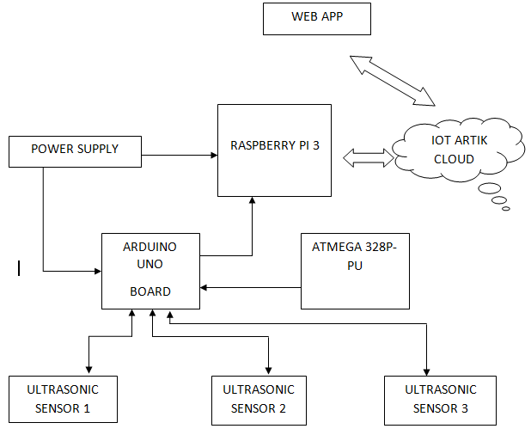
PROPOSED SYSTEM WITH BLOCK DIAGRAM

Slide 7
WORKING PRINCIPLE OF
PROPOSED SYSTEM
ATMEGA 328P (ARDUINO UNO )
RASPEBRRY PI 3
HC-SRO4 ULTRA SONIC SENSORS
COMMUNICATION PLATFORMS
POWER SUPPLY

Slide 8
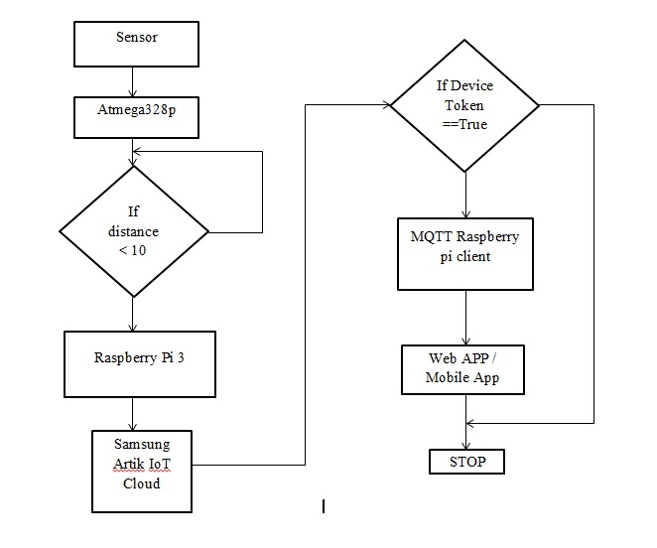
WORKING PRINCIPLE WITH FLOW CHART

Slide 9
MATHEMATICAL MODELING
By using Pulse In function it helps to determine pulse width in time
Duration of pulse is proportional to distance of obstacle.
Distance = (high level time × velocity of sound (340M/S) / 2,
In centimeter = µs/58
Distance = Duration/58.2

Slide 10
SOFTWARE TOOLS USED AND ITS FEATURES
NODE.JS FOR SERVER SIDE
ARDUINO IDE
SAMSUNG ARTIK IOT CLOUD
WEBSOCKET PROTOCOL
MQTT PROTOCOL
WEB APP

Slide 11
SOFTWARE TOOLS USED AND ITS FEATURES Cont..
Node.js is used as a platform to built on Chrome's JavaScript runtime for easily building fast and scalable network applications.
Here we used to communicate with cloud and creating a Web App using HTML and JavaScript.
Arduino IDE is used to code the microcontroller and burn the code into it.
Samsung ARTIK IoT cloud is the where sensor data are analyzed and actions are given to client Devices
MQTT is a machine-to-machine (M2M)"Internet of Things" connectivity protocol It was designed as an extremely lightweight publish/subscribe messaging transport.

Slide 12
OUTCOMES AND RESULTS
This paper proposed a parking system integrated with Samsung IoT ARTIK Cloud which helps to improve the performance by reducing number of users who fail to find a parking space and minimizes the costs of moving to the parking space.
The system also helps to find out the location of car parking by using Google Map API’ hence it helps to reducing the time to find out the car parking slots in particular areas in Metro cities, Airports, Railway stations, shopping malls, hospitals etc..

Slide 13
OUTCOMES AND RESULTS cont..
A Web App is developed to visualize the real time car parking status.
Car Parking Status is updated in every 10 seconds
Inside Samsung Artik cloud data logs from Ultra sonic sensors via Raspberry Pi is visualized through charts and other formats.

Slide 14
CONCLUSION AND FUTURE SCOPE
We can implement this system in large scale parking system by connecting more devices of different parking stations in a single cloud.
Power usage of components is very low this could help to implement even rural areas also.
This system helps to drivers to easily find out car parking locations and parking slots availability also.
By use of simple Cloud Integration this helps to replace large physical database and servers,

Slide 15
CONCLUSION AND FUTURE SCOPE cont…
Slot booking can be achieved using digital payment from web app or Mobile App.
Can be integrated with parking assistance system of Driverless Cars.
With help of Machine Learning and big data we can achieve more Precise availability and
people from metro cities can generate income by providing their land or space in to parking areas into a cloud based parking space

Slide 16
REFERENCES
[1]Abirup Khanna and Rishi Anand(2016)―”IoT based Car Parking”. Published in Internet of Things and Applications(IOTA) .
[2] K E Shouby and P Lynggard(2015) –Smart Home and Smart City Solutions enabled by 5G,IoT,AAI and CoT Services Published in IEEE IoT Conference.
[3] Choeychuen K(2015) -”Automatic parking lot mapping for available parking space detection”. In Proceedings of the 5th International Conference on Knowledge and Smart Technology (KST), Chonburi, Thailand, pp. 117– 121.
[4] T. Taleb and A. Kunz(2014) ―”Machine Type Communications in 3GPP Networks: Potential, Challenges, and Solutions” to appear, IEEE Magazine May 2014

Slide 17
REFERENCES Cont..
[5] Bilodeau V.P(2013)-” Intelligent Parking Technology Adoption. Ph.D. Thesis, University of Southern Queensland”.
[6] Li, T.S.; Ying-Chieh, Y.; Jyun-Da, W.; Ming-Ying, H.; Chih-Yang, C.(2013) Multifunctional intelligent autonomous parking controllers for carlike mobile robots. IEEE Trans. Ind. Electron. 1687–1700.
[7] Faheem1, S.A. Mahmud, G.M. Khan, M. Rahman and H. Zafar(2013) – “A Survey of Intelligent Car Parking System”.
[8] ] Kaivan Karimi and Gary Atkinson(2013) –”What the Internet of Things (IoT) Needs to Become a Reality”, White Paper, FreeScale and ARM.

Slide 18
THANK YOU

