Slide 1
AN INTELLIGENT IRRIGATION SYSTEM USING GSM MODULE

Slide 2
CONTENTS
ABSTRACT
EXISTING SCHEME
PROPOSED SYSTEM WITH BLOCK DIAGRAM
WORKING PRINCIPLE OF PROPOSED SYSTEM
WORKING PRINCIPLE WITH FLOW CHART
SOFTWARE TOOLS USED AND ITS FEATURES
OUTCOMES AND RESULTS
CONCLUSION AND FUTURE SCOPE
REFERENCES

Slide 3
ABSTRACT
An automatic irrigation system is developed to optimize water use for agricultural crops.
The system consists soil moisture sensor and temperature senor placed in the soil. The system consist water Level sensor which will indicate the presence of water level in the water source.
By comparing the signal from the sensors with threshold value the data from GSM is transmitted /received from/to mobile using software application or normal texting mode which optimizes the use of water quantity information’s are visually displayed by using LCD Display.

Slide 4
EXISTING SCHEME
M. C. Rodríguez-Sánchez, S. Borromeo, and J. A. Hernández-Tamames,(2011) “Wireless sensor networks for conservation and monitoring cultural assets”, IEEE Sensors J., vol. 11, no. 6, pp. 1382–1389.
Implemented via Internet.
Man power Required to monitor the agriculture field.
Based on the two conditions the cost of design is high.
Motor can be controlled [ON/OFF] via manual operation.
Motor can be controlled [ON/OFF] via WIFI.

Slide 5
PROPOSED SYSTEM WITH BLOCK DIAGRAM
SWITCH
POWERSUPPLY
MICRO CONTROLLER
PIC 16F877A
LCD DISPLAY
(16*2LINES)
TEMPERATURE SENSOR
GSM
SOIL SENSOR
RELAY
FLOAT SENSOR
MOTOR
WATER
SOURCE
AGRI FIELD

Slide 6
WORKING PRINCIPLE OF
PROPOSED SYSTEM
The soil moisture sensor and temperature sensor and Float sensors are monitoring the agriculture field. Then this data sent to the microcontroller unit. It displays through the LCD.
The value of the sensor range can be observed by the user in two ways. One is automatic mode and manual which is done through GSM. In manual mode, the user can control the motor when it is need to turn ON.
Thus our project is designed for low cost automatizing of irrigation system in a smart way.

Slide 7
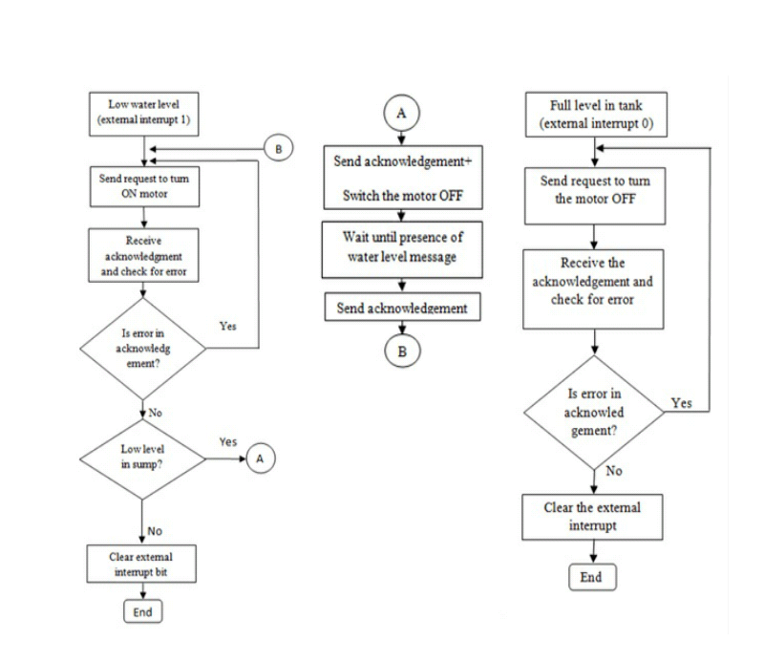
WORKING PRINCIPLE WITH FLOW CHART

Slide 8
HARDWARE DETAILS
PIC Microcontroller-16F877A
LCD display
Soil Moisture Sensor
Temperature Sensor
Float Sensor
GSM Modem
Relay
Driver Circuit
Regulated Power Supply

Slide 9
SOFTWARE TOOLS USED AND ITS FEATURES
The following tools used to develop the software for the proposed project are:
MPLAB IDE
MPLAB SIMULATOR
COMPILER C

Slide 10
SOFTWARE TOOLS USED AND ITS FEATURES Cont..
The MPLAB IDE provides the ability to Create and edit source code using the built-in editor.
Assemble, compile and link source code.Debug the executable logic by watching program flow with the built-in simulator or in real time with in-circuit emulators or in-circuit debuggers.
Make timing measurements with the simulator or emulator.View variables in Watch windows.Program firmware into devices with device programmers.

Slide 11
OUTCOMES AND RESULTS
Soil moisture sensor sense moisture presence it keeps the pump off and when it senses absence of moisture it switches on the pump and supply water to field.Water level sensor gives the presence of water in tank whether it is high or low.
The whole process is automatic irrigation system using wireless sensor networks such as GSM module. This is done using GSM which can be used from any place framer is.
User sends a message and inform to switch on/off the pump which will then intimate by sending a SMS that pump is switched on/off.

Slide 12
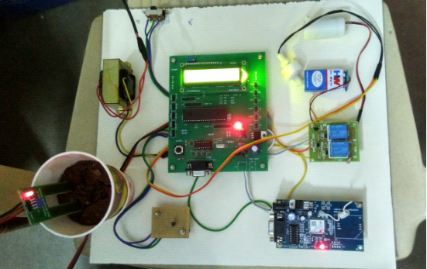
PHOTOGRAPHY OF THE RESULT

Slide 13
CONCLUSION AND FUTURE SCOPE
The system is designed to controll motor automatically .
If any problem will arise in motor, the system has not able to identify itself and message form soil moisture sensor is repeated to the user.
Whenever the power sypply is in demand an alternate solution for suply is needed .We can use solar panels also for that.

Slide 14
REFERENCES
[1] Y. Kim, R. G. Evans, and W. M. Iversen,(2008) “Remote sensing and control of an irrigation system using a distributed wireless sensor network”, IEEE Trans. Instrum. Meas., vol. 57, no. 7, pp. 1379–1387.
[2] O. Mirabella and M. Brischetto,(2011) “A hybrid wired/wireless networking infrastructure for greenhouse management”, IEEETrans. Instrum. Meas., vol. 60, no. 2, pp. 398–407.
[3] I. F. Akyildiz, W. Su, Y. Sankarasubramaniam, and E. Cayirci,(2002) “A survey on sensor networks”, IEEE Commun. Mag., vol. 40, no. 8, pp. 104–112.
[4] López, V. Custodio, and J. I. Moreno,(2010) “LOBIN: E-textile and wireless-sensor-network-based platform for healthcare monitoring in future hospital environments”, IEEE Trans. Inf. Technol. Biomed., vol. 14, no. 6, pp. 1446–1458.

Slide 15
REFERENCES Cont..
[5] J. M. Corchado, J. Bajo, D. I. Tapia, and A. Abraham,(2010) “Using heterogeneous wireless sensor networks in a telemonitoring system for healthcare”, IEEE Trans. Inf. Technol. Biomed., vol. 14, no. 2, pp. 234–240.
[6] G. X. Lee, K. S. Low, and T. Taher,(2010) “Unrestrained measurement of arm motion based on a wearable wireless sensor network”, IEEE Trans. Instrum. Meas., vol. 59, no. 5, pp. 1309–1317.
[7] D.-M. Han and J.-H. Lim,(2010) “Smart home energy management system using IEEE 802.15.4 and ZigBee”, IEEE Trans. Consum. Electron., vol. 56, no. 3, pp. 1403–1410.
[8] C. Gomez and J. Paradells,(2010) “Wireless home automation networks: A survey of architectures and technologies”, IEEE Commun. Mag., vol. 48, no. 6, pp. 92–101.

