Slide 1
CONTENTS
ABSTRACT
EXISTING SCHEME
PROPOSED SYSTEM WITH BLOCK DIAGRAM
WORKING PRINCIPLE OF PROPOSED SYSTEM
OUTCOMES AND RESULTS
CONCLUSION AND FUTURE SCOPE
REFERENCES

Slide 2
ABSTRACT
Design a prepaid energy meter to monitor the consumption of electricity.
The concept “Pay first and then use it”.
Prepaid energy meter also reduces the error made by humans while taking readings to a large extent.
This project helps us to monitor the electricity system.

Slide 3
EXISTING SCHEME
  Recharge our user credit account by using sending SMS to service provider.
  Information about the power consumed and remaining balance available is given to the user through GSM.
  The system will disconnect the power supply when the full unit of energy is consumed.
  The system is not securable energy theft is possible.
  Devidas, A.R., Ramesh, M.V. “Wireless Smart Grid Design for Monitoring and Optimizing Electric Transmission in India,” 2010 Fourth International Conference on Sensor Technologies and Applications (SENSORCOMM),” pp.637-640, 2010

Slide 4
Cont..
PROBLEMS IDENTIFIED IN EXISTING SYSTEM
The existing system is not securable.
The balance is low they disconnect the power supply.
The existing system is post paid is that there is no control.
Taking reading for companies or hotels are complicated.

Slide 5
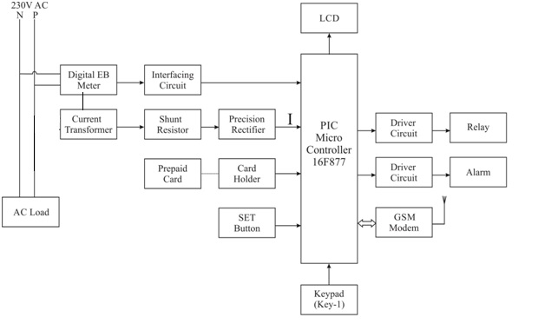
PROPOSED SYSTEM WITH BLOCK DIAGRAM

Slide 6
PIC16F877A
The technology that is used in PIC16F877A is flash technology.
High performance RISC CPU.
35 S ingle word instruction.
Features 256 bytes of EEPROM data memory.
Comparators 2, 8 channel 10-bit Analog to digital converter.
Temperature range -45 to 125.

Slide 7
CURRENT TRANSFORMER
The type instrument transformer that is designed to produce an alternating current in its secondary winding which is proportional to primary.
Used in metering equipment for three-phase 400 ampere electricity supply.
Used for safe measurement of large currents, often in the presence of high voltage.

Slide 8
PREPAID CARD
Any pocket sized card with embedded integrated circuits.
Deposit money on the prepaid card.
The amount of electricity consumption is deduced from the balance.
Prepaid card has PIN and toll free no to access number and then enter your pin.

Slide 9
GSM
First global digital cellular telecommunication system.
GSM cellular technology supports variety of data services.
Allowing bi-directional messaging, store forward and delivery.
The system should support international roaming.
GSM cellular technology uses 200 kHz RF channel.

Slide 10
WORKING PRINCIPLE OF
PROPOSED SYSTEM
Auto transformer transfer the power to the load. The energy is used by the load.
The data about the energy consumed by the load is given to the controller.
The energy is deduced after the usage and available balance is handled by the controller.
The controller send the detail to the consumer through mobile via GSM.
when the energy fully consumed controller trigger the relay and switching device to cut off.

Slide 11
OUTCOMES AND RESULTS
When the energy consumption exceeds above the set value SMS has been send to the consumer via GSM.
When the power has been fully consumed alarm indication provided.
Available balance is viewed in LCD display.
When someone use the energy without our permission theft detection will send to the customer.

Slide 12
CONCLUSION AND FUTURE SCOPE
The project conclusion based on monitor the electricity consumption of consumer house.
Allow consumer to budget electricity expenses.
Helps consumer to contribute towards energy conservation.
It can be used as three in one meter for,
Bills are send through post, instead of this, we can add a printer in every house and if give print command from the server, it will print the bill.
RFID tag can used as a recharge card which is available in various ranges.

Slide 13
REFERENCES
[1] Devidas, A.R., Ramesh, M.V. “Wireless Smart Grid Design for Monitoring and Optimizing Electric Transmission in India,” 2010 Fourth International Conference on Sensor Technologies and Applications (SENSORCOMM),” pp.637-640, 2010
[2] Md. Mejbaul Haque “Microcontroller Based Single Phase Digital Prepaid Energy Meter for Improved Metering” International Journal of Power Electronics and Drive System (IJPEDS) December 2011, pp. 139~147
[3] Ling Zou, Sihong Chu and Biao Guo.,“The Design of Prepayment PolyphaseSmart Electricity Meter System,” International Conference on Intelligent Computing and Integrated Systems (ICISS), pp. 430-432, 22-24, Dec 2010.
[4] Loss, P et al., “A Single Phase Microcontroller Based Energy Meter,” IEEE Instrumentation and Measurement Technology Conference. St. Paul Minnesota, USA, May 18-21, 1998

Slide 14
Cont..
[5] M I Tibbenham,” Implementing a pre-payment System” IEE International congress on metering and Tariffs for Energy Supply, Birmingham, UK, 1999, pp 251-157.
[6] Muhammad Faheem Khan, Ahmed Zoha, and Rana Liaqat Ali “Design and Implementation of Smart Billing and Automated Meter Reading System for Utility Gas” proc, in IEEE Conference on Information and Emerging Technologies,2007,ppl-6
[7] Ross J. Anderson, S.Johann Bezuidenhout,”Cryptographic Credit Control in Prepayment Metering Systems” proc.in IEEE Symposium on Security and privacy,Oakland,USA, 1995 pp15-22.
[8] Manual on Standardization of AC Static Electrical Energy Meters, Publication No: 304,Central Board of Irrigation and Power, New Delhi, 2008

