Slide 1
ONLINE PRICE COMPARISON FOR E-COMMERCE

Slide 2
Abstract
Price comparison sites and comparison –shopping engines gives ecommerce traders a good opportunity to boost their sales, attract new customers and go ahead against their competitors.
Even Shoppers often look for best deals and offers for a particular product which they are looking for. It is difficult to visit each and every website for comparing the deals or a price of a particular product.
Hence this comparison – shopping site is proposed which will help ecommerce merchants as well as shoppers for collecting product information, including price list, from participating retailers and then it displays collective information on a single result page in response to a shopper's or ecommerce merchant’s search query.

Slide 3
In this way, shoppers can compare prices, and service from multiple retailers on a single page and choose the merchant that offers the best overall value.
Users need to open the website and search for a particular product, it will compare the prices from different websites it will also auto correct the product spelling mistake.
This will make easy shopping with best deals as well as ecommerce merchants to know well about their competitors.

Slide 4
Existing System
In addition, the few existing analytical analyses have not addressed competition behaviors and strategic implications in complex business environments, where conventional offline firms and Internet firms coexist.
Also, previous empirical analyses have focused on where products are priced higher (or lower) rather than finding reasons for those differences.
The purpose of this study is to analyze pricing strategies between conventional offline firms and online firms through a theoretical approach and empirical analysis, and draw some important implications.

Slide 5
Disadvantage of Existing System
The start-up costs of the e-commerce portal are very high. The setup of the hardware and the software, the training cost of employees, the constant maintenance and upkeep are all quite expensive.
Although it may seem like a sure thing, the e-commerce industry has a high risk of failure. Many companies riding the dot-com wave of the 2000s have failed miserably. The high risk of failure remains even today.
At times, e-commerce can feel impersonal. So it lacks the warmth of an interpersonal relationship which is important for many brands and products. This lack of a personal touch can be a disadvantage for many types of services and products like interior designing or the jewelry business.
Security is another area of concern. Only recently, we have witnessed many security breaches where the information of the customers was stolen. Credit card theft, identity theft etc. remain big concerns with the customers.

Slide 6
PROPOSED SYSTEM :
We proposed a simplified version of the market and instead of assessing n offline firms, we assumed a single firm in the offline market.
This approach is valid, since the offline firms in the circular city model (and in the absence of any web-based seller) end up selling at the same equilibrium price and being located at equal distances from each other.
This equilibrium price depends on their production cost and the unit transportation cost of the buyers.
One can safely assume that the linear-city model is equivalent to a small segment of the market covered by one of the many firms in the more general circular-city model.

Slide 7
ADVANTAGE
E-commerce provides the sellers with a global reach.
They remove the barrier of place (geography).
Now sellers and buyers can meet in the virtual world, without the hindrance of location.
Electronic commerce will substantially lower the transaction cost.
It eliminates many fixed costs of maintaining brick and mortar shops. This allows the companies to enjoy a much higher margin of profit.
It provides quick delivery of goods with very little effort on part of the customer.
Customer complaints are also addressed quickly. It also saves time, energy and effort for both the consumers and the company.

Slide 8
TITTLE | AUTHOR | DESCRIPTION
Overview of WEB Mining Technology and Its Application in E-commerce | Li Mei, Feng Cheng, | Data mining is to extract information and knowledge which is not known by people and potentially useful from a large number of incomplete and vague random data of practical application.
Web Scraping Framework based on Combining Tag and Value Similarity | Shridevi Swami , Pujashree Vidap , | One can analyze and summarize the collected web data and can use it to find recent trends in market, details of price, product specification details etc.

Slide 9
TITTLE | AUTHOR | DESCRIPTION
Web Crawlers: Taxonomy, Issues & Challenges | Dr. Rajendra Nath ,Khyati Chopra, | This paper makes an attempt to classify all the existing crawlers on certain parameters and also identifies the various challenges to web crawlers
A Semantic Scrapping Model for Web Resources | Jos ́e Ignacio Fern ́andez-Villamor, Jacobo Blasco-Garc ́ıa, Carlos ́A. Iglesias, Mercedes Garijo | Services such as opinionminers, recommenders, mashups, data mining appli-cations or any agent-based service beneﬁt from an in-creased level of knowledge.

Slide 10
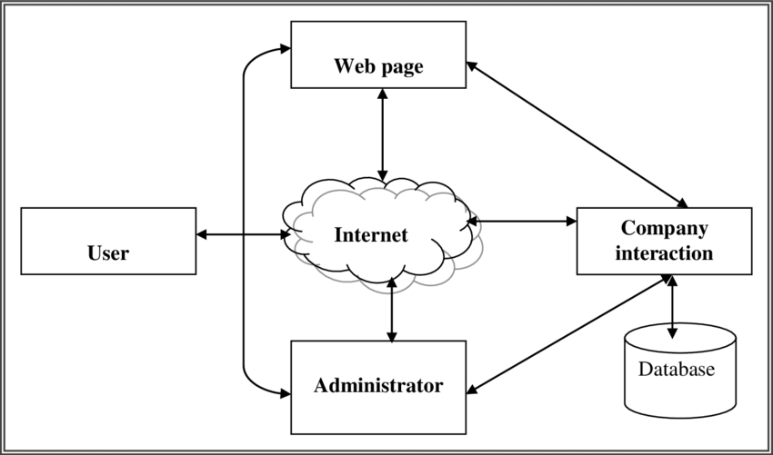
Architecture Diagram

Slide 11
SOFTWARE REQUIREMENTS:
Operating System : Windows 10
Platform : DOT NET TECHNOLOGY
Front End : ASP.Net 4.0
Back End : SQL SERVER 2014

Slide 12
HARDWARE REQUIREMENTS:
Keyboard
Mouse
Hard disk 500GB
Ram 4 Gb

Slide 13
REFERENCE
[1] Li Mei, Feng Cheng, “Overview of WEB Mining Technology and Its Application in E-commerce”, Proceedings of the 2010 IEEE 2nd International Conference on Computer Engineering and Technology, Vol. 7, 2010.
[2] Shridevi Swami , Pujashree Vidap ,” Web Scraping Framework based on Combining Tag and Value Similarity” Proceedings of the IJCSI International Journal of Computer Science Issues, Vol. 10, Issue 6, No 2, November 2013.
[3] Dr. Rajendra Nath ,Khyati Chopra,” Web Crawlers: Taxonomy, Issues & Challenges” Proceedings of the International Journal of Advanced Research in Computer Science and Software Engineering , Volume 3, Issue 4, April 2013, pp. 944-948.
[4] Jos ́e Ignacio Fern ́andez-Villamor, Jacobo Blasco-Garc ́ıa, Carlos ́A. Iglesias, Mercedes Garijo “A Semantic Scrapping Model for Web Resources” Spain.
[5] Richard K. Lomotey, Ralph Deters,” RSenter: Tool for Topics and Terms Extraction from Unstructured Data Debris”, Proceeding of the IEEE International Congress on Big Data, 2013.

Slide 14
[6] I.Kali Pradeep, I. Bhagyasri , P. Praneetha ,” E-Commerce With Backbone Of Data Mining”, Proceeding of the International Journal of Engineering Research & Technology (IJERT), Vol. 2 Issue 7, July – 2013.
[7] Arvind Kumar Sharma1, P.C. Gupta,” Study & Analysis of Web Content Mining Tools to Improve Techniques of Web Data Mining” Proceeding of the International Journal of Advanced Research in Computer Engineering & Technology (IJARCET), Volume 1, Issue 8, October 2012.
[8] Rahul Dhawani, Mrudav Shukla, Priyanka Puvar, Bhagirath Prajapati, ” A Novel Approach to Web Scraping Technology” Proceeding of the International Journal of Advanced Research in Computer Science and Software Engineering ,Volume 5, Issue 5, MAY 2015.
[9] Rupali Arora, Rinkle Rani Aggarwal ,” Modeling and Querying Data in MongoDB” ,Proceeding of the International Journal of Scientific & Engineering Research, Volume 4, Issue 7, July-2013.
[10] B Rama Mohan, A. Govardhan.” Online Aggregation Using MapReduce in MongoDB”, Proceeding of the International Journal of Advanced Research in Computer Science and Software Engineering, Volume 3, Issue 9, September, 2013

