Slide 1
A Study on E-commerce Recommender System Based on Big Data

Slide 2
Abstract
Recommender system algorithms are widely used in e-commerce to provide personalized and more accurate recommendations to online users and enhance the sales and user stickiness of e-commerce.
This paper discusses several recommendation algorithms and the challenge of tradition recommender system in big data situation, and then proposes a framework of distributed and scalable recommender system based on Hadoop.
The recommender system based on Hadoop, combining the advantage of computational ability and scalability of Map Reduce and hybrid recommendation algorithms, brings a solution to information overload problem in big e-commerce

Slide 3
Existing System
E-commerce recommender systems have been converted to a very important decision-making helper for customers, and provide online personalised recommendations using information technology and customers’ information.
The recommender system is a technology that helps to create personalisation features.
A satisfactory and new area in the field of the RSs is to analyse the characteristics and potential interests of customers (Salehi, 2013; Sharma and Ray, 2016).
In EC, RS evaluate the purchasing behaviours of the customers and learn from these behaviours to try to recommend suitable goods.

Slide 4
Disadvantage of Existing System
The main disadvantage of Content-based Filtering is that its effectiveness greatly depends on the extensive and in-depth description of products’ attributes..
Another problem is that Content-based Filtering only recommend items similar to the products described in users’ profile with the problem of content over-specialization.
With the combined advantages of Hadoop distributed computation ability and mixed recommendation, the scalable, flexible and diversified recommender system can obviously bring a solution to information overload problem in big e-commerce and provide sustainable competitive advantage for e-commerce with personalized marketing.

Slide 5
PROPOSED SYSTEM :
The proposed system of this research has resulted in the removal of traditional CF constraints and presents more accurate and appropriate recommendations for the preferences of customers.
This article provides an overview of the current state of the art in recommendation systems, their types, challenges, limitations, and business adoptions.
To assess the quality of a recommendation system, qualitative evaluation metrics are discussed in the paper.
Various application shave adopted recommendation systems, including e-commerce, healthcare, transportation, agriculture, and media.This paper provides the current landscape of recommender systems research and identifies directions in the field in various applications.

Slide 6
ADVANTAGE
Collaborative Filtering is widely used in e-commerce and is one of the most successful recommender systems in e-commerce.
Collaborative Filtering focus on finding the nearest neighbors of target user who either purchased the same precuts or rated similarly on the same products with target user .
The commonly used algorithm is Content-based Filtering is Association Rule Mining, which is a very useful method to discover the relationship hidden in large datasets.
This layer includes several data mining algorithms and machine learning algorithms, such as Association Rules mining, Clustering and Collaborative Filtering.
The algorithms layer is independent from recommendation layer for the purpose of integrating more algorithms.

Slide 7
TITTLE | AUTHOR | DESCRIPTION
Design and implementation of recommendation system for e-commerce on Hadoop | Li Wenhai, Xu Shuren. | It is proved over the years that a simple algorithm with a lot of data can always provide better results than a complex algorithm with an inadequate amount of data. To provide better product recommendations, retail businesses have to analyze huge amount of data.
Two Decades of Recommender Systems at Amazon.com | Brent Smith,Greg Linden. | Amazon is well-known for personalization and recommendations, which help customers discover items they might otherwise not have found. In this update to our original article, we discuss some of the changes as Amazon has grown.

Slide 8
TITTLE | AUTHOR | DESCRIPTION
Recommendation systems: Principles, methods and evaluation | Isinkaye FO et al. | This paper explores the different characteristics and potentials of different prediction techniques in recommendation systems in order to serve as a compass for research and practice in the field of recommendation systems.
Amazon.com Recommendations Item-to-Item Collaborative Filtering | Greg Linden , Brent Smith , and Jeremy York. | Many applications use only the items that customers purchase and explicitly rate to represent their interests, but they can also use other attributes, including items viewed, demographic data, subject interests, and favorite artists

Slide 9
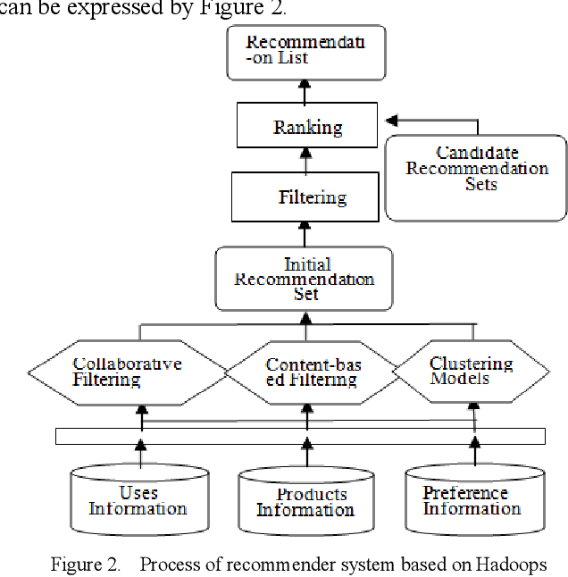
Architecture Diagram

Slide 10
SOFTWARE REQUIREMENTS:
Operating System : Windows 10
Platform : DOT NET TECHNOLOGY
Front End : ASP.Net 4.0
Back End : SQL SERVER 2014

Slide 11
HARDWARE REQUIREMENTS:
Keyboard
Mouse
Hard disk 500GB
Ram 4 Gb

Slide 12
REFERENCE
[1]Li Wenhai, Xu Shuren. "Design and implementation of recommendation system for e-commerce on Hadoop". Computer Engineering and Design .2014.1(35),pp:130-136;143.
[2]Brent Smith,Greg Linden. ”Two Decades of Recommender Systems at Amazon.com”. IEEE INTERNET COMPUTING.2017.vol 21,pp:12-18.
[3]Isinkaye FO et al. "Recommendation systems: Principles, methods and evaluation". Egyptian Informatics (2015).
[4]Greg Linden,Brent Smith,and Jeremy York."Amazon.com Recommendations Item-to-Item Collaborative Filtering". IEEE INTERNET COMPUTING.2003.Jan,pp:76-80.
[5]Badrul Sarwar, George Karypis, Joseph Konstan, and John Riedl. "Analysis of Recommendation Algorithms for E-Commerce". Proceedings of the 2nd ACM conference on Electronic commerce - EC '00 (2000).

Slide 13
[6]ZhiDan Zhao,Ming-Sheng Shang."User-based Collaborative-Filtering Recommendation Algorithms on Hadoop". 2010 Third International Conference on Knowledge Discovery and Data Mining. IEEE Computer Society,pp:478-481.
[7]Dong Liu. "A Study on Collaborative Filtering Recommendation Algorithms". 2018 IEEE 4th International Conference on Computer and Communications.,pp:2256-2261..
[8]Xuesong Zhao. "A Study on the Application of Big Data Mining in E-commerce". 2018 IEEE 4th International Conference on Computer and Communications,pp:1867-1871.
[9]CEN Kai-lun,YU Hong-yan,YANG Teng-xiao."Design and Implement of E-Commerce Real-Time Recommender System with Spark Based on Big Data". Modern Computer. 2016.8,pp:61-69.

