Slide 1
Toward Mining Capricious Data Streams A Generative Approach

Slide 2
Abstract
Learning with streaming data has received extensiveattention during the past few years.
Existing approaches assumethat the feature space is fixed or changes by following explicitregularities, limiting their applicability in real-time applications.
For example, in a smart healthcare platform, the feature space ofthe patient data varies when different medical service providersuse nonidentical feature sets to describe the patients’ symptoms.
To fill the gap, we in this article propose a novel learning para-digm, namely, Generative Learning With Streaming Capricious(GLSC) data, which does not make any assumption on the featurespace dynamics.

Slide 3
In other words, GLSC handles the data streams with a varying feature space, where each arriving data instance can arbitrarily carry new features and/or stop carrying partial old features.
Specifically, GLSC trains a learner on a universal feature space that establishes relationships between old and new features, so that the patterns learned in the old feature space can be used in the new feature space.
The universal feature space is constructed by leveraging the related nesses among features.
We propose a generative graphical model to model the construction process, and show that learning from the universal feature space can effectively improve the performance with theoretical guarantees.
The experimental results demonstrate that GLSC achieves conspicuous performance on both synthetic and real data sets.

Slide 4
Existing System
The dissemination of data stream phenomenon has necessitated the development of stream mining algorithms. The area has attracted the attention of data mining community.
Online mining when data streams evolve over time, that is when concepts drift or change completely, is becoming one of the core issues of advanced analysis of data streams.
When tackling non-stationary concepts, ensem-bles of classifiers have several advantages over single classifier methods: they are easy to scale and parallelize, they can adapt to change quickly bypruning under-performing parts of the ensemble, and they therefore usu-ally also generate more accurate concept descriptions.

Slide 5
Disadvantage of Existing System
Those approaches tackling the stream-ing data problem under different settings, however, rely on the assumptions that the feature space is fixed or changes by following explicit regularities
we divide into two convex optimization sub problems, which are with respect to wt and G, respectively, and the two sub problems are simultaneously solved at each iteration.

Slide 6
PROPOSED SYSTEM :
They proposed a general framework to generate data simulating changing environments. Their framework accommodates the STAGGER and Moving Hyper plane generation strategies. They consider a set of k data sources with known distributions.
The proposed techniques have their roots in statistics and theoretical computer science. Data-based and task-based techniques are the two categories of data stream mining algorithms. Based on these two categories, a number of clustering, classification, frequency counting and time series analysis have been developed.
Systems have been implemented to use these techniques in real applications.

Slide 7
ADVANTAGE
This is the first work to learn with capricious data streams where data come with an arbitrarily varying feature space. We want to emphasize that our learning task does not make any assumption on the feature space dynamics, which is different from existing studies.
We introduce a generative graphical model, which takes the observable feature space as the input and outputs a universal feature space. We analyze the performance bound of GLSC and prove that the obtained universal feature space can effectively improve the learning per-formance.
Extensive experiments on both synthetic and real-world data sets demonstrate the superiority of GLSC.

Slide 8
TITTLE | AUTHOR | DESCRIPTION
Online convex programming and generalized infinitesi-mal gradient ascent | M. Zinkevich, | This can be used to model factory production, farm production, and many other industrial optimization problems where one is unaware of the value of the items produced until they have already been constructed.
Online passive-aggressive algorithms | K. Crammer, O. Dekel, J. Keshet, S. Shalev-Shwartz, and Y. Singer,“ | In particular we derive and analyze algorithms for binary and multiclass categorization, regression, uniclass prediction and sequence prediction. The update steps of our different algorithms are all based on analytical solutions to simple constrained optimization problems.

Slide 9
TITTLE | AUTHOR | DESCRIPTION
Large-scale online kernellearning with random feature reparameterization | T. D. Nguyen, T. Le, H. Bui, and D. Phung, | We further introduce in this paper the reparameterized random feature (RRF), a random feature framework for large-scale online kernel learning to address both aforementioned challenges.
Onlinelearning from trapezoidal data streams | Q. Zhang, P. Zhang, G. Long, W. Ding, C. Zhang, and X. Wu, | In this paper, we study a new problem of continuous learning from doubly-streaming data where both data volume and feature space increase over time.

Slide 10
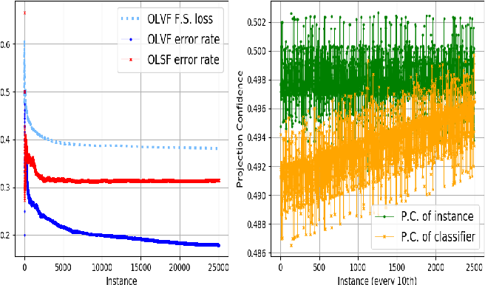
Architecture Diagram

Slide 11
SOFTWARE REQUIREMENTS:
Operating System : Windows 10
Platform : DOT NET TECHNOLOGY
Front End : ASP.Net 4.0
Back End : SQL SERVER 2014

Slide 12
HARDWARE REQUIREMENTS:
Keyboard
Mouse
Hard disk 500GB
Ram 4 Gb

Slide 13
REFERENCE
[1] M. Zinkevich, “Online convex programming and generalized infinitesi-mal gradient ascent,” inProc. ICML, 2003, pp. 928–936.
[2] K. Crammer, O. Dekel, J. Keshet, S. Shalev-Shwartz, and Y. Singer,“Online passive-aggressive algorithms,”J.Mach.Learn.Res.,vol.7,pp. 551–585, Dec. 2006.
[3] T. D. Nguyen, T. Le, H. Bui, and D. Phung, “Large-scale online kernellearning with random feature reparameterization,” inProc. 26th Int. JointConf. Artif. Intell., Aug. 2017, pp. 2543–2549.[
4] Q. Zhang, P. Zhang, G. Long, W. Ding, C. Zhang, and X. Wu, “Onlinelearning from trapezoidal data streams,”IEEE Trans. Knowl. Data Eng.,vol. 28, no. 10, pp. 2709–2723, Oct. 2016.
[5] B.-J. Hou, L. Zhang, and Z.-H. Zhou, “Learning with feature evolvablestreams,” inProc. NeurIPS, 2017, pp. 1417–1427.

Slide 14
[6] M. M. Baig and H. Gholamhosseini, “Smart health monitoring systems:An overview of design and modeling,”J. Med. Syst., vol. 37, no. 2,p. 9898, Apr. 2013.
[7] R. Haux, “Health information systems–past, present, future,”Int. J. Med.Inform., vol. 75, nos. 3–4, pp. 268–281, 2006.
[8] S. B. Baker, W. Xiang, and I. Atkinson, “Internet of Things for smarthealthcare: Technologies, challenges, and opportunities,”IEEE Access,vol. 5, pp. 26521–26544, 2017.\
[9] R.O.Duda,P.E.Hart,andD.G.Stork,Pattern Classification. Hoboken,NJ, USA: Wiley, 2012.
[10] W. Zhang, W. Feng, and J. Wang, “Integrating semantic relatedness andwords’ intrinsic features for keyword extraction,” inProc. IJCAI, 2013,pp. 2225–2231.

