Slide 1
Survey of Network Intrusion Detection Methods from the Perspective of the Knowledge Discovery in Databases Process

Slide 2
Abstract
The identification of network attacks which target information and communication systems has been a focus of the research community for years. Network intrusion detection is a complex problem which presents a diverse number of challenges.
Many attacks currently remain undetected, while newer ones emerge due to the proliferation of connected devices and the evolution of communication technology. In this survey,
we review the methods that have been applied to network data with the purpose of developing an intrusion detector, but contrary to previous reviews in the area, we analyze them from the perspective of the Knowledge Discovery in Databases(KDD) process.

Slide 3
As such, we discuss the techniques used for thecollecion, preprocessing and transformation of the data, as wellas the data mining and evaluation methods.
We also present the characteristics and motivations behind the use of each of these techniques and propose more adequate and up-to-date taxonomies and definitions for intrusion detectors based on the terminology used in the area of data mining and KDD.
Special importance is given to the evaluation procedures followed to assess the detectors, discussing their applicability in current, real networks.
Finally, as a result of this literature review, we investigate some open issues which will need to be considered for further research in the area of network security.

Slide 4
Existing System
We can explore the existing links in the dataset pointing to the related entities in other LOD datasets.
In the next step, various techniques for data consolidation, preprocessing and cleaning are applied,e.g.,schemamatching,datafusion,valuenormalization,treatmentof missing values and outliers, etc.
Many approaches have been proposed for extracting the schema of the tables, and mapping it to existing on to logies and LOD. Mulwad et al. have made significant contribution for interpreting tabular data using LOD, coming from independent domains.

Slide 5
Disadvantage of Existing System
Data preprocessing and transformation phases have received a similar lack of analysis: the number of surveys covering these tasks is small, with limited content and they ignore their associated problems and challenges
These techniques select a subset of the whole feature set that is assumed to be the most relevant to solve the problem at hand.
FSS methods reduce the cost of data mining models, help to prevent mode lover-fitting, and enable a better understanding of the data because redundancies are removed

Slide 6
PROPOSED SYSTEM :
Several approaches and APIs have been proposed for extracting named entities from text documents and linking them to LOD.
One of the most used APIs is DB pedia Spotlight ,which allows for automatically annotating text documents with DB pedia URIs
A similar approach is proposed by Perez et al. with the Onto Data Clean framework, which is able to guide the data cleaning process in a distributed environment.
The framework uses a preprocessing ontology to store the information about the required transformations.

Slide 7
ADVANTAGE
In contrast to in-line mode, mirroring allows traffic from many machines to be captured but has a bearing on the performance of the device, which is affected by the increasing number of machines to be monitored and the growing speed of modern networks.
We review the techniques used in all the steps of this process, paying special attention to the motivation behind their use.
We propose a taxonomy of NIDS detection methods based on the data mining terminology to avoid the ambiguity of previous classification proposals. To that end, we use two different criteria: (a) the detection approach and (b) the learning approach.
We review the mechanisms to avoid deterioration in detec-tion ability due to the evolution of network traffic, including attacks.

Slide 8
TITTLE | AUTHOR | DESCRIPTION
Towards a taxonomy of intrusion-detection systems | H. Debar, M. Dacier, and A. Wespi, | In this paper, we introduce a taxonomy of intrusion-detection systems that highlights the various aspects of this area. This taxonomy defines families of intrusion-detection systems according to their properties.
The architecture ofa network level intrusion detection system | R. Heady, G. F. Luger, A. Maccabe, and M. Servilla, | The proposed system will monitor base level information in network packets (source, destination, packet size, and time), learning the normal patterns and announcing anomalies as they occur.

Slide 9
TITTLE | AUTHOR | DESCRIPTION
Outside the closed world: On using machine learning for network intrusion detection | R. Sommer and V. Paxson, | We support this claim by identifying challenges particular to network intrusion detection, and provide a set of guidelines meant to strengthen future research on anomaly detection.
A new approach to dimen-sionality reduction for anomaly detection in data traffic | T. Huang, H. Sethu, and N. Kandasamy, | We present centralized and distributed versions of our algorithm and, using simulation on real traffic traces, demonstrate the qualitative and quantitative advantages of the distance-based subspace approach.

Slide 10
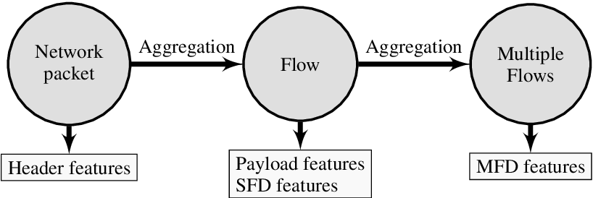
Architecture Diagram

Slide 11
SOFTWARE REQUIREMENTS:
Operating System : Windows 10
Platform : DOT NET TECHNOLOGY
Front End : ASP.Net 4.0
Back End : SQL SERVER 2014

Slide 12
HARDWARE REQUIREMENTS:
Keyboard
Mouse
Hard disk 500GB
Ram 4 Gb

Slide 13
REFERENCE
[1] H. Debar, M. Dacier, and A. Wespi, “Towards a taxonomy of intrusion-detection systems,”Computer Networks, vol. 31, no. 8, pp. 805–822,1999.
[2] C. V. Brown,IS management handbook. CRC Press, 1999.
[3] R. Heady, G. F. Luger, A. Maccabe, and M. Servilla,The architecture ofa network level intrusion detection system. University of New Mexico,1990.
[4] R. Sommer and V. Paxson, “Outside the closed world: On usingmachine learning for network intrusion detection,” in2010 IEEE Symp.on Security and Privacy, pp. 305–316, 2010
[5] T. Huang, H. Sethu, and N. Kandasamy, “A new approach to dimen-sionality reduction for anomaly detection in data traffic,”IEEE Trans.on Network and Service Management, vol. 13, pp. 651–665, Sept 2016.

Slide 14
[6] P. Garcia-Teodoro, J. Diaz-Verdejo, G. Maci ́a-Fern ́andez, andE. V ́azquez, “Anomaly-based network intrusion detection: Techniques,systems and challenges,”Computers & Security, vol. 28, no. 1-2,pp. 18–28, 2009.
[7] A. Sperotto, G. Schaffrath, R. Sadre, C. Morariu, A. Pras, and B. Stiller,“An overview of ip flow-based intrusion detection.,”IEEE Comm.Surveys & Tutorials, vol. 12, no. 3, pp. 343–356, 2010.
[8] J. J. Davis and A. J. Clark, “Data preprocessing for anomaly basednetwork intrusion detection: A review,”Computers & Security, vol. 30,no. 6-7, pp. 353–375, 2011.
[9] M. H. Bhuyan, D. K. Bhattacharyya, and J. K. Kalita, “Networkanomaly detection: methods, systems and tools,”IEEE Comm. Surveys& Tutorials, vol. 16, no. 1, pp. 303–336, 2014.
[10] M. Ahmed, A. N. Mahmood, and J. Hu, “A survey of network anomalydetection techniques,”Journal of Network and Computer Applications,vol. 60, pp. 19–31, 2016.

