Slide 1
SEMANTICS OF DATA MINING SERVICES IN CLOUD COMPUTING

Slide 2
Abstract
The recent incorporation of new Data Mining and Machine Learning services within Cloud Computing providers is empowering users with extremely comprehensive data analysis tools including all the advantages of this type of environment.
Providers of Cloud Computing services for Data Mining publish the descriptions and definitions in many formats and often not compatible with other providers.
From a functional point of view, having the possibility to describe complete Data Mining services is fundamental to maintain the usability and especially the portability of these services independently of the software/hardware support or even the differences between cloud platforms.

Slide 3
The main objective of this paper is to design a Data Mining service definition which allows to compose with a single and simple definition a complete service, in such way a data mining workflow can be ported and deployed in different providers or even in a Market Place of this type of ready-to-consume services.
This article presents a semantic scheme for the definition and description of complete Data Mining services considering both the management of the service by the provider (price, authentication, Service Level Agreement, ...) and the definition of the Data Mining workflow as a service.

Slide 4
It represents a solid contribution for paving the way to the standardization and industrialization of Data Mining services.
To asses the validity of the scheme a list of services from Data Mining providers have been described and an example of a full service for a Random Forest algorithm has been defined as a service.
In addition, a practical scenario has been developed, creating a deployment platform for Data Mining services to give functional support to the scheme, illustrating the practical benefits of the proposal for the end user.

Slide 5
Existing System
Our proposal has been designed to reuse existing vocabularies and ontologies, being able to compose data mining services in the cloud.
Most of the business information exists as unstructured data – commonly appearing in emails, blogs, discussion forums, wikis, official memos, news, user groups, chatting scripts on social networking sites, project reports, business proposals, public surveys, research and white papers.
As an emerging computing model, although cloud computing has many advantages that existing computing models do not have, there are still some problems.

Slide 6
Disadvantage of Existing System
The problem is computationally difficult (NPhard), however there are efficient heuristic algorithms that are commonly employed and converge fast to a local optimum.
The data and processing is distributed to the machines in the cluster to reduce the impact of any particular machine being overloaded that damages its processing.
Our proposal is more concise to address the problem of defining these cloud services as it is based on the study of how different Internet providers and data mining platforms define these services with their specifications.

Slide 7
PROPOSED SYSTEM :
In this paper we propose a schema of definition of data mining service in cloud computing using Linked Data and validate its operation by defining a complete service.
In order to improve the data retrieval and mining ability of agricultural information management system, an agricultural information management data model based on cloud computing and semantic technology was proposed.
This study proposes a data mining technique for a large information management system based on semantic correlation feature extraction.

Slide 8
ADVANTAGE
The main advantage of using dmcc-schema is that it greatly simplifies the design of a cloud service focused on data mining. This is because it unifies two environments: the cloud computing and services aspects, and the execution of data mining algorithms.
One of the advantages of using these services in the cloud is the ability to support large datasets. Another advantage of using the proposed occml specification is the simplicity of creating the complete service.
By using the Relational Graph between all the resources the searching can be made easy and efficient.

Slide 9
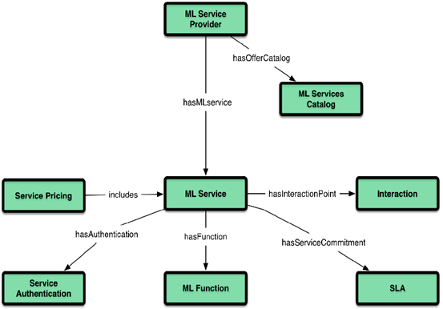
Block Diagram

Slide 10
SOFTWARE REQUIREMENTS:
Operating System : Windows 10
Platform : DOT NET TECHNOLOGY
Front End : ASP.Net 4.0
Back End : SQL SERVER 2014

Slide 11
HARDWARE REQUIREMENTS:
Keyboard
Mouse
Hard disk 500GB
Ram 4 Gb

Slide 12
CONCLUSION
In this article we have presented dmcc-schema, a lightweight vocabulary for the description and definition of DM services in CC.
Our proposal tries to gather, on the one hand, everything related to the definition of the algorithms as a service for DM and on the other hand, all the other aspects that compose the management of a CC service, which is neglected by other proposals.
The other proposals of service definition lack this integration, however dmcc-schema allows to solve this gap in terms of creation of all-in-one DM services for Cloud Computing environments.

Slide 13
REFERENCE
[1] L. Liu, “Services computing: from cloud services, mobile services to internet of services,” IEEE Transactions on Services Computing, vol. 9, no. 5, pp. 661–663, 2016.
[2] B. Marr, “Big data overload: Why most companies can’t deal with the data explosion,” Apr 2016. [Online].
[3] G. Inc., “Gartner says 6.4 billion connected ’things’ will be in use in 2016,” Gartner, Tech. Rep., 2016. [Online].
[4] T. Binz, G. Breiter, F. Leyman, and T. Spatzier, “Portable cloud services using tosca,” IEEE Internet Computing, vol. 16, no. 3, pp. 80–85, 2012.
[5] E. Newcomer and G. Lomow, Understanding SOA with Web services. Addison-Wesley, 2005.

Slide 14
[6] C. Bizer, T. Heath, and T. Berners-Lee, “Linked data-the story so far,” International journal on semantic web and information systems, vol. 5, no. 3, pp. 1–22, 2009.
[7] T. Berners-Lee, J. Hendler, O. Lassila et al., “The semantic web,” Scientific american, vol. 284, no. 5, pp. 28–37, 2001.
[8] G. Klyne and J. J. Carroll, “Resource description framework (rdf): Concepts and abstract syntax,” W3C, 2006.
[9] D. Beckett, “Turtle-terse rdf triple language,” http://www. ilrt. bris. ac. uk/discovery/2004/01/turtle/, 2008.
[10] M. Lanthaler and C. Gutl, “On using json-ld to create evolvable ¨ restful services,” in Proceedings of the Third International Workshop on RESTful Design. ACM, 2012, pp. 25–32.

