Slide 1
Secret sharing based reversible data hiding in encrypted images with multiple data-hiders

Slide 2
Abstract
The existing models of reversible data hiding in encrypted images (RDH-EI) are based on single data-hider, where the original image cannot be reconstructed when the data-hider is damaged.
To address this issue, this paper proposes a novel model with multiple data-hiders for RDH-EI based on secret sharing.
It divides the original image into multiple different encrypted images with the same size of the original image and distributes them to multiple different data-hiders for data hiding.
Each data-hider can independently embed data into the encrypted image to obtain the corresponding marked encrypted image.

Slide 3
The original image can be losslesslyrecovered by collecting sufficient marked encrypted images from undamaged data-hiders when individual data-hiders are subjected topotential damage.
This further protects the security of the original image. We provide four cases of the proposed model, namely, twojoint cases and two separable cases.
From the proposed model, we derive a separable RDH-EI method with high-capacity.Experimental results are presented to illustrate the effectiveness of the proposed method.

Slide 4
Existing System
Data hiding by digital watermarking is usually employed for multimedia copyright protection, authenticity verification, or similar purposes.
Watermarking is here adopted as a technique to provide a blind measure of the quality of service in multimedia communications.
The general watermark embedding procedure consists of embedding a watermark sequence which is usually binary into host data by means of a key.
In the detection phase the key is used to verify the presence of the embedded sequence.

Slide 5
Disadvantage of Existing System
The proposed model contains multiple data-hiders, the original image can be restored by collecting sufficient marked encrypted images from undamaged data-hiders even if some of the data-hiders are subjected to poten-tial damage.
We present four cases of the proposed model,that is, two joint cases and two separable cases. We im-plement a separable case called content-owner-independent and data-hider-independent.
The proposed separable RDH-EI method can achieve higher embedding capacity com-pared with the state-of-the-art methods.

Slide 6
PROPOSED SYSTEM :
By using a multi-MSB embedding strategy, the secret bits can be embedded in the encrypted images without any pixel oversaturation in the plaintext domain.
More importantly, by using multi-MSB embedding strategy, secrets bits can be directly extracted from encrypted domain from the multi-MSB of pixels without any error. The reconstructed image with very high visual quality can be obtained only in the case that the encryption key is obtained.
Compared with the other state-of-the-art methods, the proposed method can achieve a significantly higher maximum embedding rate

Slide 7
ADVANTAGE
The embedding rate of the proposed method is compared with several state-of-the-art methods .
The embedding rate of the proposed method is significantly higher than these state-of-the-art methods.
Meanwhile, the embedding rate of the proposed method is a constant value, which means that it is not affected by the image distribution.
In these state-of-the-art methods, the embedding rates depend on image distribution.
Images with smooth textures can achieve higher embedding rates, while images with complex textures have lower embedding rates, which can be avoided in the proposed method.
This is because they vacate embedding room before encryption bythe correlation of natural images, such as MSB prediction, adaptive, and difference expansion.
Instead, the proposed method vacates embedding room after encryption and embeds data into encrypted images with bit-plane replacement.

Slide 8
TITTLE | AUTHOR | DESCRIPTION
Losslessgeneralized-LSB data embedding | M. U. Celik, G. Sharma, A. M. Tekalp, and E. Saber, “ | We present a novel lossless (reversible) data-embedding technique, which enables the exact recovery of the original host signal upon extraction of the embedded information
Reversible data embedding using a difference expansion | J. Tian, | Reversible data embedding has drawn lots of interest recently. Being reversible, the original digital content can be completely restored. We present a novel reversible data-embedding method for digital images.

Slide 9
TITTLE | AUTHOR | DESCRIPTION
Reversible data hiding, | Z. Ni, Y.-Q. Shi, N. Ansari, and W. Su, | The algorithm has been successfully applied to a wide range of images, including commonly used images, medical images, texture images, aerial images and all of the 1096 images in CorelDraw database.
“Reversible data hidingbased on histogram modification of pixel differences | W.-L. Tai, C.-M. Yeh, and C.-C. Chang, | Performance comparisons with other existing schemes are provided to demonstrate the superiority of the proposed scheme.

Slide 10
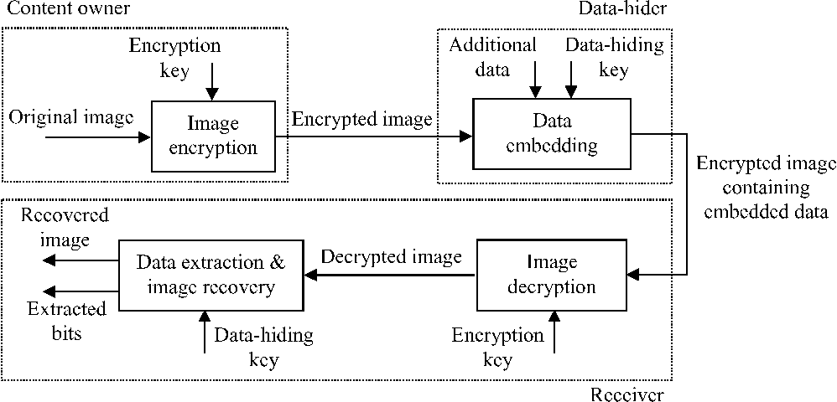
Architecture Diagram

Slide 11
SOFTWARE REQUIREMENTS:
Operating System : Windows 10
Platform : DOT NET TECHNOLOGY
Front End : ASP.Net 4.0
Back End : SQL SERVER 2014

Slide 12
HARDWARE REQUIREMENTS:
Keyboard
Mouse
Hard disk 500GB
Ram 4 Gb

Slide 13
REFERENCE
1] M. U. Celik, G. Sharma, A. M. Tekalp, and E. Saber, “Losslessgeneralized-LSB data embedding,”IEEE Transactions on Image Processing, vol. 14, no. 2, pp. 253–266, Feb. 2005.
[2] J. Tian, “Reversible data embedding using a difference expansion,” IEEE Transactions on Circuits and Systems for Video Technol ogy,vol. 13, no. 8, pp. 890–896, Aug. 2003.
[3] Z. Ni, Y.-Q. Shi, N. Ansari, and W. Su, “Reversible data hiding,”IEEE Transactions on Circuits and Systems for Video Technology,vol. 16, no. 3, pp. 354–362, Mar. 2006.
[4] W.-L. Tai, C.-M. Yeh, and C.-C. Chang, “Reversible data hidingbased on histogram modification of pixel differences,”IEEE Trans-actions on Circuits and Systems for Video Technology, vol. 19, no. 6,pp. 906–910, Jun. 2009.
[5] X. Li, W. Zhang, X. Gui, and B. Yang, “A novel reversible datahiding scheme based on two-dimensional difference-histogrammodification,”IEEE Transactions on Information Forensics and Se-curity, vol. 8, no. 7, pp. 1091–1100, Jul. 2013.

Slide 14
[6] L. Luo, Z. Chen, M. Chen, X. Zeng, and Z. Xiong, “Reversibleimage watermarking using interpolation technique,”IEEE Transac-tions on Information Forensics and Security, vol. 5, no. 1, pp. 187–193,Mar. 2010
[7] H.-T. Wu and J. Huang, “Reversible image watermarking onprediction errors by efficient histogram modification,”Signal Pro-cessing, vol. 92, no. 12, pp. 3000–3009, Dec. 2012.
[8] W. Puech, M. Chaumont, and O. Strauss, “A reversible data hidingmethod for encrypted images,” inProc. SPIE, Electronic Imaging,Security, Forensics, Steganography, and Watermarking of MultimediaContents X, vol. 6819, Jan. 2008, pp. 68 191E–1–68 191E–9.
[9] X. Zhang, “Reversible data hiding in encrypted image,”IEEESignal Processing Letters, vol. 18, no. 4, pp. 255–258, Apr. 2011.
[10] W. Hong, T.-S. Chen, and H.-Y. Wu, “An improved reversibledata hiding in encrypted images using side match,”IEEE SignalProcessing Letters, vol. 19, no. 4, pp. 199–202, Apr. 2012.

