Slide 1
Schema Theory Based Data Engineering in Gene Expression Programming for Big Data Analytics

Slide 2
Abstract
Gene expression programming (GEP) is a data driven evolutionary technique that well suits for correlation mining.
Parallel GEPs are proposed to speed up the evolution process using a cluster of computers or a computer with multiple CPU cores. However, the generation structure of chromosomes and the size of input data are two issues that tend to be neglected when speeding up GEP in evolution.
To fill there search gap, this paper proposes three guiding principles to elaborate the computation nature of GEP in evolution based on an analysis of GEP schema theory.

Slide 3
As a result, anovel data engineered GEP is developed which follows closely the generation structure of chromosomes in parallelization and considers the input data size in segmentation.
Experimental results on two data sets with complementary features show that the data engineered GEP speeds up the evolution process significantly without loss of accuracy in data correlation mining.
Based on the experimental tests, a computation model of the data engineered GEP is further developed to demonstrate its high scalability in dealing with potential big data using a large number of CPU cores.

Slide 4
Existing System
Big data analytics has a close proximity to data min-ing approaches.
Mining big data is more challenging thantraditional data mining due to massive data volume.
Thecommon practice is to extend the existing data mining algorithms to cope with massive datasets, by executing onsamples of big data and then merging the sample results

Slide 5
Disadvantage of Existing System
The flexible structure of GEP together withits black-box style in solution searching makes GEP an appealing analytic approach to big data problems.
The other data set has strongly correlated data samples but each sample has a small number of input factors.Experimental results show that the data engineered GEP reduces the computation time significantly without loss of accuracy inprocessing the segmented data chunks,which makes it scalable in dealing with potential big data problems.
these GEPs have not considered the size of an input data in parallelization leading toa scalability issue when dealing with an ever-growingsize ofpotential big data.

Slide 6
PROPOSED SYSTEM :
The method first applies principal component analysis for feature selection from diabetes dataset and estimates the best feature weights using mutual information.
Afterwards, the method is applied to classify patients where modified cuckoo search is used to find the best value for Candγ parameters of the proposed methods.
There are a lot of biclustering algorithms proposed by researchers. Cheng and Church propose a biclustering method that iteratively deletes and adds objects and features in a greedy manner.

Slide 7
ADVANTAGE
The proposed self-learning GEP provides a mechanism to maintain the structure of the accumulated schemata which leads to an enhanced performance.
When the structure of a data set like the power system data is simple, the performance gain of parallelization can be easily offset by the computation over head incurred in maintaining these CPU threads.
To evaluate the performance of the data engineered GEP, a number of experiments were conducted.

Slide 8
TITTLE | AUTHOR | DESCRIPTION
Gene Expression Programming: a New Adaptive Algorithm for Solving Problems | C. Ferreira, | The chromosomes function as a genome and are subjected to modification by means of mutation, transposition, root transposition, gene transposition, gene recombination, and one- and two-point recombination. The chromosomes encode expression trees which are the object of selection.
Evolutionary Algorithms in Theory and Practice: Evolution Strategies,Evolutionary Programming | T. Bäck, | On the basis of the evolutionary cycle, similarities and differences between these algorithms are described. We briefly discuss how EAs can be adapted to work well in case of multiple objectives, and dynamic or noisy optimization problems.

Slide 9
TITTLE | AUTHOR | DESCRIPTION
Adaptation in Natural and Artificial Systems: An Introductory Analysis with Applications to Biology | JH. Holland, | Adaptation in Natural and Artificial Systems is the book that initiated this field of study, presenting the theoretical foundations and exploring applications.
Genetic Programming as a Means for Programming Computers by Natural Selection | J. R. Koza, | In genetic programming, populations of computer programs are genetically bred using the Darwinian principle of survival of the fittest and using a genetic crossover (sexual recombination) operator appropriate for genetically mating computer programs.

Slide 10
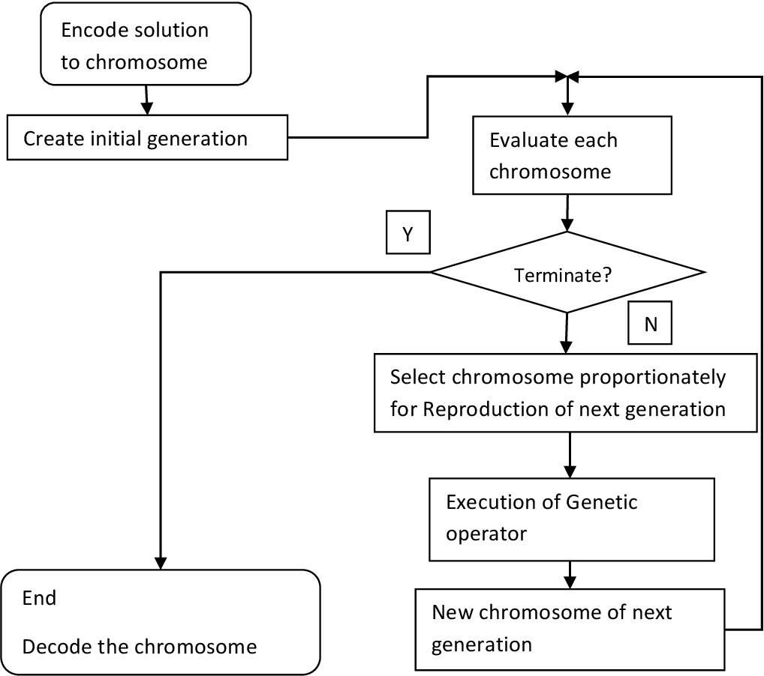
Architecture Diagram

Slide 11
SOFTWARE REQUIREMENTS:
Operating System : Windows 10
Platform : DOT NET TECHNOLOGY
Front End : ASP.Net 4.0
Back End : SQL SERVER 2014

Slide 12
HARDWARE REQUIREMENTS:
Keyboard
Mouse
Hard disk 500GB
Ram 4 Gb

Slide 13
REFERENCE
[1] C. Ferreira, “Gene Expression Programming: a New Adaptive Algorithm for Solving Problems”, Complex Systems, vol.13, no.2, pp.22, 2001.
[2] T. Bäck, Evolutionary Algorithms in Theory and Practice: Evolution Strategies,Evolutionary Programming, Genetic Algorithms,1996.
[3] JH. Holland, Adaptation in Natural and Artificial Systems: An Introductory Analysis with Applications to Biology, Control, and Artificial Intelligence,U Michigan Press, 1975.
[4] J. R. Koza, “Genetic Programming as a Means for Programming Computers by Natural Selection”, Stat. Comput., vol. 4, no. 2, pp. 87–112, 1994.
[5]D. H. Wolpert and W. G. Macready, “No Free Lunch Theorems for Optimization,” IEEE Trans. EvolutionaryComputation, vol. 1, no. 1, pp. 67–82, 1997.

Slide 14
[6]C. Ferreira, “Combinatorial Optimization by Gene Expression Programming: Inversion Revisited,” in Proc. Argentine Symp. Artif. Intell., pp. 160–174, 2002.
[7]C. Ferreira, “Discovery of the Boolean Functions to the Best Density-Classification Rules UsingGene Expression Programming,”Genetic Programming,inProc.of the 5th European Conference, EuroGP 2002, vol. 2278, pp. 50–59, 2002.
[8]C. Zhou, P. C. Nelson, W.Xiao, & T. M. Tirpak, “Discovery of classification rules by Using Gene Expression Programming,” in Proc. of the Int. Conf. on Artificial Intelligence,pp. 1355-1361,June, 2002.
[9]C. Zhou, W. Xiao, T. M. Tirpak, and P. C. Nelson, “Evolving Accurate and Compact Classification Rules with Gene Expression Programming,” IEEE Transactions onEvolutionary Computation, vol. 7, no. 6, pp. 519–531, 2003.
[10]M. H. Marghnyand I. E. El-Semman. “Extracting Logical Classification Rules with Gene Expression Programming: Microarray Case Study,” in Proc.of the International Conference on Artificial Intelligence and Machine Learning (AIML 05), Cairo, Egypt, 2005.

