Slide 1
Dynamic Scheduling for Stochastic Edge Cloud Computing Environments using A3C learning and Residual Recurrent Neural Networks

Slide 2
Abstract
The ubiquitous adoption of Internet-of-Things (IoT) based applications has resulted in the emergence of the Fog computing paradigm, which allows seamlessly harnessing both mobile-edge and cloud resources. Efficient scheduling of application tasks in such environments is challenging due to constrained resource capabilities, mobility factors in IoT, resource heterogeneity, network hierarchy, and stochastic behaviors.
Existing heuristics and Reinforcement Learning based approaches lack generalize ability and quick adaptability, thus failing to tackle this problem optimally. They are also unable to utilize the temporal workload patterns and are suitable only for centralized setups. However, Asynchronous-Advantage-Actor-Critic (A3C) learning is known to quickly adapt to dynamic scenarios with less data and Residual Recurrent Neural Network (R2N2) to quickly update model parameters.

Slide 3
Thus, we propose an A3C based real-time scheduler for stochastic Edge-Cloud environments allowing decentralized learning, concurrently across multiple agents. We use the R2N2 architecture to capture a large number of host and task parameters together with temporal patterns to provide efficient scheduling decisions.
The proposed model is adaptive and able to tune different hyper-parameters based on the application requirements. We explicate our choice of hyper parameters through sensitivity analysis. The experiments conducted on Real world data set show a significant improvement in terms of energy consumption, response time, Service Level Agreement and running cost by 14.4%, 7.74%, 31.9%, and 4.64%, respectively when compared to the state-of-the-art algorithms.

Slide 4
Existing System
Task scheduling of complex systems having hierarchical topology is analogous to distribution of jobs or tasks of an application to a group of processors with heterogeneous processing capabilities for fulfilling the optimization goal of minimization of completion time. Therefore, a task graph and a process graph are feed as the inputs of task scheduling. The output is a schedule representing the assignment of tasks to processor.

Slide 5
Disadvantage of Existing System
It still faces many challenges due to the limited processing capacity of the local computing resources.
The local computing resources require a lot of finance and human forces.

Slide 6
PROPOSED SYSTEM :
In this paper, we present a novel architecture, which is a collaboration of the computing resources on cloud provider side and the local computing resources (thick clients)on client side. In addition, the main factor of this framework is the dynamic genetic task scheduling to globally minimize the completion time in cloud service, while taking into account network condition and cloud cost paid by customers. Our simulation and comparison with other scheduling approaches show that the proposal produces a reasonable performance together with a noteworthy cost saving for cloud customers.

Slide 7
ADVANTAGE
These modifications can generate to an actual multi face testate during genetic operators.
Thus, our way is to disregard the time frame through genetic manipulation and allot time slot to each assignment so as to achieve a reasonable schedule well ahead.

Slide 8
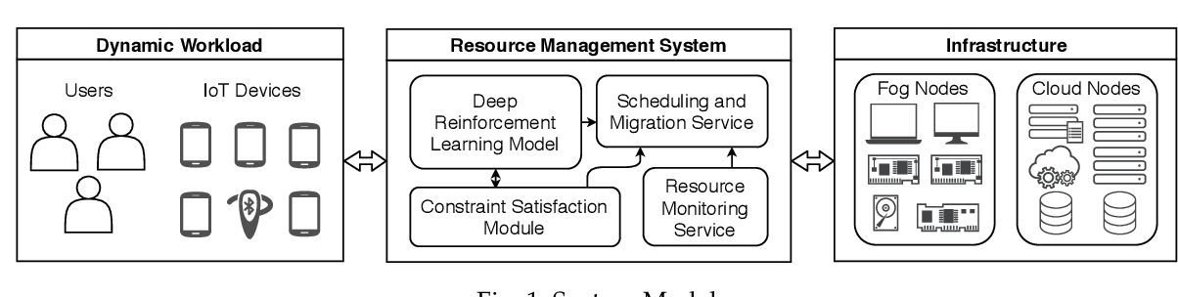
Architecture Diagram

Slide 9
Literature Survey
TITTLE | AUTHOR | CONCEPT
Quality of Experience (QoE)-aware placement of applications in Fog computing environments,” | R. Mahmud, S. N. Srirama, K. Ramamohanarao, and R. Buyya, | Fog computing aims at offering Cloud like services at the network edge for supporting Internet of Things (IoT) applications with low latencyresponserequirements.
“QoS-aware deployment of IoT applications through the fog,” | A. Brogi and S. Forti, | Fog computing aims at extending the Cloud by bringing computational power, storage and communication caabilities to the edge of the network, in support of the IoT.

Slide 10
TITTLE | AUTHOR | CONCEPT
“A cost-and performance-effective approach for task scheduling based on collaboration between cloud and fog computing,” | X.-Q. Pham, N. D. Man, N. D. T. Tri, N. Q. Thai, and E.-N. Huh, | The rapid development of Internet of Things applications, along with the limitations of cloud computing due mainly to the far distance between Internet of Thing devices and cloud-based platform, has promoted a newly distributed computing platform based on collaboration between cloud computing and fog computing
“Prioritized task scheduling in fog computing | T. Choudhari, M. Moh, and T.-S. Moh, ,” | Fog computing, similar to edge computing, has been proposed as a model to introduce a virtualized layer between the end users and the back-end cloud data centers.

Slide 11
SOFTWARE REQUIREMENTS:
Operating System : Windows XP.
Platform : DOT NET TECHNOLOGY
Front End : ASP.Net 3.5
Back End : SQL SERVER 2005

Slide 12
HARDWARE REQUIREMENTS:
Keyboard
Mouse
Hard disk 500GB
Ram 4 Gb

Slide 13
REFERENCES
[1] R. Mahmud, S. N. Srirama, K. Ramamohanarao, and R. Buyya, “Quality of Experience (QoE)-aware placement of applications in Fog computing environments,” Journal of Parallel and Distributed Computing, vol. 132, pp. 190 203, 2019.
[2] J. Gubbi, R. Buyya, S. Marusic, and M. Palaniswami, “Internet of Things (IoT): A vision, architectural elements, and future directions,” Future Generation Computer Systems, vol. 29, no. 7, pp. 1645–1660, 2013.
[3] McKinsey & Company, “The Internet of Things: How to capture the value of IoT,” May, 2018.
[4] S. Tuli, R. Mahmud, S. Tuli, and R. Buyya, “FogBus: A Blockchainbased Lightweight Framework for Edge and Fog Computing,” Journal of Systems and Software, vol. 154, pp. 22 – 36, 2019.
[5] J. Wang, K. Liu, B. Li, T. Liu, R. Li, and Z. Han, “Delay-sensitive multi-period computation offloading with reliability guarantees in fog networks,” IEEE Transactions on Mobile Computing, 2019.

Slide 14
[6] X. Chen, L. Jiao, W. Li, and X. Fu, “Efficient multi-user computation offloading for mobile-edge cloud computing,” IEEE/ACM Transactions on Networking, vol. 24, no. 5, pp. 2795–2808, 2015.
[7] O. Skarlat, M. Nardelli, S. Schulte, M. Borkowski, and P. Leitner, “Optimized IoT service placement in the fog,” Service Oriented Computing and Applications, vol. 11, no. 4, pp. 427–443, 2017.
[8] A. Beloglazov and R. Buyya, “Optimal online deterministic algorithms and adaptive heuristics for energy and performance efficient dynamic consolidation of virtual machines in cloud data centers,” Concurrency and Computation: Practice and Experience, vol. 24, no. 13, pp. 1397–1420, 2012.
[9] X.-Q. Pham, N. D. Man, N. D. T. Tri, N. Q. Thai, and E.-N. Huh, “A cost-and performance-effective approach for task scheduling based on collaboration between cloud and fog computing,” International Journal of Distributed Sensor Networks, vol. 13, no. 11, pp. 1–16, 2017.
[10] A. Brogi and S. Forti, “QoS-aware deployment of IoT applications through the fog,” IEEE Internet of Things Journal, vol. 4, no. 5, pp. 1185–1192, 2017.

