Slide 1
On the Security of Reversible Data Hiding in Encrypted Images by MSB Prediction

Slide 2
Abstract
The reversible data hiding in encrypted images by MSB prediction of P. Puteaux and W. Puesch not only provides high embedding bit-rates, but also entails a very low mathematical complexity.
This correspondence investigates its security and shows flaws in embedding imperceptibility, unauthorized detection/removal of embedded data and unauthorized access to image content. Secure solutions are discussed.

Slide 3
Existing System
In this method, the original MSB values are lost in the sub sequent data hiding step .
So, the first step is to use the previous pixels to predict the current pixel value and mark the wrong pixel
In the plaintext domain, most RDH algorithms embed data by modifying the LSB (least significant bit) to ensure the visual quality of the image.
But in the encryption domain, we do not require high visual quality of the image. For this reason, the MSB (most significant bit)of the pixel can be used as marked bits to record the label map for image restoration. Puteaux et al.

Slide 4
Disadvantage of Existing System
The block map and the true MSBs of the blocks with errors are stored into the MSB of the last M pixels .
Instead of 8 pixels as in the original EPE-HCRDH, the optimal block size for the secure reserved area with block map scheme appears to be4×8pixels (experimentally determined by varying the block size on a large data set).
The standard decryption by XOR-ing must be completed with true MSBs recovery. By reverse engineering, the receivers could get information on the data embed-ding procedure.

Slide 5
PROPOSED SYSTEM :
In this paper, we propose a new high-capacity and separable RDHEI method using Huffman coding labeling (HVLCL-RDHEI).
We can divide the proposed method into three phases, namely the encryption phase, the embedded phase, and the decryption phase.
In the encryption phase, we first calculate the label map of the original image, then encrypt the original image and embed the label map into the encrypted image.
In the embedding phase, we can embed multi-bit information in each encrypted pixel by multi-MSB substitution based on the embedded label map.

Slide 6
ADVANTAGE
The security of the RDH-EI by MSB prediction of P. Puteaux and W. Puech has been investigated.
The replacement of flag-bits with a predetermined data hiding reserved area ensures the imperceptibility of the embedding and eliminates unauthorized access to image content.
The proposed secure versions provide similar performances(embedding bit-rate and mathematical complexity).
After the prediction check, the image is encrypted (XOR-based encryption) and split into disjoint blocks of eight pixels.
The blocks with at least one prediction error are not used for data hiding.

Slide 7
TITTLE | AUTHOR | DESCRIPTION
Reversible data hiding : advances in the past two decades | Y. Q. Shi, X. Li, X. Zhang, H. T. Wu and K. Ma, | In the past two decades, reversible data hiding (RDH), also referred to as lossless or invertible data hiding, has gradually become a very active research area in the field of data hiding.
An efficient MSB prediction-based method for high-capacity reversible data hiding in encrypted images | P. Puteaux and W. Puech, | Reversible data hiding in encrypted images (RDHEI) is an effective technique to embed data in the encrypted domain.

Slide 8
TITTLE | AUTHOR | DESCRIPTION
Reversible Data Hiding in Encrypted Images by Reserving Room Before Encryption | K. Ma, W. Zhang, X. Zhao, N. Yu, and F. Li, | In this paper, we propose a novel method by reserving room before encryption with a traditional RDH algorithm, and thus it is easy for the data hider to reversibly embed data in the encrypted image.
High capacity reversible data hiding in encrypted images by patch-level sparse representation | X. Cao, L. Du, X. Wei, D. Meng, and X. Guo, | In this paper, to better explore the correlation between neighbor pixels, we propose to consider the patch-level sparse representation when hiding the secret data.

Slide 9
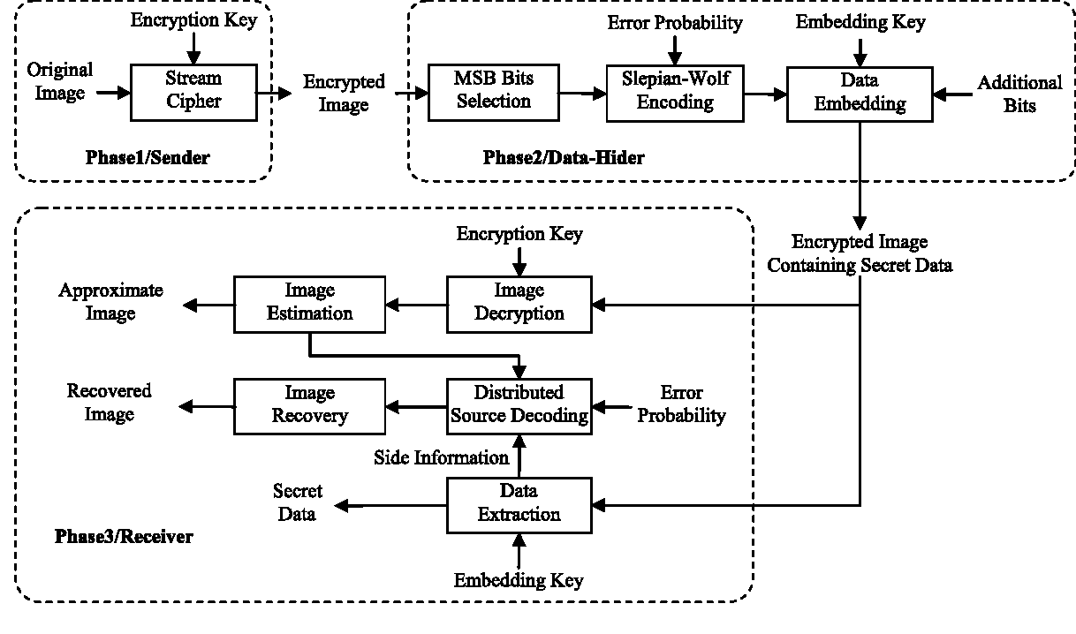
Architecture Diagram

Slide 10
SOFTWARE REQUIREMENTS:
Operating System : Windows 10
Platform : DOT NET TECHNOLOGY
Front End : ASP.Net 4.0
Back End : SQL SERVER 2014

Slide 11
HARDWARE REQUIREMENTS:
Keyboard
Mouse
Hard disk 500GB
Ram 4 Gb

Slide 12
REFERENCE
[1] Y. Q. Shi, X. Li, X. Zhang, H. T. Wu and K. Ma, ”Reversible data hiding : advances in the past two decades ”, IEEE Access, 4, pp. 3210-3237, 2017.
[2] P. Puteaux and W. Puech, ”An efficient MSB prediction-based method for high-capacity reversible data hiding in encrypted images ” ,IEEE Trans.Inf. Forensics Security, 7, pp. 1670-1681, 2018.
[3] K. Ma, W. Zhang, X. Zhao, N. Yu, and F. Li, ”Reversible Data Hiding in Encrypted Images by Reserving Room Before Encryption ”, IEEE Trans.Inf. Forensics Security, vol. 8, pp. 553–568, 2013.
[4] X. Cao, L. Du, X. Wei, D. Meng, and X. Guo, ”High capacity reversible data hiding in encrypted images by patch-level sparse representation” IEEE Trans. Cybernetics, vol. 46, pp. 1132–1143, 2016.

Slide 13
.[5] Y. Puyang, Z. Yin and Z. Qian, ”Reversible Data Hiding in EncryptedImages with Two-MSB Prediction”,IEEE Intl. Workshop Inf. For ensics Security (WIFS), 2018.
[6] K. Chen and C.-C. Chang,” High-capacity reversible data hiding in encrypted images based on extended Run-Length coding and block-based MSB plane rearrangement ”, JVCI, 58, pp. 334-344, 2019.
[7] F.S. Makri and Z.M. Psillakis ,” On success runs of a fixed lengthin Bernoulli sequences: Exact and asymptotic results” ,Computers &Mathematics with Applications, 61(4), pp. 761-772, 2011.

