Slide 1
Object Discovery From a Single Unlabeled Image by Mining Frequent Item set With Multi-scale Features

Slide 2
Abstract
The goal of our work is to discover dominant objects in a very general setting where only a single un labeled image is given.
This is far more challenge than typical co-localization or weakly-supervised localization tasks.
To tackle this problem, we propose a simple but effective pattern mining-based method, called Object Location Mining (OLM), which exploits the advantages of data mining and feature representation of pre-trained convolutional neural networks (CNNs).
Specifically, we first convert the feature maps from a pre-trained CNN model into a set of transactions, and then discovers frequent patterns from transaction database through pattern mining techniques.

Slide 3
We observe that those discovered patterns, i.e., co-occurrence highlighted regions, typically hold appearance and spatial consistency.
Motivated by this observation, we can easily discover and localize possible objects by merging relevant meaningful patterns.
Extensive experiments on a variety of bench marks demonstrate that OLM achieves competitive localization performance compared with the state-of-the-art methods.
We also evaluate our approach compared with unsupervised saliency detection methods and achieves competitive results on seven benchmark datasets.
Moreover, we conduct experiments on fine-grained classification to show that our proposed method can locate the entire object and parts accurately, which can benefit to improving the classification results significantly.

Slide 4
Existing System
Frequent pattern mining searches for recurring relationships in a given dataset. this section introduces the basic concepts of frequent pattern mining for the discovery of interesting associations and correlations between item sets in transactional and relational databases.
We begin presenting an example of market basket analysis, the earliest form of frequent pattern mining for association rules.
Frequent item set mining leads to the discovery of associations and correlations among items in large transactional or relational datasets. With massive amounts of data continuously being collected and stored, many industries are becoming interested in mining such patterns from their databases.

Slide 5
Disadvantage of Existing System
Object localization from unlabeled data is a very challenging problem, there exist a limited number of comparable methods.
The extracts feature descriptors from the last max-pooling layer of a pre-trained VGG-16 model and employs a simple “mean-threshold” strategy to locate the main objects in fine-grained images.
For promoting the development of saliency community, explores a deeper insight into the SOD problem and proposes a new high-quality SOC dataset.

Slide 6
PROPOSED SYSTEM :
We propose a novel deep network architecture for unsupervised learning, which factors the image into multiple object instances that are based on the sparsity of images and the inter-frame structure of videos.
We propose a method to discover the primary object in single images by completely unsupervised learning without any manual annotation or pre-trained features.
Our segmentation quality tends to increase logarithmically with the amount of training data, which suggests the infinite possibilities of learning and generalization of our model.
Besides, our model maintains a very high speed in testing and the experimental results demonstrate that it is at least two orders of magnitude faster than the related co-segmentation methods

Slide 7
ADVANTAGE
We propose a novel pattern mining-based method, called Object Location Mining (OLM), for object discovery and localization from a single unlabeled image. Our method exploits the advantage of data mining and feature representation of pre-trained CNN models.
We also evaluate the localization ability on unsupervised saliency detection and fine-grained classification task .
Our method achieves competitive performance compared with the state-of-the-art methods.
we extract the deep features from multiple convolutional layers and use a tunable threshold to select the descriptors that are used to convert to items.

Slide 8
TITTLE | AUTHOR | DESCRIPTION
Ssd: Single shot multi box detector | W. Liu, D. Anguelov, D. Erhan, C. Szegedy, S. Reed, C. Y. Fu, and A. C. Berg, | Our SSD model is simple relative to methods that require object proposals because it completely eliminates proposal generation and subsequent pixel or feature re sampling stage and encapsulates all computation in a single network.
You only look once: Unified, real-time object detection | J. Redmon, S. Divvala, R. Girshick, and A. Farhadi, | we frame object detection as a re-gression problem to spatially separated bounding boxes andassociated class probabilities. A single neural network pre-dicts bounding boxes and class probabilities directly fromfull images in one evaluation

Slide 9
TITTLE | AUTHOR | DESCRIPTION
Learning deep features for discriminative localization | B. Zhou, A. Khosla, A. Lapedriza, A. Oliva, and A. Torralba, | This technique was previously proposed as a means for regularizing training, we find that it actually builds a generic localizable deep representation that exposes the implicit attention of CNNs on an image.
Wildcat: Weakly supervised learning of deep convnets for image classification, point wise localization and segmentation | T. Durand, T. Mordan, N. Thome, and M. Cord, | This paper introduces WILDCAT, a deep learning method which jointly aims at aligning image regions for gaining spatial invariance and learning strongly localized features.

Slide 10
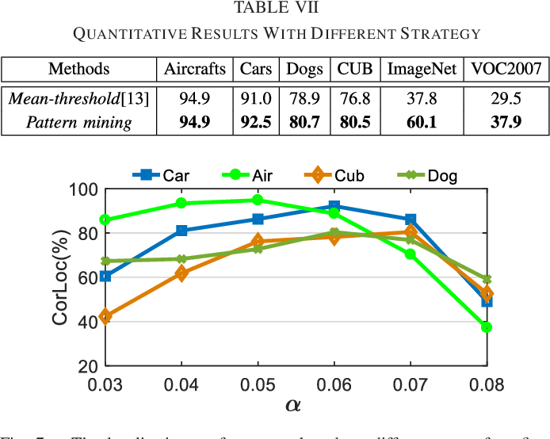
Architecture Diagram

Slide 11
SOFTWARE REQUIREMENTS:
Operating System : Windows 10
Platform : DOT NET TECHNOLOGY
Front End : ASP.Net 4.0
Back End : SQL SERVER 2014

Slide 12
HARDWARE REQUIREMENTS:
Keyboard
Mouse
Hard disk 500GB
Ram 4 Gb

Slide 13
REFERENCE
[1] W. Liu, D. Anguelov, D. Erhan, C. Szegedy, S. Reed, C. Y. Fu, and A. C. Berg, “Ssd: Single shot multi box detector,” inECCV, 2016, pp.21–37.
[2] J. Redmon, S. Divvala, R. Girshick, and A. Farhadi, “You only look once: Unified, real-time object detection,” in CVPR, 2016, pp. 779–788.
[3] B. Zhou, A. Khosla, A. Lapedriza, A. Oliva, and A. Torralba, “Learning deep features for discriminative localization,” in CVPR, 2016, pp.2921–2929.
[4] T. Durand, T. Mordan, N. Thome, and M. Cord, “Wildcat: Weakly supervised learning of deep convnets for image classification, point wise localization and segmentation,” in CVPR, 2017, pp. 5957–5966.
[5] X. Zhang, Y. Wei, J. Feng, Y. Yang, and T. S. Huang, “Adversarial complementary learning for weakly supervised object localization,” in CVPR, 2018, pp. 1325–1334.

Slide 14
[6] K. Tang, A. Joulin, L. J. Li, and F. F. Li, “Co-localization in real-world images,” in CVPR, 2014, pp. 1464–1471.
[7] A. Joulin, K. Tang, and F. F. Li, “Efficient image and video co-localization with frank-wolfe algorithm,” inECCV, 2014, pp. 253–268.
[8] M. Cho, S. Kwak, C. Schmid, and J. Ponce, “Unsupervised object discovery and localization in the wild: Part-based matching with bottom-up region proposals,” in CVPR, 2015, pp. 1201–1210.
[9] Y. Li, L. Liu, C. Shen, and A. V. D. Hengel, “Image co-localization by mimicking a good detector’s confidence score distribution,” inECCV,2016, pp. 19–34.
[10] X. S. Wei, C. L. Zhang, Y. Li, C. W. Xie, J. Wu, C. Shen, and Z. H.Zhou, “Deep descriptor transforming for image co-localization,” in IJCAI, 2017, pp. 3048–3054.

