Slide 1
A Unified Framework for User Identification across Online and Offline Data

Slide 2
Abstract
User identification across multiple datasets has a wide range of applications and there has been an increasing set of research works on this topic during recent years.
However, most of existing works focus on user identification with a single input data type, e.g., (I) identifying a user across multiple social networks with online data and (II) detecting a single user from heterogeneous trajectory datasets with offline data.
Different from previous works, in this paper, we propose a framework on user identification between online and offline datasets.

Slide 3
We build connections between these two types of data by a mapping from IP addresses to physical locations.
To solve this problem, we propose a novel framework consists of three steps. First, we use a clustering method based on locations of IP addresses to map IP addresses into specific physical location distributions. Second, we propose a novel pair wise index to reduce space cost and running time for computing the co-occurrence. Lastly, we apply a learning-to-rank method to merge the effect of multiple features we get in the first two steps.
Based on our framework, we design experiments to demonstrate the efficiency (in time and space) of our framework, together with the precision and recall of our approach compared to other methods.

Slide 4
Existing System
The identification of individuals across different social media sites.
We divide these studies into three different categories according to the information they rely on: username-based identi-fication, profile-based identification and network- and content-based identification.

Slide 5
Disadvantage of Existing System
We design several experiments to evaluate our framework, and use a much larger dataset from Beijing to show that our framework can efficiently handle large-scale problems.
Our main purpose is to identify corresponding users from two different datasets: the online and offline data.

Slide 6
PROPOSED SYSTEM :
In this paper, we aim to perform user identification across online and offline datasets, instead of working only on one type of data as previous works.
The intuition is that, although there exist several kinds of online and offline data, they often share similar features.
For online data, since it is generated from online activities, it usually contains IP addresses from mobile devices.
For offline data, there is often offline location information of users.

Slide 7
ADVANTAGE
we propose a novel pair wise-index to increase the efficiency of our frame works.
In order to evaluate the efficiency and effectiveness of our frame work, we have designed several experiments.
we have designed a series of experiments in order to test the efficiency of our framework.
Parameters of the model can be better determinedwith an automatic process.
It is more convenient to convert a Gaussian distribu-tion into a grid-based distribution.
According to our experiment, we can get a betterpredicting accuracy by this method.

Slide 8
TITTLE | AUTHOR | DESCRIPTION
User identification across multiple social networks | J. Vosecky, D. Hong, and V. Y. Shen, | A facility to aggregate our on-line friends into a single integrated environment would en-able the user to keep up-to-date with their virtual contacts more easily, as well as to provide improved facility to search for people across different websites.
Inferring anchor links acrossmultiple heterogeneous social networks | X. Kong, J. Zhang, and P. S. Yu, | In this paper, we study the problem of anchor link prediction across multiple heterogeneous social networks, i.e., discovering the correspondence among different accounts of the same user.

Slide 9
TITTLE | AUTHOR | DESCRIPTION
Mapping users across networks by manifold alignment on hyper graph. | S. Tan, Z. Guan, D. Cai, X. Qin, J. Bu, and C. Chen, | we use hyper graph to model high-order relations here. For a target user in one network, the proposed algorithm ranks all users in the other net-work by their possibilities of being the corresponding user.
Hydra : Large-scale social identity linkage via heterogeneous behavior modeling | S. Liu, S. Wang, F. Zhu, J. Zhang, and R. Krishnan, | We study the problem of large-scale social identity linkage across different social media platforms, which is of critical importance to business intelligence by gaining from social data a deeper un-der standing and more accurate profiling of users.

Slide 10
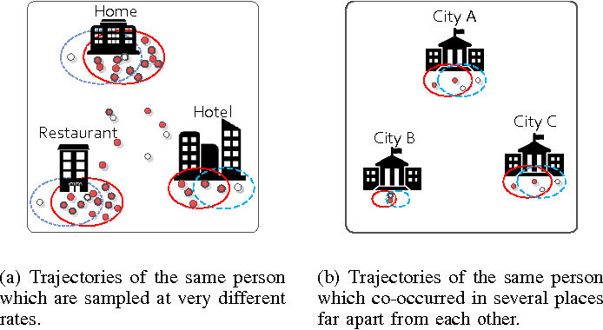
Architecture Diagram

Slide 11
SOFTWARE REQUIREMENTS:
Operating System : Windows 10
Platform : DOT NET TECHNOLOGY
Front End : ASP.Net 4.0
Back End : SQL SERVER 2014

Slide 12
HARDWARE REQUIREMENTS:
Keyboard
Mouse
Hard disk 500GB
Ram 4 Gb

Slide 13
REFERENCE
[1] M. C. Gonzalez, C. A. Hidalgo, and A.-L. Barabasi, “Understand-ing individual human mobility patterns, ”Nature, vol. 453, no.7196, pp. 779–782, 2008.
[2] Y.-A. de Montjoye, C. A. Hidalgo, M. Verleysen, and V. D. Blondel, “Unique in the crowd: The privacy bounds of human mobility,” Scientific reports, vol. 3, 2013.
[3] Y.-A. de Montjoye, L. Radaelli, V. K. Singh, and A. S. Pentland, “Unique in the shopping mall: On the reidentifiability of creditcard meta data, ”Science, vol. 347, no. 6221, pp. 536–539, 2015.
[4] G. Salton and M. J. McGill, “Introduction to modern information retrieval,” 1986.

Slide 14
[5] T.-Y. Liu, “Learning to rank for information retrieval,” Foundations and Trends in Information Retrieval, vol. 3, no. 3, pp. 225–331, 2009.
[6] T. Hao, J. Zhou, Y. Cheng, L. Huang, and H. Wu,“User identification in cyber-physical space: A case study on mobile query logs and trajectories,” in SIGSPATIAL, 2016, pp. 71:1–71:4.
[7] M. Ester, H.-P. Kriegel, J. Sander, and X. Xu,“A density-base dalgorithm for discovering clusters in large spatial databases with noise.” in KDD, vol. 96, no. 34, 1996, pp. 226–231.
[8] G. McLachlan and D. Peel,Finite mixture models. John Wiley &Sons, 2004.
[9] Z. Chen, H. T. Shen, X. Zhou, Y. Zheng, and X. Xie, “Searching trajectories by locations: An efficiency study,” in SIGMOD, 2010,pp. 255–266.
[10] F. M. Naini, J. Unnikrishnan, P. Thiran, and M. Vetterli, “Where you are is who you are: User identification by matching statistics,” IEEE-TIFS, vol. 11, no. 2, pp. 358–372, 2016.

