Slide 1
A Block chain-based Framework for Lightweight Data Sharing and Energy Trading in V2G Network

Slide 2
Abstract
The Vehicle-to-Grid (V2G) network is, where the battery-powered vehicles provide energy to the power grid, is highly emerging. A robust, scalable, and cost-optimal mechanism that can support the increasing number of transactions in a V2Gnetwork is required.
Existing studies use traditional block chain as to achieve this requirement. Block chain-enabled V2G networks require a high computation power and are not suitable for micro-transactions due to the mining reward being higher than the transaction value itself.
Moreover, the transaction throughput in the generic block chain is too low to support the increasing number of frequent transactions in V2G networks.

Slide 3
To address these challenges, in this paper, a lightweight block chain-based protocol called Directed Acyclic Graph-based V2G network(DV2G) is proposed. Here block chain refers to any Distributed Ledger Technology (DLT) and not just the bit coin chain of blocks.
A tangle data structure is used to record the transactions in the network in a secure and scalable manner. A game theory model is used to perform negotiation between the grid and vehicle sat an optimized cost.
The proposed model does not require the heavy computation associated to the addition of the transactions to the data structure and does not require any fees to post the transaction. The proposed model is shown to be highly scalable and supports the micro-transactions required in V2G networks.

Slide 4
Existing System
While the intersection of block chain and In-dustrial Internet of Things (IIoT) has received considerable research interest lately, the conflict between the high resource requirements of block chain and the generally inadequate performance of IIoT devices has not been well tackled.
On one hand, due to the introductions of mathematical concepts, including Public Key Infrastructure, Merkle Hash Tree, and Proof of Work (PoW), deploying block chain demands huge computing power. On the other hand, full nodes should synchronize massive block data and deal with numerous transactions in peer-to-peer network, whose occupation of storage capacity and bandwidth makes IIoTdevices difficult to afford.

Slide 5
Disadvantage of Existing System
Traditional power generators face unpredictable fluctuations in their power demand due to the uncertainty in RES.
With smart grids, information can be exchanged between consumers and the grid, and energy flow can take place between consumers and different parts of the smart grid.
The issue withRES is that their power generation fluctuates as per the weatherand climate conditions, and the exact prediction of the amountof generated energy is not easy.

Slide 6
PROPOSED SYSTEM :
In this paper, we propose alightweight blockchain system calledLightChain,whichis resource-efficient and suitable for power-constrainedIIoT scenarios.
Specifically, we present a green consensusmechanism named Synergistic Multiple Proof for stimulat-ing the cooperation of IIoT devices, and a lightweight datastructure called LightBlock to streamline broadcast content.Furthermore, we design a novel Unrelated Block OffloadingFilter to avoid the unlimited growth of ledger without affect-ing blockchain’s traceability.

Slide 7
The extensive experimentsdemonstrate thatLightChaincan reduce the individualcomputational cost to 39.32% and speed up the block gen-eration by up to 74.06%. In terms of storage and networkusage, the reductions are 43.35% and 90.55%, respectively

Slide 8
ADVANTAGE
  Various works propose the use of other consensus algorithmssuch as Proof of Stake (POS), Proof of Burn (POB), or Proofof Elapsed Time (POET) to overcome the limitations of thegeneric blockchain.
  We propose a unique and secure energy trading platformin V2G network.
  It is based on Directed Acyclic Graph (DAG) which usestangle data structure to store transactions

Slide 9
TITTLE | AUTHOR | DESCRIPTION
. Electric vehicles as anew power source for electric utilities | W. Kempton and S. E. Letendre, | Electric-drive vehicles, whether fueled by batteries or by liquid or gaseous fuels generating electricity on-board, will have value to electric utilities as power resources.
Optimal decentralizedprotocol for electric vehicle charging | L. Gan, U. Topcu, and S. H. Low | We propose a decentralized algorithm to optimally schedule electric vehicle (EV) charging. The algorithm exploits the elasticity of electric vehicle loads to fill the valleys in electric load profiles.

Slide 10
TITTLE | AUTHOR | DESCRIPTION
Mobqos: Mobility-aware and qos-driven sdn framework for autonomous vehicles | S. Garg, K. Kaur, S. H. Ahmed, A. Bradai, G. Kaddoum,and M. Atiquzzaman | An intelligent transportation system (ITS) is a cyber physical system (CPS) that is well recognized due to its distinctive applications such as passenger safety, enhanced traffic efficiency, and infotainment services.
Estimation ofcost savings from participation of electric vehicles invehicle to grid (v2g) schemes, | M. Kiaee, A. Cruden, and S. Sharkh, | The storage capacity of the batteries in an electric vehicle (EV) could be utilised to store electrical energy and give it back to the grid when needed by participating in vehicle to grid (V2G) schemes.

Slide 11
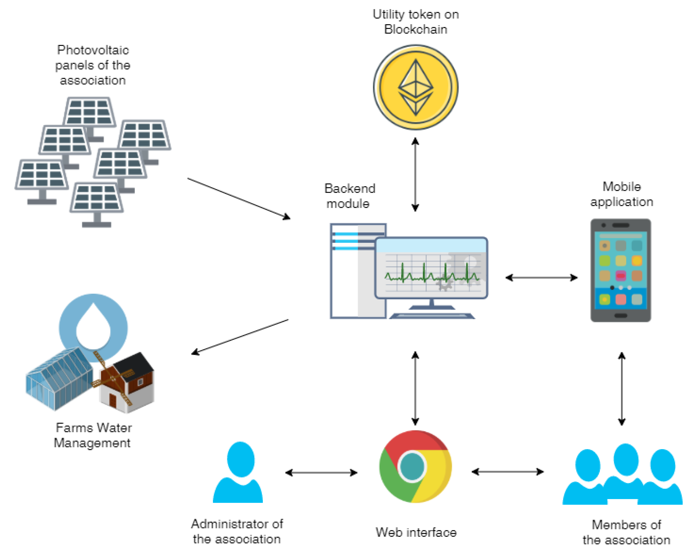
Architecture Diagram

Slide 12
SOFTWARE REQUIREMENTS:
Operating System : Windows 10
Platform : DOT NET TECHNOLOGY
Front End : ASP.Net 4.0
Back End : SQL SERVER 2014

Slide 13
HARDWARE REQUIREMENTS:
Keyboard
Mouse
Hard disk 500GB
Ram 4 Gb

Slide 14
REFERENCE
[1] H. Farhangi, “The path of the smart grid,”IEEE Powerand Energy Magazine, vol. 8, no. 1, pp. 18–28, January2010.
[2] W. Kempton and S. E. Letendre, “Electric vehicles as anew power source for electric utilities,”TransportationResearch Part D: Transport and Environment, vol. 2,no. 3, pp. 157–175, 1997.
[3] L. Gan, U. Topcu, and S. H. Low, “Optimal decentralizedprotocol for electric vehicle charging,”IEEE Transac-tions on Power Systems, vol. 28, no. 2, pp. 940–951,2012.
[4] S. Garg, K. Kaur, S. H. Ahmed, A. Bradai, G. Kaddoum,and M. Atiquzzaman, “Mobqos: Mobility-aware and qos-driven sdn framework for autonomous vehicles,”IEEEWireless Communications, vol. 26, no. 4, pp. 12–20,August 2019.
[5] S. Garg, K. Kaur, G. Kaddoum, S. H. Ahmed, andD. N. K. Jayakody, “Sdn-based secure and privacy-preserving scheme for vehicular networks: A 5g per-spective,”IEEE Transactions on Vehicular Technology,vol. 68, no. 9, pp. 8421–8434, Sep. 2019.

Slide 15
[6] M. Kiaee, A. Cruden, and S. Sharkh, “Estimation ofcost savings from participation of electric vehicles invehicle to grid (v2g) schemes,”Journal of Modern PowerSystems and Clean Energy, vol. 3, no. 2, pp. 249–258,2015.
[7] W. Tushar, W. Saad, H. V. Poor, and D. B. Smith, “Eco-nomics of electric vehicle charging: A game theoreticapproach,”IEEE Transactions on Smart Grid, vol. 3,no. 4, pp. 1767–1778, 2012.
[8] W. Tushar, C. Yuen, H. Mohsenian-Rad, T. Saha, H. V.Poor, and K. L. Wood, “Transforming energy networksvia peer to peer energy trading: Potential of gametheoretic approaches,”arXiv preprint arXiv:1804.00962,2018.
[9] W. Tushar, B. Chai, C. Yuen, D. B. Smith, K. L. Wood,Z. Yang, and H. V. Poor, “Three-party energy manage-ment with distributed energy resources in smart grid,”IEEE Transactions on Industrial Electronics, vol. 62,no. 4, pp. 2487–2498, 2014.
[10] S. Nakamotoet al., “Bitcoin: A peer-to-peer electroniccash system,” 2008.

