Slide 1
ANIMAL ALERT SYSTEM IN AGRICULTURE LAND USING PIR SENSOR IR SENSOR BUZZER GSM

Slide 2
Abstract
The main aim of our project is to protect the crops from damage caused by animal as well as divert the animal without any harm.
Animal detection system is designed to detect the presence of animal and offer a warning.
In this project we used PIR and ultrasonic sensors to detect the movement of the animal and send signal to the controller .
It diverts the animal by producing sound and signal further, this signal is transmitted to GSM and which gives an alert to farmers and forest department immediately.

Slide 3
Existing System
This project describes a security alarm system that can monitor an industry and home.
This is a simple and useful security system and easy to install. This motion detector is realized using readily available, low cost components.
One of its many placations is in a rolling shutter guard for offices, lands and shops.
The detector will sense motion caused activities like animals and switch on the connected load (bulb, piezo buzzer, etc) to alert you.

Slide 4
Disadvantage of Existing System
Less Accuracy
More Equipment Fault
Harmful to animals

Slide 5
PROPOSED SYSTEM :
In the proposed system, Crop monitoring is done where sensors are used to collect information in the agricultural field. In our proposed work, PIR, Smoke sensor and GSM is used.
When animals come near to the PIR sensor and it detects the animal movement. After getting that initial input signal, it is passed for further processing.
Then it will be given to the microcontroller.
Our system will be activated, immediately buzzer will be on, at the same time it sends an SMS and makes call to the owner.
Microcontroller Block is used for reading the inputs from PIR and Smoke sensor. Whole process is controlled by microcontroller.
The GSM module is used for sending SMS and making call to farmer when movement or smoke is detected. It also turns ON the motor, when smoke is detected. It alerts the farmer that some animals try to enter into the farm.
Our LCD data will be display for SMS sending.

Slide 6
ADVANTAGE
To provide protection from the attacks of the wild animals and thus minimizing the probable loss to the farmer.
To detect intrusion around the field.
To send notification to farm owner and forest officials using IoT.

Slide 7
TITTLE | AUTHOR | DESCRIPTION
Smart Passive Infrared Sensor -Hardware Platform | ArturFrankiewicz; RafałCupek. | This system mainly deals with the light automation with dual operating process. The room will be furnished with the PIR sensor where it detects the human motion and powers up all the light sources and ventilation devices connected to the system.
Community Alarm System Design Based On MCU And GSM | Hanshi Wang; Jingli Lu; Lizhen Liu; Wei Song; Zhaoxia Wang; | In this paper, we use GSM mobile network that is the most reliable and matured in this day to achieve community alarm system. And it will directly convey the alarm news in short message or telephone at manager's mobile phone. The design includes hardware and software parts.

Slide 8
TITTLE | AUTHOR | DESCRIPTION
Quality Of Obstacle Distance Measurement Using Ultrasonic Sensor And Precision Of Two Computer Vision-Based Obstacle Detection Approaches | Markus Borschbach; Navya Amin, | In this paper, the accuracy of detection of obstacles and estimating their distance from the user using US sensors is determined.
Ultrasonic And Infrared Sensors Performance In A Wireless Obstacle Detection System | Mustapha, Baharuddin, AladinZayegh, and Rezaul K. Begg. | In this project, an obstacle detection system is built based on these two types of sensors. The system is intended for use by the elderly and people with vision impairment.

Slide 9
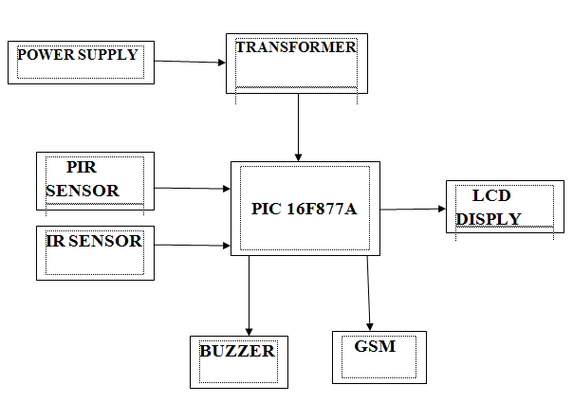
Architecture Diagram

Slide 10
SOFTWARE REQUIREMENTS:
Operating System : Windows 10
Platform : DOT NET TECHNOLOGY
Front End : ASP.Net 4.0
Back End : SQL SERVER 2014

Slide 11
HARDWARE REQUIREMENTS:
Keyboard
Mouse
Hard disk 500GB
Ram 4 Gb

Slide 12
REFERENCE
[1]ArturFrankiewicz; RafałCupek.”Smart Passive Infrared Sensor -Hardware Platform“ Year: 2013 IECON 2013 -39th Annual Conference of the IEEE Industrial Electronics SocietyPages: 7543 -7547,
[2]DOI:10.1109/IECON.2013.6700389CITED BY:PAPERS (1)
[3]Hanshi Wang; Jingli Lu; Lizhen Liu; Wei Song; Zhaoxia Wang; “Community Alarm System Design Based On MCU And GSM” Year: 2015
[4]Volume:01 Pages:859-862, DOI:10.1109/ICCSNT.2015.7490876, IEEE Conference Publications.
[5]Markus Borschbach; Navya Amin,“Quality Of Obstacle Distance Measurement Using Ultrasonic Sensor And Precision Of Two Computer Vision-Based Obstacle Detection Approaches” Year: 2015, 2015 International Conference on Smart Sensors and Systems (IC-SSS)

Slide 13
[6]Pages: 1-6, DOI: 10.1109/SMARTSENS.2015.7873595IEEE Conference Publications
[7]Mustapha, Baharuddin, AladinZayegh, and Rezaul K. Begg. “Ultrasonic And Infrared Sensors Performance In A Wireless Obstacle Detection System” Artificial Intelligence, Modelling and Simulation (AIMS), 2013 1st International Conference on. IEEE, 2013.
[8]Dr. Wilson, “Electric Fence” Handbook of Texas, Project report published by the Texas State Historical Association. August 4, 2011
[9]T. Mohammad, “Using Ultrasonic AndInfrared Sensors For Distance Measurement” World Academy of Science, Engineering and Technology,pp. 293-298, 2009.
[10]Discant, A. Rogozan, C. Rusu and A. Bensrhair, “Sensors For Obstacle Detection” 2007 30th International Spring Seminar on Electronics Technology (ISSE), Cluj-Napoca, 2007, pp. 100-105. doi: 10.1109/ISSE.2007.4432828

