Slide 1
A NEW IMPULSE ON STROKE PATIENT HEALTH CARE USING DEEP LEARNING (STROKE PREDICTION)

Slide 2
Abstract
Many predictive techniques have been widely applied in clinical decision Making such as predicting occurrence of a disease or diagnosis, evaluating Prognosis or outcome of diseases and assisting clinicians to recommend Treatment of diseases. However, the conventional predictive models or techniques are still not effective enough in capturing the underlying knowledge because it is incapable of simulating the complexity on feature representation of the medical problem domains. This research reports predictive analytical techniques for stroke diseases using deep learning model applied on heart disease dataset. The trtia fibrillation symptoms in heart patients are a major risk factor of stroke and share common variables to predict stroke. The outcomes of this research are more accurate than medical scoring systems currently in use for warning heart patients if they are likely to develop stroke.

Slide 3
Existing System
We apply the bi-CNN to estimate four perfusion parameters: CBV, CBF, T max, and MTT.
Our results show that the bi-CNN estimations are comparable to the existing techniques, demonstrating that CNNs are capable of learning rich temporal feature filters that can extract important patterns from the data to make accurate parameter estimations.
To the best of our knowledge, our work is the first to leverage deep learning techniques in the area ofperfusion parameter estimation

Slide 4
Disadvantage of Existing System
The training set will compare between previous cases and new cases. However, diagnosis of disease is difficult problem because the number of risk factors are increase and complex. So, it need to improve prediction accuracy.
In particular, there have been many computer-aided diagnosis systems using deep learning for detecting diverse diseases. Machine-learning/deep learning has been employed to detect or predict certain diseases using various approaches and datasets.

Slide 5
PROPOSED SYSTEM :
There is limited previous work on utilizing machine learning algorithms to estimate perfusion parameters. In this work, we present a novel bi-input convolutional neural network (bi-CNN) to approximate four perfusion parameters without using an explicit deconvolution method.
These bi-CNNs produced good approximations for all four parameters, with relative average root-mean-square errors (ARMSEs) ≤5% of the maximum values.
We further demonstrate the utility of the estimated perfusion maps for quantifying the salvageable tissue volume in stroke, with more than 80% agreement with the ground truth.
These results show that deep learning techniques area promising tool for perfusion parameter estimation without requiring a standard deconvolution process.

Slide 6
ADVANTAGE
The dataset we used included 13 variables, where the data were classified into training and testing data.
We used both ABC and scaler to convert categorical variable in to continuous variable, and to generate models for testing.
We then trained the DNN using ABC variables and compared to predict the results.
The training and testing data did not overlap with one another.
We demonstrate the predictive performance of our OCT models on the tasks of predictingin-hospital mortality, mortality within a year from discharge, and recurrence within a year fromdischarge.

Slide 7
TITTLE | AUTHOR | DESCRIPTION
"Artificial Neural NetworkModel in StrokeDiagnosis " | Lela Mirtskhulava, Gillian Pearce, Julian Wong and Salah Al-Maje | The aim of this paper is to present a model of ANN and to use it in diagnostic approaches for stroke by using the data that can serve as inputs for ANNs. We not only consider the usefulness of ANN to the field of stroke medicine but also evaluate the application of ANNs to other branches of human medicine.
" Predictive Model for Transferring Stroke In-Patients to Intensive Care Unit". | Nawal N. Alotaibi and Sreela Sasi | Early diagnosis of stroke is essential for timely prevention and treatment. It is the third important reasonof death, due to clot and break in the blood vessels, causing the brain tissues to damage. Medical department is alwayscurious about finding a better way for predicting stroke. The recovery of stroke patients is a very slow process andalsovery expensive.

Slide 8
TITTLE | AUTHOR | DESCRIPTION
"The International Stroke Trial Database. | Sandercock, Peter Ag, Maciej Niewada, and Anna Członkowska. | We aimed to make individual patient data from the International Stroke Trial (IST), one of the largest randomised trials ever conducted in acute stroke, available for public use, to facilitate the planning of future trials and to permit additional secondary analyses.
A stroke prediction score in the elderly:validation and web-based. | R. A. Kronmal T. Lumley. | The objective of this study was to construct a prediction model for predicting stroke in an elderly U.S. population, and to assess the accuracy in this population of other previously published prediction models.

Slide 9
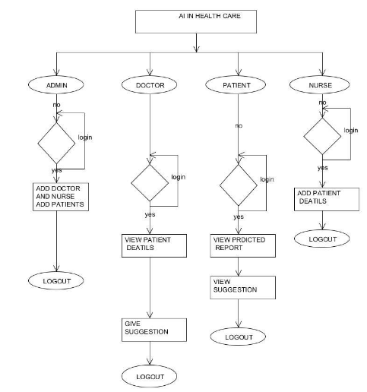
Architecture Diagram

Slide 10
SOFTWARE REQUIREMENTS:
Operating System : Windows 10
Platform : DOT NET TECHNOLOGY
Front End : ASP.Net 4.0
Back End : SQL SERVER 2014

Slide 11
HARDWARE REQUIREMENTS:
Keyboard
Mouse
Hard disk 500GB
Ram 4 Gb

Slide 12
REFERENCE
[1] J. M. Engels and P. Diehr. Imputation of miss-ing longitudinal data: a comparison of methods.Journal of Clinical Epidemiology, 56(10):968 976,2003.
[2] Klein J. and Moeschberger M.Survival Analy-sis: Techniques for Censored and Truncated Data.Springer, 2003.
[3] J.C. Sanchez J. Prados, A. Kalousis.Miningmass spectra for diagnosis and biomarker discov-ery of cerebral accidents.Proteomics, 4:2320–2332, 2004.
[4] E. J. Candes J.F. Cai and Z. Shen. A singularvalue thresholding algorithm for matrix comple-tion.arXiv, 2008.
[5] Satoshi Saitoh Kenji Ikeda, Hiromitsu Kumada.Effect of repeated transcatheter arterial emboliza-tion on the survival time in patients with hepato-cellular carcinoma.Cancer, 2006.

Slide 13
.[6] Tsuyoshi Nakamura Kouhei Akazawa. Simulationprogram for estimating statistical power of cox’sproportional hazards model assuming no specificdistribution for the survival time.Elseview Ire-land, 1991.
[7] Steven G. Self Kung-Yee Liang and Xinhua Liu.The cox proportional hazards model with changepoint: An epidemiologic application.Biometrics, 46:783–793, 1990.
[8] P. Enright L.P. Fried, N.O. Borhani. The cardio-vascular health study: design and rationale.AnnEpidemiol, 1(3):263–276, 1991.
[9] Thomas Augustin Ralf Bender and Maria Blet-tner.Generating survival times to simulatecox proportional hazards models.Statistics inMedicine, 24:1713–1723, 2005.
[10] R. A. Kronmal T. Lumley. A stroke predictionscore in the elderly: validation and web-basedapplication.Journal of Clinical Epidemiology,55(2):129–136, 2002.

