Slide 1
A Fiber-Wireless Sensor Networks QoS Mechanism for Smart Grid Applications

Slide 2
Abstract
Smart grid applications, such as teleportation, synchrophasors, remote condition monitoring, and control of assets, require timely and reliable data communication systems. Many communication architectures and solutions have been proposed to provide support for these smart grid applications, including ber networks, wireless mobile networks, wireless sensor networks (WSNs), and so on. The use of heterogeneous solutions is an attractive architecture option since it combines the advantages of two or more communication systems to meet the delay and reliability requirements of the smart grid. Fiber-wireless sensor networks (Fi-WSNs) are gaining popularity as a reliable communication infrastructure in many other applications. This is due to the low cost, reliability, availability, the distributed nature of the WSNs, and the high bandwidth and reliability of the optical ber networks.

Slide 3
Although the Fi-WSNs systems can provide a good delay performance, they may not meet the requirements of the above smart grid delay-critical applications. In this paper, we propose a novel adaptive and cross-layer service differentiation mechanism for the Fi-WSNs. The proposed mechanism implements an adaptive scheduling mechanism and allows WSNs to cooperate with the optical network unit (ONU) to reduce the delay for high priority trafc. We determine the effects of the proposed mechanism on the quality of service (QoS) of delay critical smart grid monitoring applications in terms of the end-to-end delay and reliability. We show through simulations that our proposed QoS mechanism can reduce the end-to-end delay in the Fi-WSN system and in the long-reach passive optical networks (LR-PONs). We also show that our mechanism can outperform the existing techniques under the same traffic and network conditions.

Slide 4
Existing System
Implementing QoS approaches in communication systems can greatly improve safety in the smart grid environment .
Smart grid safety and protection has been extensively studied in the past few years.
we develop and evaluate a novel adaptive and cross-layer QoS mechanism for the Fi-WSNs, namely, Cross Layer WSN-Modified Optical Coding (XWMOC) for delay critical smart grid applications.

Slide 5
Disadvantage of Existing System
The ﬂow of electric power is unidirectional from generation units to the consumers.
WSNs include large number of sensor nodes which obtain data about physical phenomena that is difficult to obtain in more conventional ways.

Slide 6
PROPOSED SYSTEM :
We determine the effects of the proposed mechanism on the quality of service (QoS) of delay critical smart grid monitoring applications in terms of the end-to-end delay and reliability.
We show through simulations that our proposed QoS mechanism can reduce the end-to-end delay in the Fi-WSN system and in the long-reach passive optical networks (LR-PONs).
We also show that our mechanism can outperform the existing techniques under the same trafficc and network conditions.

Slide 7
ADVANTAGE
To provide support for these smart grid applications, including fiber networks, wireless mobile networks, and wireless sensor networks (WSNs).
The use of heterogeneous solutions is an attractive
architecture option since it combines the advantages of two or more communication systems.

Slide 8
TITLE | AUTHOR | DESCRIPTION
Integrating renewable energy resources into the smartgrid: Recent developments in information and communication technolo-gies | M. H. Rehmani, M. Reisslein, A. Rachedi, M. Erol-Kantarci, andM. Radenkovic, | In this article, we give an overview of recent efforts that aim to integrate RERs into the SG. We outline the integration of RERs into the SG along with their supporting communication networks.
Fiber-wireless (FiWi) broadband access networks in an age ofconvergence: Past, present, and future | M. Maier, | We explore ways of how they can be deployed across relevant economic sectors other than telecommunications per se, taking major paradigm shifts such as the Third Industrial Revolution, Energy Internet, smart grid, and explosion of mobile data traffic in today’s cellular networks into account.

Slide 9
TITLE | AUTHOR | DESCRIPTION
Applications of wireless sensors in medicine | H. Furtado and R. Trobec, | WSN consists of a collection of autonomous sensors or actuators capable of collecting and manipulating data, performing some simple local analysis and communicating wirelessly with a higher WSN level.
Smart park-ing: An application of optical wireless sensor network | J. Chinrungrueng, U. Sunantachaikul, and S. Triamlumlerd, | We have demonstrated our system to the public in several exhibitions. It is realized that this simple invention could be applied to monitor vehicles in a parking garage.

Slide 10
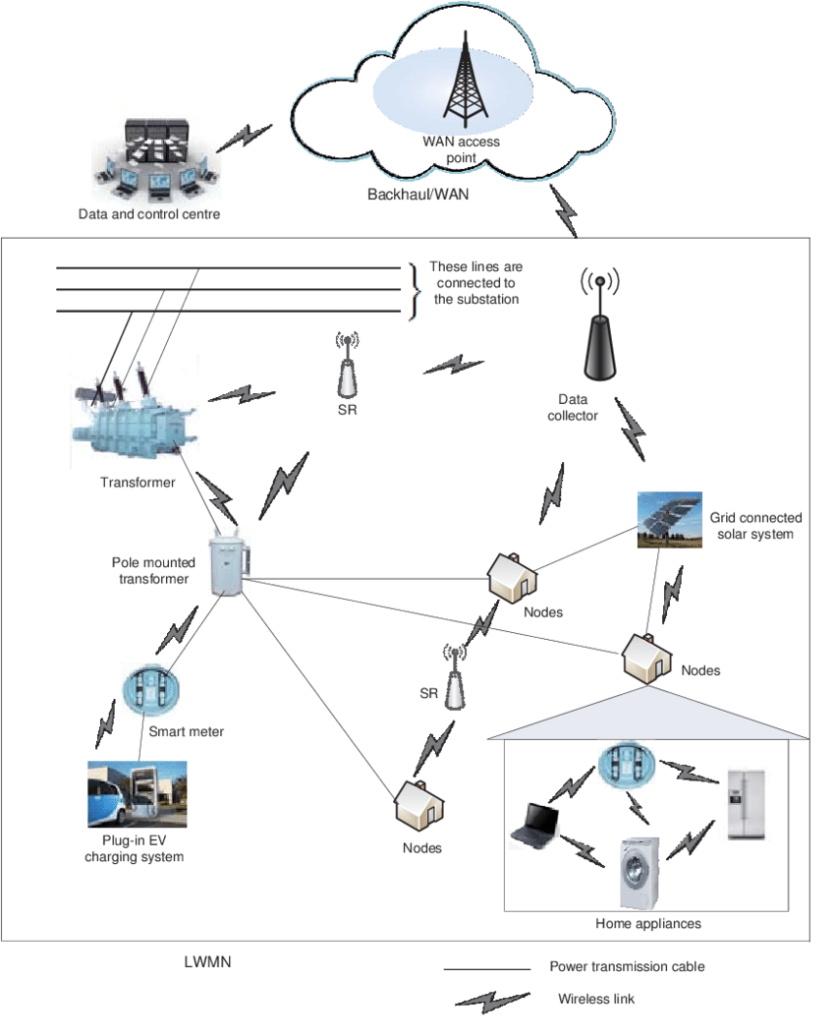
Architecture Diagram

Slide 11
SOFTWARE REQUIREMENTS:
Operating System : Windows 10
Platform : DOT NET TECHNOLOGY
Front End : ASP.Net 4.0
Back End : SQL SERVER 2014

Slide 12
HARDWARE REQUIREMENTS:
Keyboard
Mouse
Hard disk 500GB
Ram 4 Gb

Slide 13
REFERENCE
[1] M. H. Rehmani, M. Reisslein, A. Rachedi, M. Erol-Kantarci, andM. Radenkovic, ‘‘Integrating renewable energy resources into the smartgrid: Recent developments in information and communication technolo-gies,’’IEEE Trans. Ind. Informat., vol. 14, no. 7, pp. 2814–2825, Jul. 2018.
[2] M. Maier, ‘‘Fiber-wireless (FiWi) broadband access networks in an age ofconvergence: Past, present, and future,’’Adv. Opt., vol. 2014, May 2014,Art. no. 945364.
[3] H. Furtado and R. Trobec, ‘‘Applications of wireless sensors in medicine,’’inProc. 34th Int. Conv. MIPRO, May 2011, pp. 257–261.
[4] J. Chinrungrueng, U. Sunantachaikul, and S. Triamlumlerd, ‘‘Smart park-ing: An application of optical wireless sensor network,’’ inProc. Int. Symp.Appl. Internet Workshops, Jan. 2007, p. 66.
[5] A. Taherkordi, M. A. Taleghan, and M. Sharifi, ‘‘Achieving availability andreliability in wireless sensor networks applications,’’ inProc. 1st Int. Conf.Availability, Rel. Secur. (ARES), Apr. 2006, p. 7 and p. 535.

Slide 14
[6] N. Ghazisaidi and M. Maier, ‘‘Fiber-wireless (FiWi) access networks:Challenges and opportunities,’’IEEE Netw., vol. 25, no. 1, pp. 36–42,Jan./Feb. 2011.
[7] K. C. Budkaet al.,Communication Networks for Smart Grids. London,U.K.: Springer, 2014.
[8] M. U. Tariq, J. Florence, and M. Wolf, ‘‘Improving the safety andsecurity of wide-area cyber–physical systems through a resource-aware, service-oriented development methodology,’’Proc. IEEE, vol. 106, no. 1,pp. 144–159, Jan. 2018.
[9] Y. Zhang, Y. Li, J. Song, B. Li, and X. Chen, ‘‘A new protection scheme forHVDC transmission lines based on the specific frequency current of DCfilter,’’IEEE Trans. Power Del., to be published.
[10] M. Maier and M. Lévesque, ‘‘Dependable fiber-wireless (FiWi) access net-works and their role in a sustainable third industrial revolution economy,’’IEEE Trans. Rel., vol. 63, no. 2, pp. 386–400, Jun. 2014.

