Slide 1
Heart Attack Detection and Heart Rate Monitoring Using IoT

Slide 2
Abstract
This paper is intended to monitor Heart beat with android application which is used to measure the heart beat of different persons.
It is built using Android Studio.
It may also include the different modules based on the software specification, system requirement, hardware requirement and disk space.

Slide 3
Existing System
It uses data smoothing in an Integer array to figure out the average red pixel value in the image.
Once it figures out the average it determines a heartbeat when the average red pixel value in the latest image is greater than the smoothed average.
Wearable’s with optical heart-rate monitors have small LEDs on their undersides that shines green light onto the skin on your wrist.

Slide 4
Disadvantage of Existing System
It can produce annoying or corrupt your data.
This method has disadvantages like inaccurate results, hectic wired connections over the body.

Slide 5
PROPOSED SYSTEM :
The proposed system have eminence of detecting heart attack with help of observing heart rate based on internet of thing. Our method uses a pulse sensor, Arduino board and a Wi-Fi module.
After setting up the system, the pulse sensor will start sensing heart rate readings and will display the heartbeat of person on LCD screen.
Also, with the use of Wi-Fi module it will transmit the data over internet. System allows a set point which can help in determining whether a person is healthy or not by checking his/her heartbeat and comparing it with set point.
After setting these limits, the system will start monitoring the heart rate of patient and immediately the heart rate goes above or below the certain limit the system will send an alert message.
As a part of this project we are implementing an android application model that will track the heartbeat of particular patient and monitor it correctly and give the emergency message on chances of heart attack.

Slide 6
ADVANTAGE
Portable system∙
Save risk of heart attack as you can check it in home.
Affordable system∙
Temperature and Heart beat monitoring by single device∙
All Patient monitored by single person seating in Server room.
This system also helps for Hospital monitoring system.

Slide 7
TITTLE | AUTHOR | DESCRIPTION
“ IoT based Heart Attack detection using the Wristband”. | Shikha, E.Sriranjini, Manju Jose, Dr.Sasi Kala Rani, | Internet of Things (IOT) plays a vital role in connecting the surrounding environmental things to the network and made easy to access those un-internet things from any remote location. The human death due to heart attack is increasing day by day. Due to today’s human life style, eating habits, irregular daily routines, the heart attack problem is becoming predominant.
“Heart Attack Detection and Heart Rate Monitoring using IoT” | Nikunj Patel, PrinceKumar Patel, Nehal Patel. | These days various people are misplacing their life inferable from heart assault and deficiency of restorative thoughtfulness regarding persistent at right stage. Subsequently, in this venture we are actualizing pulse observing and heart assault acknowledgment framework utilizing IoT.

Slide 8
TITTLE | AUTHOR | DESCRIPTION
“Heart rate measurement and electrical pulse signal analysis of subjects span of 20-80 years” | Neramitr Chirakanphaisarn, Thdsanee Thongkanluang, Yuwathida Chiwpreechar. | Heart rate monitoring is a vital aspect of maintaining heart health. People from different age groups have different ranges for maximum and minimum values of heart rate, the monitoring system must be compatible enough to tackle this scenario.
“Remote Heart Rate Monitoring System using IoT” . | Sufiya S Kazi, Gayatri Bajantri, Trupti Thite. | The heart Diseases cause millions of death worldwide because of the increase in the aging population and the rising of healthcare costs. There is also a demand of quality healthcare from remote locations.

Slide 9
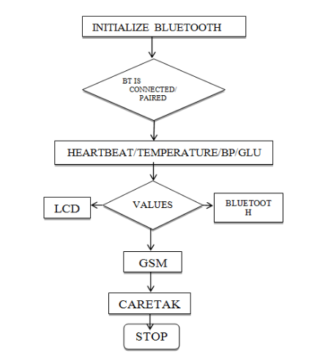
Architecture Diagram

Slide 10
SOFTWARE REQUIREMENTS:
Operating System : Windows 10
Platform : DOT NET TECHNOLOGY
Front End : ASP.Net 4.0
Back End : SQL SERVER 2014

Slide 11
HARDWARE REQUIREMENTS:
Keyboard
Mouse
Hard disk 500GB
Ram 4 Gb

Slide 12
REFERENCE
[1]Gowrishankar, S., M. Y. Prachita, and ArvindPrakash. "IoT based Heart Attack Detection, Heart Rate andTemperature Monitor.“
[2]Mallick, Bandana, and Ajit Kumar Patro. "Heart rate monitoring system using finger tip through arduino andprocessing software."International Journal of Science, Engineeringand Technology Research (IJSETR)5.1 (2016):84-89.
[3]Patel, Shivam, and Yogesh Chauhan. "Heart attack detection and medical attention using motion sensing device-kinect."International Journal of Scientific and Research Publications4.1 (2014).
[4]Aboobacker,Arith, Balamurugan, Deepak,Sathish“Heartbeat Sensing and Heart Attack Detection using Internet ofThings: IoT”International Journal of Engineering Science and Computing April 2017.
[5]Ajitha, U., et al. "IOT Based Heart Attack Detection and AlertSystem."International Journal of Engineering andManagement Research (IJEMR)7.2 (2017): 285-288.

Slide 13
[6]Manisha, Mamidi, et al. "Iot on heart attack detection and heart rate monitoring."International Journal of Innovationin Engineering and Technology (IJIET).
[7]Mayur, Suraj, Shubham, Nikhil “International Journal For Engineering Applications And Technology”.
[8]Yadav, Yashasavi, and Manasa Gowda. "Heart Rate Monitoring and Heart Attack Detection using WearableDevice."International Journal for technical researchand Application(2016).
[9]Ashrafuzzaman, Md, et al. "Heart attack detection using smart phone." International Journal Of TechnologyEnhancements And Emerging Engineering Research 1.2013 (2013): 23-27.
[10]https://store.arduino.cc/usa/arduino-uno-rev3

