Slide 1
Quaternary Logic Lookup Table in Standard CMOS

Slide 2
Abstract
Interconnections are increasingly the dominant contributor to delay, area and energy consumption in CMOS digital circuits. Multiple-valued logic can decrease the average power required for level transitions and reduces the number of required interconnections, hence also reducing the impact of interconnections on overall energy consumption. In this paper, we propose a quaternary lookup table (LUT) structure, designed to replace or complement binary LUTs in field programmable gate arrays. The circuit is compatible with standard CMOS processes, with a single voltage supply and employing only simple voltagemode structures. A clock boosting technique is used to optimize the switches resistance and power consumption. The proposed implementation overcomes several limitations found in previous quaternary implementations published so far, such as the need for special features in the CMOS process or power-hungry current-mode cells. We present a full adder prototype based on the designed LUT, fabricated in a standard 130-nm CMOS technology, able to work at 100 MHz while consuming 122 µW. The experimental results demonstrate the correct quaternary operation and confirm the power efficiency of the proposed design.

Slide 3
Existing System
To achieve this, existing synthesis tools will be analyzed to determine the most suited for this application. The chosen one will be examined to see what features and functionalities it provides and which are missing.
It will be extended with new functionalities with the purpose of overcoming existing gaps and perform the desired goal.
The existing network representation stored in the MVSIS framework has the same functionality, but does not have an accurate representation of the internal nodes.
This was the main deciding factor on which algorithm to use in this work since no previous tool existed and a base platform with the broadest compatibility is very important.

Slide 4
Disadvantage of Existing System
An approach to mitigate the impact of interconnections is to use multiple-valued logic (MVL), hence, more information can be carried in each wire, reducing the routing network.
However, a solution for this problem is to use an nMOS in series with N1, avoiding the drain-source voltage to be higher than VDD, in each transistor.
These drawbacks have prevented MVL from being competitive when compared with binary logic.
This decoder is based on voltage-mode self-referenced comparators that allows the use of a standard CMOS technology and overcomes previous design drawbacks.

Slide 5
PROPOSED SYSTEM :
The propose QLUT is made out of two block: 16-1 multiplier utilizing a variety of switches that sets up a low-resistance way between one setup input and the output as per the input esteems.
In the proposed method, here we use the direct technique to do the work in a single clock cycle.
The proposed design of half adder & full adder using quaternary logic has better function as compared to binary logic.
The proposed gates allow designing any MVL digital circuit taking advantage of the knowledge coming from the binary circuits.
Several MVL devices have been proposed and some are in use, such as memories, combinational circuits such as adders and multipliers, as well as programmable devices.

Slide 6
ADVANTAGE
We have to consider the pad, bonding wire, PCB wire and probe, which will degrade the performance of the real signal applied to the circuit.
The exposed limitations encourage the exploration of circuit and system-level techniques to achieve higher energy efficiency.
The proposed MVL LUT can replace or complement conventional binary logic, since the designed circuit is simple, efficient and we can combine both; i.e., they use the same implementation/fabrication technology.
However, in spite of these advantages, it is known that the use of MVL comes at the price of having relatively lower noise margin than the binary, therefore its use is commonly not trusted.

Slide 7
TITLE | AUTHOR | DESCRIPTION
Dynamic power consumption in virtex-II FPGA family | L. Shang, A. S. Kaviani, and K. Bathala, | This paper analyzes the dynamic power consumption in the fabric of Field Programmable Gate Arrays (FPGAs) by taking advantage of both simulation and measurement.
Multiple-valued logic in FPGAs | Z. Zilic and Z. Vranesic, | This paper considers the applicability of multiple-valued logic (MVL) circuits in implementation of field-programmable gate arrays (FPGAs).

Slide 8
TITLE | AUTHOR | DESCRIPTION
Multiple-valued logic buses for reducing bus energy in low-power systems | E. Ozer, R. Sendag, and D. Gregg, | This is followed by an empirical study conducted by running various applications to measure bus switching activities as well as total bus energy consumption of real-world applications.
CMOS voltage mode quaternary look-up tables for multi-valued FPGAs | R. da Silva, C. Lazzari, H. Boudinov, and L. Carro, | Their popularity stems from the fact that they can be reprogrammed to implement any function, with any amount of parallelism.

Slide 9
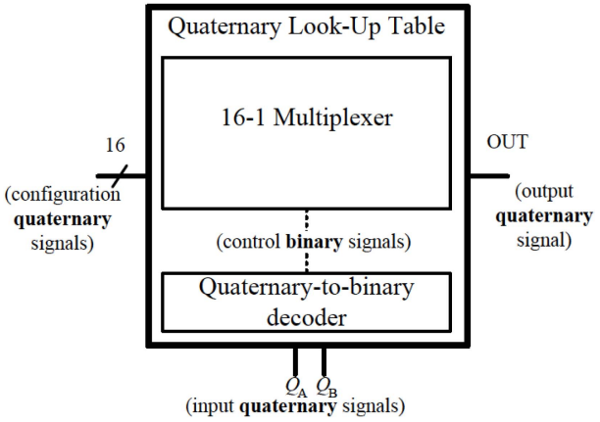
Block Diagram

Slide 10
SOFTWARE REQUIREMENTS:
Operating System : Windows 10
Platform : DOT NET TECHNOLOGY
Front End : ASP.Net 4.0
Back End : SQL SERVER 2014

Slide 11
HARDWARE REQUIREMENTS:
Keyboard
Mouse
Hard disk 500GB
Ram 4 Gb

Slide 12
CONCLUSION
In this paper, we have reported an innovative QLUT design that can be used for multiple valued combinational logic or as a building block in FPGAs. The QLUT internal functionality is implemented using simple standard CMOS structures. This feature is achieved through a quaternary-to-binary decoder that quantize the input signals. This decoder is based on voltage-mode self-referenced comparators that allows the use of a standard CMOS technology and overcomes previous design drawbacks. Also, a CB technique was used to decrease the switches resistance and increase the operation frequency, while at the same time, achieving low power consumption. Therefore, the presented design is a valid solution to reduce the interconnections impact, without increasing power consumption or losing performance. Experimental results were performed on an ASIC implementation of a full adder employing the designed QLUT. The obtained results attested the circuit feasibility and its advantages, using a standard CMOS process and its main characteristics (timing and power).

Slide 13
REFERENCE
[1] J. Rabaey, Low Power Design Essentials (Integrated Circuits and Systems). New York, NY, USA: Springer-Verlag, 2009.
[2] L. Shang, A. S. Kaviani, and K. Bathala, “Dynamic power consumption in virtex-II FPGA family,” in Proc. ACM/SIGDA Int. Symp. FieldProgram. Gate Arrays, 2002, pp. 157–164.
[3] Z. Zilic and Z. Vranesic, “Multiple-valued logic in FPGAs,” in Proc. Midwest Symp. Circuits Syst., 1993, pp. 1553–1556.
[4] E. Ozer, R. Sendag, and D. Gregg, “Multiple-valued logic buses for reducing bus energy in low-power systems,” IEE Comput. Digital Tech., vol. 153, no. 4, pp. 270–282, Jul. 2006.
[5] K. Current, “Current-mode CMOS multiple-valued logic circuits,” IEEE J. Solid-State Circuits, vol. 29, no. 2, pp. 95–107, Feb. 1994.

Slide 14
[6] J. Kim, “An area efficient multiplier using current-mode quaternary logic technique,” in Proc. 10th IEEE Int. Solid-State Integr. Circuit Technol., Nov. 2010, pp. 403–405.
[7] W. S. Chu and W. Current, “Current-mode CMOS quaternary multiplier circuit,” Electron. Lett., vol. 31, no. 4, pp. 267–268, 1995.
[8] R. da Silva, C. Lazzari, H. Boudinov, and L. Carro, “CMOS voltagemode quaternary look-up tables for multi-valued FPGAs,” Microelectron. J., vol. 40, no. 10, pp. 1466–1470, 2009.
[9] C. Lazzari, J. Fernandes, P. Flores, and J. Monteiro, “An efficient low power multiple-value look-up table targeting quaternary FPGAs,” in Integrated Circuit and System Design. Power and Timing Modeling, Optimization, and Simulation (Lecture Notes in Computer Science), R. van Leuken and G. Sicard, Eds., New York, NY, USA: Springer-Verlag, 2011, pp. 84–93.
[10] J. H. Anderson and F. N. Najm, “Power estimation techniques for FPGAs,” IEEE Trans. Very Large Scale Integr. (VLSI) Syst., vol. 12, no. 10, pp. 1015–1027, Oct. 2004.

