Slide 1
A Low-Power Architecture for the Design of a One-Dimensional Median Filter

Slide 2
Abstract
This brief presents a low-power architecture for the design of a one-dimension median filter. It is a word-level two-stage pipelined filter, receiving an input sample and generating a median output at each machine cycle. The power consumption is reduced by decreasing the number of signal transitions in the circuit. This can be done by keeping the stored samples immobile in the window through the use of a token ring in our architecture. The experimental results have shown that, at the expense of some additional area cost, the power consumption can be successfully reduced.

Slide 3
Existing System
When an input sample enters the window, the sorting of existing samples is reused in generating the new median output.
The proposed median filter offers comparable search performance, scalability and lower cost than existing median filter.
Short-circuit current exists during the transitions as one network is turned on and the other network is still active.
The delay increases significantly as the voltage approaches the threshold voltage and the capacitance load for routing and/or pipeline registers increases, there exists an optimal power supply voltage.

Slide 4
Disadvantage of Existing System
To conquer this problem, a new median filter architecture targeting low power consumption is proposed.
The main problem of the median filter is its high computational cost: the temporal complexity of sorting N values even with the most efficient sorting algorithms is O(N·log N).
The low power design problems can be broadly classified into two: analysis and optimization. Analysis problems are concerned about the accurate estimation of the power or energy dissipation at different phases of the design process.
But major criteria to be considered are the impact of circuit delay which affects throughput and performance of circuit.

Slide 5
PROPOSED SYSTEM :
A modified selective one dimensional median filter design is proposed in this work which is aimed at reducing the power consumption.
In this paper, an efficient design of median-filter hardware, capable of delivering the median value in real-time under stringent requirements on power is proposed.
A new word level one dimensional filter architecture is proposed, in which the new median output, with a filtering latency of only one clock cycle, is generated at each machine cycle for each incoming sample.
The improvement is achieved by performing the deletion and insertion of samples in one clock cycle, and a new control circuit is proposed to govern these two operations.

Slide 6
ADVANTAGE
A median filter is a nonlinear filter widely used in digital signal and image processing for the smoothing of signals, suppression of impulse noise, and edge preservation.
The performance of imaging sensors is affected by a variety of factors, such as environmental conditions during image acquisition and by the quality of sensing elements themselves.
There is great interest in understanding how to continue increasing performance without increasing the power dissipation.
With the advent of internet technology and the stupendous growth of multimedia technologies, the design of power efficient real time image and video processing hardware has become a great challenge to designers and researchers.

Slide 7
TITLE | AUTHOR | DESCRIPTION
Fast median calculation method | J. Cadenas, G. M. Megson, R. S. Sherratt, and P. Huerta, | The ever increasing demand for high image quality requires fast and efficient methods for noise reduction. The best-known order-statistics filter is the median filter.
Robust interfaces for mixed-timing systems | T. Chelcea and S. M. Nowick, | This paper presents several low-latency mixed-timing FIFO (first-in-first-out) interfaces designs that interface systems on a chip working at different speeds.

Slide 8
TITLE | AUTHOR | DESCRIPTION
Minimization of switching activities of partial products for designing low-power multipliers | O. T.-C. Chen, S. Wang, and Y.-W. Wu, | This work presents low-power 2's complement multipliers by minimizing the switching activities of partial products using the radix-4 Booth algorithm.
Design of an area-efficient one dimensional median filter | R.-D. Chen, P.-Y. Chen, and C.-H. Yeh, | It is a word-level filter, storing the samples in the window in descending order according to their values.

Slide 9
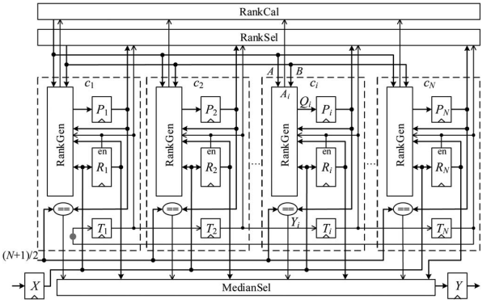
Block Diagram

Slide 10
SOFTWARE REQUIREMENTS:
Operating System : Windows 10
Platform : DOT NET TECHNOLOGY
Front End : ASP.Net 4.0
Back End : SQL SERVER 2014

Slide 11
HARDWARE REQUIREMENTS:
Keyboard
Mouse
Hard disk 500GB
Ram 4 Gb

Slide 12
CONCLUSION
A low-power architecture for the design of a 1-D median filter has been proposed in this brief. The power saving is achieved by adopting a token ring in our design, where the stored samples are kept immobile; only the rank of each sample has to be updated at each new cycle. As can be seen from the experimental results, the power consumption for median filters in practical use has been successfully reduced at the expense of some area overhead.

Slide 13
REFERENCE
[1] J. Cadenas, G. M. Megson, R. S. Sherratt, and P. Huerta, “Fast median calculation method,” Electron. Lett., vol. 48, no. 10, pp. 558–560, May 2012.
[2] T. Chelcea and S. M. Nowick, “Robust interfaces for mixed-timing systems,” IEEE Trans. Very Large Scale Integr. (VLSI) Syst., vol. 12, no. 8, pp. 857–873, Aug. 2004.
[3] O. T.-C. Chen, S. Wang, and Y.-W. Wu, “Minimization of switching activities of partial products for designing low-power multipliers,” IEEE Trans. Very Large Scale Integr. (VLSI) Syst., vol. 11, no. 3, pp. 418–433, Jun. 2003.
[4] R.-D. Chen, P.-Y. Chen, and C.-H. Yeh, “Design of an area-efficient onedimensional median filter,” IEEE Trans. Circuits Syst. II, Exp. Briefs, vol. 60, no. 10, pp. 662–666, Oct. 2013.
[5] C. Choo and P. Verma, “A real-time bit-serial rank filter implementation using Xilinx FPGA,” in Proc. SPIE Real-Time Image Process., 2008, vol. 6811, pp. 68110F-1–68110F-8.

Slide 14
[6] S. A. Fahmy, P. Y. K. Cheung, and W. Luk, “High-throughput onedimensional median and weighted median filters on FPGA,” IET Comput. Digit. Tech., vol. 3, no. 4, pp. 384–394, Jul. 2009.
[7] I. M. Panades and A. Greiner, “Bi-synchronous FIFO for synchronous circuit communication well suited for network-on-chip in GALS architectures,” in Proc. 1st Int. Symp. NOCS, 2007, pp. 83–94.
[8] V. G. Moshnyaga and K. Hashimoto, “An efficient implementation of 1-D median filter,” in Proc. 52nd IEEE Int. MWSCAS, 2009, pp. 451–454.
[9] M. Mottaghi-Dastjerdi, A. Afzali-Kusha, and M. Pedram, “BZ-FAD: A low-power low-area multiplier based on shift-and-add architecture,” IEEE Trans. Very Large Scale Integr. (VLSI) Syst., vol. 17, no. 2, pp. 302–306, Feb. 2009.
[10] D. Prokin and M. Prokin, “Low hardware complexity pipelined rank filter,” IEEE Trans. Circuits Syst. II, Exp. Briefs, vol. 57, no. 6, pp. 446– 450, Jun. 2010.

