Slide 1
Algorithm and Architecture for a Low-Power Content-Addressable Memory Based on Sparse Clustered Networks

Slide 2
Abstract
We propose a low-power Content-Addressable Memory (CAM) employing a new algorithm for associativity between the input tag and the corresponding address of the output data. The proposed architecture is based on a recently developed sparse clustered-network using binary connections that onaverage eliminates most of the parallel comparisons performed during a search. Therefore, the dynamic energy consumption of the proposed design is significantly lower compared to that of a conventional low-power CAM design. Given an input tag, the proposed architecture computes a few possibilities for the location of the matched tag and performs the comparisons on them to locate a single valid match. TSMC 65 nm CMOS technology was used for simulation purposes. Following a selection of design parameters such as the number of CAM entries, the energy consumption and the search delay of the proposed design are 8%, and 26% of that of the conventional NAND architecture respectively with a 10% area overhead. A design methodology based on the silicon-area and power budgets, and performance requirements is discussed.

Slide 3
Existing System
Once a search data word is applied to the input of a Content Addressable Memory, the matching data word is retrieved within a single clock cycle if it exists.
There exists at least one active connection from each cluster in P2 toward a neuron in P2, that neuron is activated.
Although dynamic CMOS circuit techniques can result in low-power and low-cost CAM’s, these designs can suffer from low noise margins, charge sharing, and other problems not to be energy efficient when scaled.
Thus a new family of associative memories based on SCNs has been recently introduced and implemented using field-programmable gate arrays (FPGAs).

Slide 4
Disadvantage of Existing System
The drawback of this architecture is that the banks can overflow since the length of the words remains the same for all the banks.
Although dynamic CMOS circuit techniques can result in low-power and low-cost CAMs, these designs can suffer from low noise-margins, charge sharing and other problems.
Although a NAND-type CAM has the advantage of lower energy consumption compared to that of the NOR-type counterpart, it has two drawbacks: a quadratic delay dependence on the number of cells due to the serial pull-down path, and a low noise margin.
A drawback of such methods, unlike SCN-CAM, is that as the length of the tags is increased, the cycle time and the circuit complexity of the pre-computation stage is dramatically increased.

Slide 5
PROPOSED SYSTEM :
The dynamic energy consumption of the proposed design is significantly lower compared with that of other conventional low-power Content Addressable Memory design.
To overcome this, novel hierarchical priority encoder architecture suitable for high-density CAM was proposed.
A high-performance AND-type match-line scheme is proposed in, where multiple fan-in AND gates are used for low switching activity along with segmented style match-line evaluation to reduce the energy consumption.
In the proposed design, we demonstrate how it is possible to reduce the number of comparisons to only N bits.

Slide 6
ADVANTAGE
In this paper, an extended version is presented that elaborates the effect of the design’s degrees of freedom, and the effect of non-uniformity of the input patterns on energy consumption and the performance.
The MLs are highly capacitive, a sense amplifier is typically considered for each ML to increase the performance of the search operation.
A high-performance AND-type match-line scheme is proposed in where multiple-fan-in AND-gates are used for low switching activity along with segmented-style match-line evaluation to reduce the energy consumption.
In SCN-CAM, we use the NOR-type CAM structure, in order to to take advantage of its better noise margin and the low latency, compared to the NAND-type counterpart.

Slide 7
TITLE | AUTHOR | DESCRIPTION
A 128x128b high-speed wide-AND match-line content addressable memory in 32nm CMOS | A. Agarwal, S. Hsu, S. Mathew, M. Anders, H. Kaul, F. Sheikh, and R. Krishnamurthy, | A 128-entry × 128b content addressable memory (CAM) design enables 145ps search operation in 1.0V, 32nm high-k metal-gate CMOS technology.
Two new techniques integrated for energy efficient TLB design | Y.-J. Chang and M.-F. Lan, | In our design, we first propose a real-time filter scheme to facilitate the block buffering to eliminate the redundant TLB accesses without comparator delay.

Slide 8
TITLE | AUTHOR | DESCRIPTION
Next generation routers | H. Chao, | This paper first points out the issues of building such routers, such as memory speed constraint, packet arbitration bottleneck, and interconnection complexity.
Design of multi-field IPv6 packet classifiers using ternary CAMs | N.-F. Huang, W.-E. Chen, J.-Y. Luo, and J.-M. Chen, | Several packet classification algorithms to accelerate packet processing and reduce the memory requirement have been proposed.

Slide 9
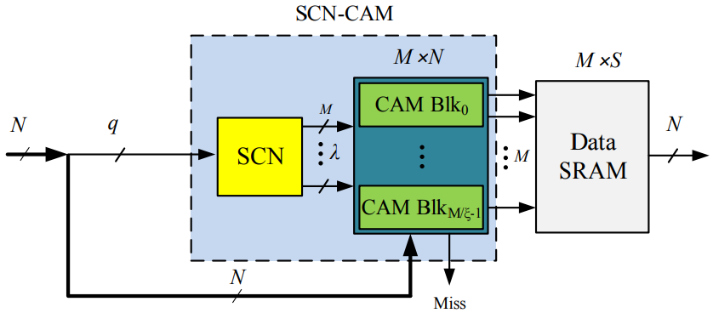
Block Diagram

Slide 10
SOFTWARE REQUIREMENTS:
Operating System : Windows 10
Platform : DOT NET TECHNOLOGY
Front End : ASP.Net 4.0
Back End : SQL SERVER 2014

Slide 11
HARDWARE REQUIREMENTS:
Keyboard
Mouse
Hard disk 500GB
Ram 4 Gb

Slide 12
CONCLUSION
In this paper, the algorithm and the architecture of a lowpower Content-Addressable Memory (CAM) is introduced. The proposed architecture (SCN-CAM) employs a novel associativity mechanism based on a recently-developed family of associative memories based on sparse clustered networks (SCNs). SCN-CAM is suitable for low-power applications, where frequent and parallel look-up operations are required. SCNCAM employs an SCN-based classifier, which is connected to several independently-compare-enabled CAM sub-blocks, some of which are enabled once a tag is presented to the SCNbased classifier. By using independent nodes in the output part of SCN-CAM’s training network, simple and fast updates can be achieved without retraining the network entirely. With optimized lengths of the reduced-length tags, SCN-CAM eliminates most of the comparison operations given a uniform distribution of the reduced-length inputs. Depending on the application, non-uniform inputs may result in higher power consumptions, but does not affect the accuracy of the final result. In other words, a few false-positives may be generated by the SCN-based classifier, which are then filtered by the enabled CAM sub-blocks. Therefore. no false-negatives are ever generated. Conventional NAND-type and NOR-type architectures were also implemented in the same process technology to compare SCN-CAM against, along with other recently-developed CAM architectures. It has been estimated that for a case-study design parameter, the energy consumption and the cycle time of SCN-CAM are 8.02%, and 28.6% of that of the conventional NAND-type architecture respectively with a 10.1% area overhead. Future work includes investigating sparse compression techniques for the matrix storing the connections in order to further reduce the area overhead.

Slide 13
REFERENCE
[1] A. Agarwal, S. Hsu, S. Mathew, M. Anders, H. Kaul, F. Sheikh, and R. Krishnamurthy, “A 128x128b high-speed wide-AND match-line content addressable memory in 32nm CMOS,” in 2011 Proceedings of the ESSCIRC (ESSCIRC), Sep. 2011, pp. 83–86.
[2] Y.-J. Chang and M.-F. Lan, “Two new techniques integrated for energyefficient TLB design,” IEEE Transactions on Very Large Scale Integration (VLSI) Systems, vol. 15, no. 1, pp. 13–23, Jan. 2007.
[3] H. Chao, “Next generation routers,” Proceedings of the IEEE, vol. 90, no. 9, pp. 1518–1558, Sep. 2002.
[4] N.-F. Huang, W.-E. Chen, J.-Y. Luo, and J.-M. Chen, “Design of multi-field IPv6 packet classifiers using ternary CAMs,” in Global Telecommunications Conference (GLOBECOM), vol. 3, 2001, pp. 1877– 1881.
[5] M. Meribout, T. Ogura, and M. Nakanishi, “On using the CAM concept for parametric curve extraction,” IEEE Transactions on Image Processing, vol. 9, no. 12, pp. 2126 – 2130, Dec. 2000.

Slide 14
[6] M. Nakanishi and T. Ogura, “A real-time CAM-based hough transform algorithm and its performance evaluation,” in Pattern Recognition, 1996., Proceedings of the 13th International Conference on, vol. 2, Aug. 1996, pp. 516–521 vol.2.
[7] L.-Y. Liu, J.-F. Wang, R.-J. Wang, and J.-Y. Lee, “CAM-based VLSI architectures for dynamic Huffman coding,” IEEE Transactions on Consumer Electronics, vol. 40, no. 3, pp. 282 –289, aug 1994.
[8] C.-C. Wang, C.-J. Cheng, T.-F. Chen, and J.-S. Wang, “An adaptively dividable dual-port BiTCAM for virus-detection processors in mobile devices,” IEEE Journal of Solid-State Circuits, vol. 44, no. 5, pp. 1571 –1581, May 2009.
[9] B. Wei, R. Tarver, J.-S. Kim, and K. Ng, “A single chip lempel-ziv data compressor,” in IEEE International Symposium on Circuits and Systems (ISCAS), May 1993, pp. 1953–1955.
[10] S. Panchanathan and M. Goldberg, “A content-addressable memory architecture for image coding using vector quantization,” IEEE Transactions on Signal Processing, vol. 39, no. 9, pp. 2066–2078, Sep. 1991.

