Slide 1
Seizure Prediction using Hilbert Huang Transform on Field Programmable Gate Array

Slide 2
Abstract
The Hilbert Huang Transform (HHT) has been used extensively in the time-frequency analysis of electroencephalography (EEG) signals and Brain-Computer Interfaces. Most studies utilizing the HHT for extracting features in seizure prediction have used intracranial EEG recordings. Invasive implants in the cortex have unknown long term consequences and pose the risk of complications during surgery. This added risk dimension makes them unsuitable for continuous monitoring as would be the requirement in a Body Area Network. We present an HHTbased system on Field Programmable Gate Array (FPGA) for predicting epileptic seizures using scalp EEG. We use bandwidth features of Intrinsic Mode Functions and obtain a classification accuracy of close to 100% using patient-specific classifiers in software. Details of FPGA implementation are also given.

Slide 3
Existing System
It is prospective to replace the existing bulk-optical EOM with photonic integrated chips, where sophisticated and tailored nonlinear transformations can be realized using nested optical circuits on a single chip.
It takes advantage of electro-optic nonlinear transformation in EOM, and flexible signal generation and controllable timing, highly programmable signal filtering, and stable delay logic implementation in FPGA.
However, such training is usually energy and time consuming, and its efficiency varies by the complexity of task, the size of the network, the nonlinearity and connectivity between the nodes.

Slide 4
Disadvantage of Existing System
The detection of seizures using binary classifiers to distinguish between different EEG-based features in the ictal and interictal periods may be considered a largely solved problem.
Despite many promising Brain-Computer Interfaces (BCIs) being proposed in the literature, most have been implemented in software and remain confined to research laboratories - the necessity of a bulky computer being one of the primary drawbacks in bringing them to the everyday user.
With more and more problems being identified as computationally complex and/or excessively time consuming, alternative computational paradigms are actively explored to solve these problems as they increasingly emerge.

Slide 5
PROPOSED SYSTEM :
This work proposes an efficient approach to extract the features of epileptic seizures by decomposing EEG into band limited signals termed as IMF’s by empirical decomposition EMD.
For detecting and classifying epileptic seizures various time-frequency methods have been proposed most importantly the wavelet transform and all these are non- stationary methods.
The proposed technique provides a tool for neuro physicians for identifying brain abnormalities due to epilepsy and also can also be developed as ASIC.
The proposed technique essentially provides benefits like fast diagnosis, high accuracy with good sensitivity and specificity.

Slide 6
ADVANTAGE
The HHT has been a popular tool used in the study of EEG with its ability to analyze both nonlinear and non-stationary biomedical signals by decomposing them into data-dependent basis functions.
A bandpass FIR filter with cutoffs set to 0.5 Hz and 100 Hz and a 60 Hz notch filter were used at the preprocessing stage to remove baseline wander and suppress powerline noise.
The design utilizes sawtooth interpolation instead of the cubic spline interpolation used in software in order to facilitate continuously processing incoming data.
An Snumber termination criteria is used instead of the conventional convergence criteria involving the number of zero crossings and the number of local extrema of the signal.

Slide 7
TITLE | AUTHOR | DESCRIPTION
Seizure prediction: the long and winding road | F. Mormann, R. G. Andrzejak, C. E. Elger, and K. Lehnertz, | A method capable of predicting the occurrence of seizures from the electroencephalogram (EEG) of epilepsy patients would open new therapeutic possibilities.
Seizure prediction using EEG spatiotemporal correlation structure | J. R. Williamson, D. W. Bliss, D. W. Browne, and J. T. Narayanan, | A seizure prediction algorithm is proposed that combines novel multivariate EEG features with patient-specific machine learning.

Slide 8
TITLE | AUTHOR | DESCRIPTION
Real-time epileptic seizure prediction using AR models and Support Vector Machines | L. Chisci, A. Mavino, G. Perferi, M. Sciandrone, C. Anile, G. Colicchio, and F. Fuggetta, | This choice is characterized by low computational requirements compatible with a real-time implementation of the overall system.
Epileptic seizure prediction by using Empirical Mode Decomposition and complexity analysis of singlechannel scalp electroencephalogram | T. Zhu, L. Huang, and X. Tian, | This paper presents a new approach to recognize and predict succedent epileptic seizures by using single-channel electroencephalogram (EEG) analysis.

Slide 9
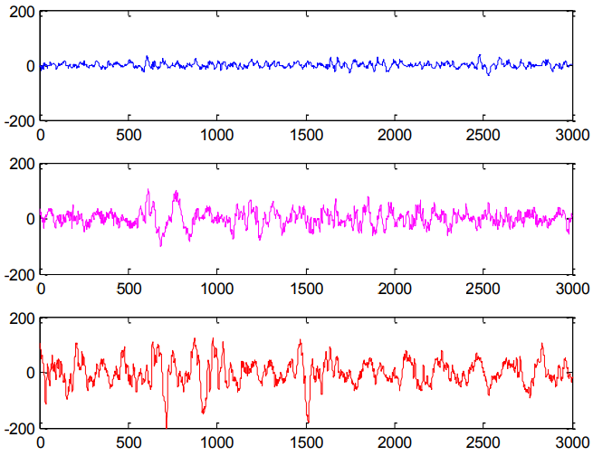
Block Diagram

Slide 10
SOFTWARE REQUIREMENTS:
Operating System : Windows 10
Platform : DOT NET TECHNOLOGY
Front End : ASP.Net 4.0
Back End : SQL SERVER 2014

Slide 11
HARDWARE REQUIREMENTS:
Keyboard
Mouse
Hard disk 500GB
Ram 4 Gb

Slide 12
CONCLUSION
The HHT has been utilized in a number of BCI applications due to its ability to analyze non-linear and non-stationary signals. Most studies where it has been used for feature extraction in predicting oncoming epileptic seizures have made use of iEEG and few have utilized scalp EEG. However, the long term side effects of implantable chips for EEG acquisition are unknown and can cause scar tissue to develop around the devices reducing contact with neuron populations and thereby rendering them ineffective. We present the FPGA implementation of a scalp EEG-based seizure prediction system using bandwidth features extracted from different IMFs. Good classification accuracy has been obtained using patientspecific classifiers. Future efforts would include optimizing the design even further by reusing hardware resources due to the availability of a large number of clock cycles in between the reception of successive epochs of EEG. Implementing EMD using cubic spline interpolation would also help increase the accuracy of the proposed system.

Slide 13
REFERENCE
[1] F. Mormann, R. G. Andrzejak, C. E. Elger, and K. Lehnertz, “Seizure prediction: the long and winding road,” Brain, vol. 130, no. 2, pp. 314– 333, 2007.
[2] J. R. Williamson, D. W. Bliss, D. W. Browne, and J. T. Narayanan, “Seizure prediction using EEG spatiotemporal correlation structure,” Epilepsy & Behavior, vol. 25, pp. 230–238, 2012.
[3] J. C. Sackellares, “Seizure prediction,” Epilepsy Currents, vol. 8, no. 3, pp. 55–59, 2008.
[4] L. Chisci, A. Mavino, G. Perferi, M. Sciandrone, C. Anile, G. Colicchio, and F. Fuggetta, “Real-time epileptic seizure prediction using AR models and Support Vector Machines,” IEEE Trans. Biomed. Eng., vol. 57, pp. 1124–1132, May 2010.
[5] T. Zhu, L. Huang, and X. Tian, “Epileptic seizure prediction by using Empirical Mode Decomposition and complexity analysis of singlechannel scalp electroencephalogram,” in 2nd International Conference on Biomedical Engineering and Informatics, pp. 1–4, Oct 2009.

Slide 14
[6] N. Ozdemir and E. Yildirim, “Epileptic seizure prediction based on Hilbert Huang transform and artificial neural networks,” in 20th Signal Processing and Communications Applications Conference, pp. 1–4, April 2012.
[7] F. Duman, N. Ozdemir, and E. Yildirim, “Patient specific seizure prediction algorithm using Hilbert-Huang transform,” in IEEE-EMBS International Conference on Biomedical and Health Informatics, pp. 705– 708, Jan 2012.
[8] N. Ozdemir and E. Yildrim, “Patient specific seizure prediction system using Hilbert spectrum and Bayesian networks classifiers,” Computational and Mathematical Methods in Medicine, vol. 2014, pp. 1–10, August 2014.
[9] M. Z. Parvez, M. Paul, and M. Antolovich, “Detection of pre-stage of epileptic seizure by exploiting temporal correlation of EMD decomposed EEG signals,” Journal of Medical and Bioengineering, vol. 4, pp. 110– 116, Apr 2015.
[10] V. Bajaj and R. Pachori, “Classification of seizure and nonseizure EEG signals using Empirical Mode Decomposition,” IEEE Trans. Inf. Technol. Biomed., vol. 16, pp. 1135–1142, Nov 2012.

