Slide 1
Graph-Based Transistor Network Generation Method for Super gate Design

Slide 2
Abstract
Transistor network optimization represents an effective way of improving VLSI circuits. This paper proposes a novel method to automatically generate networks with minimal transistor count, starting from an irredundant sum-of-products expression as the input. The method is able to deliver both series–parallel (SP) and non-SP switch arrangements, improving speed, power dissipation, and area of CMOS gates. Experimental results demonstrate expected gains in comparison with related approaches.

Slide 3
Existing System
Existing graph-based methods, in turn, are able to provide the NSP solution, also with seven transistors.
However, there exist efficient heuristics to deal with the problem and to obtain acceptable orders in a reasonable CPU execution time.
All new transistors created during the duplications can be stored in the existing transistor list and no new structure is necessary to keep the modifications.
The existence of parasite elements (capacitances and resistances) impacts directly in the electrical signal propagation on the circuits.
A transient on input signal, there will be a period in which both NMOS and PMOS transistor will conduct simultaneously, causing a current flow through the direct path existing between power supply and ground terminals.

Slide 4
Disadvantage of Existing System
There are other parameters that impact circuit quality such as transistor sizing, layout compaction, and waveform of input stimuli.
The drawback for generating this kind of network is that complementary series/parallel operations cannot be used to obtain the dual plane, since there are some transistors that are neither in series nor in parallel with others.
The disadvantages of fullcustom can include increased manufacturing and design time, and much higher skill requirements on the part of the design team.
The disadvantage is that the constrained nature of the library, especially due to the limited number of cells, reduces the possibility of finetuning the design

Slide 5
PROPOSED SYSTEM :
The proposed method starts from a sum-of products (SOP) form F and produces a reduced transistor network.
The Vdd/Gnd and Output nodes are kept as special vertices (this information is necessary in the proposed algorithm).
It is important to notice that the solution proposed here does not generate transistor networks from an equation description, as it is done in state-of-the-art transistor networks generation methods.
The work proposed here concentrate at the cell level, and investigates more efficient area and delay methods to optimize transistor networks taking into account the length of chains and the overall transistor counts.

Slide 6
ADVANTAGE
In this sense, one can consider the bounded solution when targeting performance or the unbounded solution for smaller area.
Therefore, efficient algorithms to automatically generate optimized transistor networks are quite useful for designing digital integrated circuits (ICs).
Even though previous steps are very efficient in finding logic sharing, there may still cubes not represented through any of the found networks.
Switch based technologies, such as CMOS, FinFET, and carbon nanotubes, can take advantage of such an improvement.
The nMOS transistor width is 64 nm while the pMOS transistor width is defined using the PN ratio equals to two, in the inverter gate used as reference for the logical effort method.

Slide 7
TITLE | AUTHOR | DESCRIPTION
BDD decomposition for mixed CMOS/PTL logic circuit synthesis | Y.-T. Lai, Y.-C. Jiang, and H.-M. Chu, | In this paper, we propose a technique to construct a BDD whose nodes can be implemented by CMOS logic and pass-transistor logic (PTL) in a cell library.
Accurate total static leakage current estimation in transistor stacks | H. Al-Hertani, D. Al-Khalili, and C. Rozon, | In the estimation phase, unit width GIDL and gate tunneling are estimated deterministically while subthreshold leakage is estimated using the pre-extracted data.

Slide 8
TITLE | AUTHOR | DESCRIPTION
Design and synthesis of dynamic circuits | T. J. Thorp, G. S. Yee, and C. M. Sechen, | Dynamic circuits are widely used in today's high-performance microprocessors for obtaining timing goals that are not possible using static CMOS circuits.
Transistor-level optimization of digital designs with flex cells | R. Roy, D. Bhattacharya, and V. Boppana, | The quest to overcome the limitations of standard-cell-based design methods leads naturally to the creation of new design- and context-specific cells-designated flex cells-during the process of optimizing a given digital design.

Slide 9
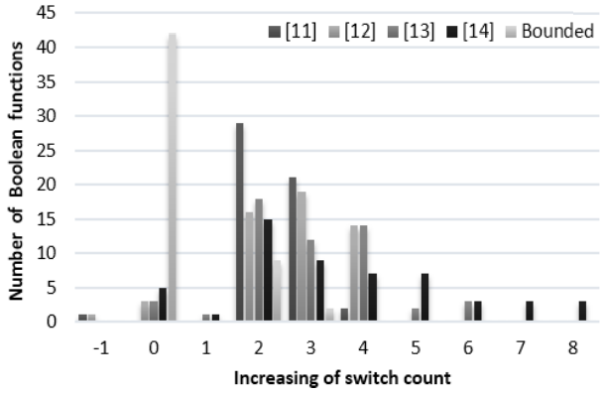
Block Diagram

Slide 10
SOFTWARE REQUIREMENTS:
Operating System : Windows 10
Platform : DOT NET TECHNOLOGY
Front End : ASP.Net 4.0
Back End : SQL SERVER 2014

Slide 11
HARDWARE REQUIREMENTS:
Keyboard
Mouse
Hard disk 500GB
Ram 4 Gb

Slide 12
CONCLUSION
This paper described an efficient graph-based method to generate optimized transistor (switch) networks. Our approach generates more general arrangements than the usual SP associations. Experimental results demonstrated a significant reduction in the number of transistor needed to implement logic networks, when compared with the ones generated by existing related approaches. It is known that the transistor count minimization in CMOS gates may improve the performance, power dissipation, and area of digital ICs. In a general point-of-view, the proposed method produces efficient switch arrangements quite useful to be explored by different IC technologies based on switch theory.

Slide 13
REFERENCE
[1] Y.-T. Lai, Y.-C. Jiang, and H.-M. Chu, “BDD decomposition for mixed CMOS/PTL logic circuit synthesis,” in Proc. IEEE Int. Symp. Circuits Syst. (ISCAS), vol. 6. May 2005, pp. 5649–5652.
[2] H. Al-Hertani, D. Al-Khalili, and C. Rozon, “Accurate total static leakage current estimation in transistor stacks,” in Proc. IEEE Int. Conf. Comput. Syst. Appl., Mar. 2006, pp. 262–265.
[3] T. J. Thorp, G. S. Yee, and C. M. Sechen, “Design and synthesis of dynamic circuits,” IEEE Trans. Very Large Scale Integr. (VLSI) Syst., vol. 11, no. 1, pp. 141–149, Feb. 2003.
[4] A. I. Reis and O. C. Andersen, “Library sizing,” U.S. Patent 8 015 517, Jun. 5, 2009.
[5] R. Roy, D. Bhattacharya, and V. Boppana, “Transistor-level optimization of digital designs with flex cells,” Computer, vol. 38, no. 2, pp. 53–61, Feb. 2005.

Slide 14
[6] M. Rostami and K. Mohanram, “Dual-vth independent-gate FinFETs for low power logic circuits,” IEEE Trans. Comput.-Aided Design Integr. Circuits Syst., vol. 30, no. 3, pp. 337–349, Mar. 2011.
[7] M. H. Ben-Jamaa, K. Mohanram, and G. De Micheli, “An efficient gate library for ambipolar CNTFET logic,” IEEE Trans. Comput.-Aided Design Integr. Circuits Syst., vol. 30, no. 2, pp. 242–255, Feb. 2011.
[8] M. C. Golumbic, A. Mintz, and U. Rotics, “An improvement on the complexity of factoring read-once Boolean functions,” Discrete Appl. Math., vol. 156, no. 10, pp. 1633–1636, May 2008.
[9] E. M. Sentovich et al., “SIS: A system for sequential circuit synthesis,” Dept. Elect. Eng. Comput. Sci., Univ. California, Berkeley, Berkeley, CA, USA, Tech. Rep. UCB/ERL M92/41, May 1992.
[10] M. G. A. Martins, V. Callegaro, L. Machado, R. P. Ribas, and A. I. Reis, “Functional composition and applications,” in Int. Workshop Logic Synthesis Tech. Dig. (IWLS), Jun. 2012, pp. 1–8. [Online]. Available: http://www.inf.ufrgs.br/logics/

