Slide 1
A High-Performance FIR Filter Architecture for Fixed and Reconfigurable Applications

Slide 2
Abstract
Transpose-form finite impulse response (FIR) structures are inherently pipelined and support multiple constant multiplication (MCM) results in significant saving of computation. However, transpose-form configuration does not directly support the block processing unlike direct-form configuration. In this paper, we explore the possibility of realization of block FIR filter in transpose-from configuration for area-delay efficient realization of large order FIR filters for both fixed and reconfigurable applications. Based on detail computational analysis of transpose-form configuration of FIR filter we have derived a flowgraph for transpose-from block FIR filter with optimized register complexity. A generalized block formulation is presented for transpose-from FIR filter. We have derived a general multiplierbased architecture for the proposed transpose-form block filter for reconfigurable applications. A low-complexity design using MCM scheme is also presented for the block implementation of fixed FIR filters.

Slide 3
Performance comparison shows that the proposed structure involves significantly less area-delay product (ADP) and less energy per sample (EPS) than the existing block direct-form structure for medium or large filter lengths while for the short-length filters, the existing block direct-form FIR structure has less ADP and less EPS than the proposed structure. ASIC synthesis result shows that the proposed structure for block-size 4 and filter-length 64 involve 42% less ADP and 40% less EPS than the best available FIR structure proposed for reconfigurable applications. For the same filter length and the same block size, the proposed structure involves 13% less ADP and 12.8% less EPS than that of the existing direct-from block FIR structure. Based on these findings, we present a scheme for the selection of direct-form and transpose-form configuration based on the filter lengths and block-length for obtaining areadelay and energy efficient block FIR structures.

Slide 4
Existing System
In the existing method, the possibility of realization of FIR filter in transpose form configuration to achieve efficient area and delay for large order FIR filters were explored.
The proposed structure significantly reduces the area delay product (ADP) and energy per sample (EPS) than the existing FIR structure.
In the existing method, the implementation of direct-form structure has less area delay product (ADP) and less energy per sample (EPS) for the short-length filters.
The proposed structure has the best results in the reduction of number of slices, LUTs, power consumption, area delay product, energy per sample than the existing method for higher order FIR filter.

Slide 5
Disadvantage of Existing System
Element usage is high
Cycle period is high
We've offered a procedure to find out the MCM blocks for horizontal and vertical sub expression elimination inside the proposed block FIR filter for constant coefficients to minimize the computational problem.

Slide 6
PROPOSED SYSTEM :
The proposed form involves substantially a low area delay product (ADP) and much low energy per sample (EPS) than the prevailing block implementation of direct shape for average or large filters, at the same time as for the small filters, the block implementation of direct shape has less ADP and much less EPS compared to the proposed form.
The layout techniques proposed are extra appropriate for two-d fir filters and block least imply square adaptive filters.
In this proposed method, the carry look ahead adder is used to increase the speed and also to reduce the area and power consumption.

Slide 7
ADVANTAGE
The area-delay performance of the proposed structure is found better than that of direct-form structure of for higher filter lengths due to smaller cycle period.
Filter coefficients very often remain constant and known a priori in signal processing applications.
Several designs have been suggested by various researchers for efficient realization of FIR filters (having fixed coefficients) using distributed arithmetic (DA) and multiple constant multiplication (MCM) methods.
In this paper we explore the possibility of realization of block FIR filter in transpose-from configuration in order to take advantage of the MCM schemes and the inherent pipelining for area-delay efficient realization of large order FIR filters for both fixed and reconfigurable applications.

Slide 8
TITLE | AUTHOR | DESCRIPTION
A new adaptive noise cancellation scheme in the presence of crosstalk [speech signals] | E. Mirchandani, R. L. Zinser Jr., and J. B. Evans, | A new adaptive filter structure is introduced that permits a closer placement of the transducers and that allows the cancellation of noise in the presence of crosstalk.
Design of a high-order FIR digital filtering and variable gain ranging seismic data acquisition system | D. Xu and J. Chiu, | The noise in the digitized seismic signal is filtered by a high-order finite impulse response (FIR) digital filter implemented in the microcomputer system.

Slide 9
TITLE | AUTHOR | DESCRIPTION
Low power and high speed implementation of FIR filters for software defined radio receivers | A. P. Vinod and E. M-K. Lai, | The most computationally intensive part of the wideband receiver of a software defined radio (SDR) is the intermediate frequency (IF) processing block. Digital filtering is the main task in IF processing.
Comparison of programmable FIR filter architectures for low power | T. Solla and O. Vainio, | The designs include a fully programmable MAC-based filter processor, and dedicated architectures where the filter coefficients can either be stored in registers or are fixed before synthesis.

Slide 10
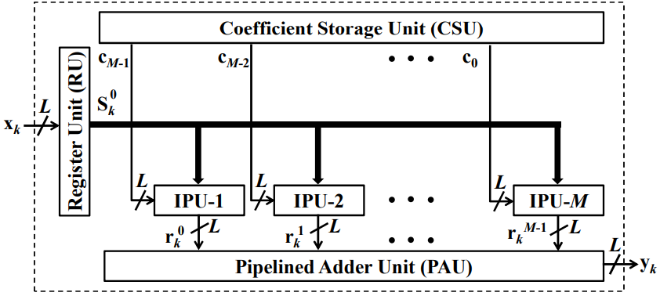
Block Diagram

Slide 11
SOFTWARE REQUIREMENTS:
Operating System : Windows 10
Platform : DOT NET TECHNOLOGY
Front End : ASP.Net 4.0
Back End : SQL SERVER 2014

Slide 12
HARDWARE REQUIREMENTS:
Keyboard
Mouse
Hard disk 500GB
Ram 4 Gb

Slide 13
CONCLUSION
Transpose-form structures are inherently pipelined and supports MCM which results significant saving in computation and increase in higher sampling rate. However, transposeform configuration does not directly support the block processing. In this paper, we have explored the possibility of realization of block FIR filter in transpose-from configuration for area-delay efficient realization of large order FIR filters for both fixed and reconfigurable applications. We have made computational analysis of transpose-form configuration of FIR filter and derived a flow-graph for transpose-from block FIR filter with optimized register complexity. A generalized block formulation is also presented for transpose-from block FIR filter. Based on that we have derived transpose-form block filter for reconfigurable applications. We have presented the scheme to identify the MCM blocks explored the horizontal and vertical sub-expression elimination for the implementation of the proposed block FIR structure for fixed coefficients to reduce the computational complexity.

Slide 14
A low-complexity design method using MCM scheme is also presented for the block implementation of fixed FIR filters. Performance comparison shows that the proposed structure involve significantly less ADP and less EPS than the existing block direct-form structure for medium or large filter lengths while for the short-length filters, the existing block direct-form FIR structure has less ADP and less EPS than the proposed structure. ASIC synthesis result shows that the proposed structure for block-size 4 and filter-length 64 involve 42% less ADP and 40% less EPS than the best available FIR structure of for reconfigurable applications. For the same filter length and block size, the proposed structure involves 13% less ADP and 12.8% less EPS than that of the existing direct-from block FIR structure of. Based on these findings, selection of direct-form and transpose-form configuration based on the filter lengths and block-length is suggested for obtaining area-delay and energy efficient structures for block FIR filters.

Slide 15
REFERENCE
[1] J. G. Proakis and D. G. Manolakis, Digital Signal Processing: Principles, Algorithms and Applications. Upper Saddle River, NJ: PrenticeHall, 1996.
[2] T. Hentschel and G. Fettweis, ”Software radio receivers,” in CDMA Techniques for Third Generation Mobile Systems, Dordrecht, The Netherlands: Kluwer Academic, 1999, pp. 257–283.
[3] E. Mirchandani, R. L. Zinser Jr., and J. B. Evans, ”A new adaptive noise cancellation scheme in the presence of crosstalk [speech signals],” IEEE Trans. Circuits Syst. II, Analog. Digit. Signal Process, vol. 39, no. 10, pp. 681–694, Oct. 1995.
[4] D. Xu and J. Chiu, ”Design of a high-order FIR digital filtering and variable gain ranging seismic data acquisition system,” in Proc. IEEE Southeastcon’93, Apr. 1993, pp. 6.
[5] J. Mitola, ”Object-oriented approaches to wireless systems engineering,” in Software Radio Architecture, New York: Willy, 2000.

Slide 16
[6] A. P. Vinod and E. M-K. Lai , ”Low power and high speed implementation of FIR filters for software defined radio receivers,” in IEEE Trans. on Wireless Communications, vol. 7, no. 5, pp. 1669–1675, 2006.
[7] T. Solla and O. Vainio, ”Comparison of programmable FIR filter architectures for low power,” in Proc. 28th Eur. Solid-State Circuits Conf., Firenze, Italy, Sep. 2002, pp. 759–762.
[8] K. Muhammad and K. Roy, ”Reduced computational redundancy implementation of DSP algorithms using computation sharing vector scaling,” IEEE Trans. Very Large Scale Integr. Syst., vol. 10, no. 3, pp. 292–300, Jun. 2002.
[9] X. Chenghuan, C. He, Z. Shunan, and W. Hua, ”Design and implementation of a high-speed programmable polyphase FIR filter,” in Proc. 5th Int. Conf. Applicat.-Specific Integr. Circuit, vol. 2. Oct. 2003, pp. 783787.
[10] J. Park, W. Jeong, H. Mahmoodi-Meimand, Y. Wang, H. Choo, and K. Roy, ”Computation sharing programmable FIR filter for low-power and high-performance applications,” IEEE J. Solid State Circuits, vol. 39, no. 2, pp. 348–357, Feb. 2004.

