Slide 1
Low-Energy Power-ON-Reset Circuit for Dual Supply SRAM

Slide 2
Abstract
Design of a low-energy power-ON reset (POR) circuit is proposed to reduce the energy consumed by the stable supply of the dual supply static random access memory (SRAM), as the other supply is ramping up. The proposed POR circuit, when embedded inside dual supply SRAM, removes its ramp-up constraints related to voltage sequencing and pin states. The circuit consumes negligible energy during ramp-up, does not consume dynamic power during operations, and includes hysteresis to improve noise immunity against voltage fluctuations on the power supply. The POR circuit, designed in the 40-nm CMOS technology within 10.6-µm2 area, enabled 27× reduction in the energy consumed by the SRAM array supply during periphery power-up in typical conditions.

Slide 3
Existing System
It is noteworthy that in some cases there exist limit cycle trajectories that does not satisfy the latter condition yet are asymptotic.
This criteria is based on the existence of at least two periodic solutions for a periodically accessed SRAM cell.
Moreover, it has been shown that the behavior of the infinitely long chain of the noisy gates can be investigated by analyzing a loop comprising the noisy gates of the chain.
In other words, for any noise source the noise margin is the amount of noise that makes the cell violate the criteria of data stability: having three coincident points on VTC and its mirror.

Slide 4
Disadvantage of Existing System
In the event that the ISO stick requirement is does not achieve, a unauthentic problem happens starting the steady source VA when VP remains high.
Therefore, novel efficient techniques needs to be investigated along with the feasibility of the conventional schemes to alleviate this problem.
The dynamic power consumption of the SRAM units is becoming an issue as the technology scales.
The FSM starts its operation upon receiving the activation signal which is issued by the interface circuitry.

Slide 5
PROPOSED SYSTEM :
The proposed circuit is distinguishes the increase in fringe voltage utilizing exhibit voltage.
The yield motion OUT can be utilized as the isolation signal, to guarantee that here is no immediate way between the VA& the shared belief amid VP increase.
In the proposed architecture, selective variation of the source voltage of the drive transistors breaks the deadlock between the standby power consumption and the dynamic power consumption.
The proposed definition of the dynamic data stability criteria introduces a new bound for the cell parameter variations and revises the notion of static noise margin (SNM).

Slide 6
ADVANTAGE
To measure its efficiency, the proposed POR was integrated with the netlist, along with parasitics, of an SRAM instance in the same technology.
The output signal OUT can be used as the ISO, to ensure that there is no direct path between the VA and the common ground during VP ramp-up.
It requires less power to operate.
High performance.
It requires less voltage levels.
It reduce leakage current.

Slide 7
TITLE | AUTHOR | DESCRIPTION
Dual-VCC 8T-bitcell SRAM array in 22 nm tri-gate CMOS for energy-efficient operation across wide dynamic voltage range | J. Kulkarni et al., | A 14KB 8T-bitcell SRAM array is demonstrated in 22nm tri-gate CMOS with fine-grain dual-VCC assist techniques.
A power-on reset pulse generator for low voltage applications | T. Yasuda, M. Yamamoto, and T. Nishi, | This circuit improves pulse height and noise immunity compared with prior circuits considering process, temperature, and voltage variations.

Slide 8
TITLE | AUTHOR | DESCRIPTION
Design of a novel power-on-reset circuit based on power supply detector | J. Zhang, L. Jiang, and Z. Zeng, | A power-on-reset circuit of novel simple structure and high reliability is proposed. The circuit has been designed in 0.5 mum bipolar CMOS technology.
A self-biased current source based power-on reset circuit for on-chip applications | A. Katyal and N. Bansal, | In this paper, we present a power-on reset circuit specifically designed for on-chip applications.

Slide 9
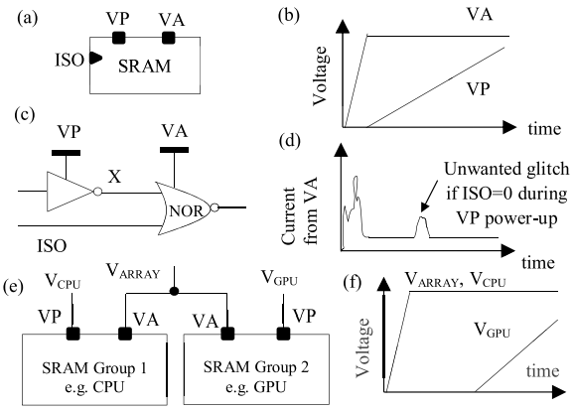
Block Diagram

Slide 10
SOFTWARE REQUIREMENTS:
Operating System : Windows 10
Platform : DOT NET TECHNOLOGY
Front End : ASP.Net 4.0
Back End : SQL SERVER 2014

Slide 11
HARDWARE REQUIREMENTS:
Keyboard
Mouse
Hard disk 500GB
Ram 4 Gb

Slide 12
CONCLUSION
We benchmarked our POR with the state-of-the art POR in analog and digital domain. From Table II, it is evident that our circuit has a significant area advantage as compared with the resistance (R)-based approach, high trip point voltage to track supply ramp as compared with the MOS-based solutions, and limited variation. We have presented the design of a novel power-ON circuit to reduce the energy consumed during supply ramp-up in a dual supply SRAM. The circuit implementation in the 40-nm CMOS technology consumed 10.6-μm2 area and enabled 27× reduction (ranging from 9× to 138×) in the energy consumed by the SRAM array supply during periphery power-up in typical case. Though we have focused on its usage for the SRAM, the proposed POR can be used for other hard macros as well.

Slide 13
REFERENCE
[1] J. Kulkarni et al., “Dual-VCC 8T-bitcell SRAM array in 22 nm tri-gate CMOS for energy-efficient operation across wide dynamic voltage range,” in Proc. Symp. VLSI Technol., Jun. 2013, pp. C126–C127.
[2] R. C. Steele, “Power-up reset circuit,” U.S. Patent 4 983 857, Jan. 8, 1991.
[3] T. Yasuda, M. Yamamoto, and T. Nishi, “A power-on reset pulse generator for low voltage applications,” in Proc. IEEE Int. Symp. Circuits Syst. (ISCAS), vol. 4. May 2001, pp. 599–601.
[4] J. Zhang, L. Jiang, and Z. Zeng, “Design of a novel power-on-reset circuit based on power supply detector,” in Proc. 8th Int. Conf. Embedded Comput., Sep. 2009, pp. 355–359.
[5] T. Tanzawa, “A process- and temperature-tolerant power-on reset circuit with a flexible detection level higher than the bandgap voltage,” in Proc. IEEE Int. Symp. Circuits Syst. (ISCAS), May 2008, pp. 2302–2305.

Slide 14
[6] A. Katyal and N. Bansal, “A self-biased current source based power-on reset circuit for on-chip applications,” in Proc. Int. Symp. VLSI Design, Autom., Test, Apr. 2006, pp. 1–4.
[7] W.-C. Yen, H.-W. Chen, and Y.-T. Lin, “A precision CMOS power-onreset circuit with power noise immunity for low-voltage technology,” IEICE Trans. Electron, vol. E87-C, no. 5, pp. 778–784, 2004.
[8] H. S. Kim, “Power-up/power-down detection circuit,” U.S. Patent 6 593 790, Jul. 15, 2003.
[9] S. K. Wadhwa, G. K. Siddhartha, and A. Gaurav, “Zero steady state current power-on-reset circuit with brown-out detector,” in Proc. 19th Int. Conf. VLSI Design, Jan. 2006, pp. 1–6.
[10] S. U. Ay, “A nanowatt cascadable delay element for compact power-onreset (POR) circuits,” in Proc. 52nd IEEE Int. Midwest Symp. Circuits Syst. (MWSCAS), Aug. 2009, pp. 62–65.

