Slide 1
Energy Efficient Approximate Multiplier Design using Bit Significance Driven Logic Compression

Slide 2
Abstract
Approximate arithmetic has recently emerged as a promising paradigm for many imprecision-tolerant applications. It can offer substantial reductions in circuit complexity, delay and energy consumption by relaxing accuracy requirements. In this paper, we propose a novel energy-efficient approximate multiplier design using a significance-driven logic compression (SDLC) approach. Fundamental to this approach is an algorithmic and configurable lossy compression of the partial product rows based on their progressive bit significance. This is followed by the commutative remapping of the resulting product terms to reduce the number of product rows. As such, the complexity of the multiplier in terms of logic cell counts and lengths of critical paths is drastically reduced.

Slide 3
A number of multipliers with different bit-widths (4-bit to 128-bit) are designed in SystemVerilog and synthesized using Synopsys Design Compiler. Post-synthesis experiments showed that up to an order of magnitude energy savings, and reductions of 65% in critical delay and almost 45% in silicon area can be achieved for a 128-bit multiplier compared to an accurate equivalent. These gains are achieved with low accuracy losses estimated at less than 0.00071 mean relative error. Additionally, we demonstrate the energy-accuracy trade-offs for different degrees of compression, achieved through configurable logic clustering. In evaluating the effectiveness of our approach, a case study image processing application showed up to 68.3% energy reduction with negligible losses in image quality expressed as peak signal-to-noise ratio (PSNR).

Slide 4
Existing System
Existing work on approximate MAC unit is very scarce comapred to other functional units.
The proposed design exploits an approximate hybrid redundant adder as the basic building block for both addition and multiplication operations in the MAC unit.
There exists a considerable amount of efforts to design approximate hardware components.
The works replace constant multiplications with multiple operations of shift-and-add.
However, having multiple designs to meet the required quality, mandate a complex controller with a large area overhead.

Slide 5
Disadvantage of Existing System
These factors have prompted close attention in approximate multiplier design research, since improvements made in the power/speed of a multiplier are expected to substantially impact on overall system power/ performance trade-offs.
A number of simulations are carried out to examine the impact of error on the proposed approach for different sizes of multiplier.
However, such error rates can be misleading, as the eventual impact of error is reflected in error distance metrics such as MRED and NMED.
On a statistical basis, the results of NMED and MRED metrics show how the impact of error is alleviated when the size of the multiplier is increased.

Slide 6
PROPOSED SYSTEM :
To our knowledge, the proposed design is the first work that successfully uses highorder approximate compressors in the approximate multiplier design.
In, different approximate multiplier designs (based on approximate 4:2 compressors) have been proposed to save the power consumption.
To assess the performance of proposed multipliers (PAWM1 and PAWM2), the DMs such as power, delay, PDP, and area are extracted and compared against the EWM and DAWMs.
This power advantage can be attributed to the underlying architecture of proposed compressors.

Slide 7
ADVANTAGE
There is a persistent demand for higher computational performance at low energy cost for emerging applications.
This can be leveraged as an opportunity for energy-efficient systems design for current and future generations of application-specific systems.
This allows for building larger energy-efficient multipliers using small approximate ones; however, the hierarchical organization of small approximate blocks will eventually propagate errors which increase with the multiplier size.
A number of powerand area-efficient multiplier redesign approaches have been proposed by changing the functional behavior.
We propose a novel energy-efficient approximate multiplier design approach using bit significance-driven logic compression (SDLC).

Slide 8
TITLE | AUTHOR | DESCRIPTION
Approximate computing: An emerging paradigm for energy-efficient design | J. Han and M. Orshansky, | Approximate computing has recently emerged as a promising approach to energy-efficient design of digital systems.
Introduction to approximate computing: Embedded tutorial | L. Sekanina, | The purpose of this paper is to introduce the principles of approximate computing and survey the research conducted in major subareas of approximate computing which are relevant for design and test of digital circuits.

Slide 9
TITLE | AUTHOR | DESCRIPTION
A comparative evaluation of approximate multipliers | H. Jiang, C. Liu, N. Maheshwari, F. Lombardi, and J. Han, | Moreover, many errors do not make an obvious difference in applications such as image processing due to the perceptual limitations of human beings.
Design of voltage-scalable meta-functions for approximate computing | D. Mohapatra, V. K. Chippa, A. Raghunathan, and K. Roy, | The net effect of these design techniques is improved accuracy (fewer and smaller errors) under a wide range of over-scaled voltages.

Slide 10
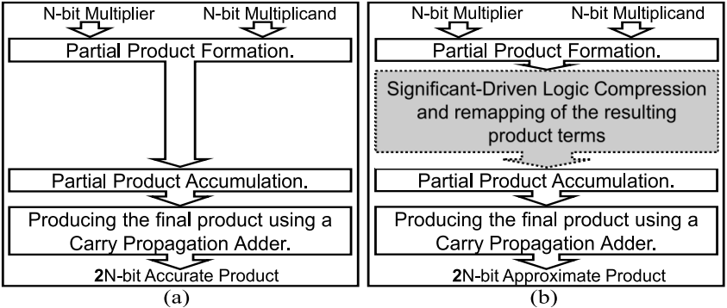
Block Diagram

Slide 11
SOFTWARE REQUIREMENTS:
Operating System : Windows 10
Platform : DOT NET TECHNOLOGY
Front End : ASP.Net 4.0
Back End : SQL SERVER 2014

Slide 12
HARDWARE REQUIREMENTS:
Keyboard
Mouse
Hard disk 500GB
Ram 4 Gb

Slide 13
CONCLUSION
In this paper, a novel approximate multiplier design is proposed using significance-driven logic compression (SDLC). This design approach utilizes an algorithmic and configurable lossy compression based on bit significance to form a reduced set of partial product terms. This is then reorganized and accumulated using various schemes of parallel multiplication. On a statistical basis, the results of NMED and MRED metrics show how the impact of error is alleviated when the size of the multiplier is increased. Additionally, the error distributions show high right-skewness for error probabilities, indicating that the proposed multiplier gives close to exact products for most inputs. The results obtained after synthesis have shown a substantial decrease in run-time, power consumption and even in silicon area. We demonstrate energy-accuracy tradeoffs for different levels of approximations achieved through configurable logic clustering. To illustrate the effect of variable logic clusters, case study of an image-processing application shows that the proposed approach can provide significant energy and area savings with negligible loss in output quality, especially when utilizing smaller bit depth clusters. We believe that the proposed approach can be used with already existing low-power compute units to extract manifold benefits with a minimal loss in output quality.

Slide 14
REFERENCE
[1] J. Han and M. Orshansky, “Approximate computing: An emerging paradigm for energy-efficient design,” in 2013 18th IEEE European Test Symposium (ETS), pp. 1–6, May 2013.
[2] L. Sekanina, “Introduction to approximate computing: Embedded tutorial,” in 2016 IEEE 19th DDECS, pp. 1–6, April 2016.
[3] H. Jiang, C. Liu, N. Maheshwari, F. Lombardi, and J. Han, “A comparative evaluation of approximate multipliers,” in 2016 IEEE/ACM International Symposium on NANOARCH, pp. 191–196, July 2016.
[4] D. Mohapatra, V. K. Chippa, A. Raghunathan, and K. Roy, “Design of voltage-scalable meta-functions for approximate computing,” in 2011 DATE, pp. 1–6, March 2011.
[5] Y. Liu, T. Zhang, and K. K. Parhi, “Computation error analysis in digital signal processing systems with overscaled supply voltage,” IEEE Transactions on VLSI Systems, vol. 18, pp. 517–526, April 2010.

Slide 15
[6] N. Petra, D. D. Caro, V. Garofalo, E. Napoli, and A. G. M. Strollo, “Truncated binary multipliers with variable correction and minimum mean square error,” IEEE Transactions on Circuits and Systems I: Regular Papers, vol. 57, pp. 1312–1325, June 2010.
[7] J. E. Stine and O. M. Duverne, “Variations on truncated multiplication,” in DSD, 2003, pp. 112–119, Sept 2003.
[8] P. Kulkarni, P. Gupta, and M. Ercegovac, “Trading accuracy for power with an underdesigned multiplier architecture,” in 2011 24th Internatioal Conference on VLSI Design, pp. 346–351, Jan 2011.
[9] C. H. Lin and I. C. Lin, “High accuracy approximate multiplier with error correction,” in 2013 IEEE 31st ICCD, pp. 33–38, Oct 2013.
[10] G. Zervakis, K. Tsoumanis, S. Xydis, D. Soudris, and K. Pekmestzi, “Design-efficient approximate multiplication circuits through partial product perforation,” IEEE Transactions on Very Large Scale Integration (VLSI) Systems, vol. 24, pp. 3105–3117, Oct 2016.

