Slide 1
Dual-Quality 4;2 Compressors for Utilizing in Dynamic Accuracy Configurable Multipliers

Slide 2
Abstract
In this paper, we propose four 4:2 compressors, which have the flexibility of switching between the exact and approximate operating modes. In the approximate mode, these dual-quality compressors provide higher speeds and lower power consumptions at the cost of lower accuracy. Each of these compressors has its own level of accuracy in the approximate mode as well as different delays and power dissipations in the approximate and exact modes. Using these compressors in the structures of parallel multipliers provides configurable multipliers whose accuracies (as well as their powers and speeds) may change dynamically during the runtime. The efficiencies of these compressors in a 32-bit Dadda multiplier are evaluated in a 45-nm standard CMOS technology by comparing their parameters with those of the state-of-the-art approximate multipliers. The results of comparison indicate, on average, 46% and 68% lower delay and power consumption in the approximate mode. Also, the effectiveness of these compressors is assessed in some image processing applications.

Slide 3
Existing System
The 4:2 and 5:2 compressors are commonly used in reducing the delay of the partial product in parallel multiplier summation stage.
In this structure, the weights of all the inputs and the sum output are the same whereas the weights of the carry and Cout outputs are one binary bit position higher.
The parameters of existing system were also taken as reference values in order to compare with the proposed design.
The effectiveness of the proposed compressors in their exact operating mode utilized in the Dadda multiplier will be compared with that of the proposed approximate multiplier by in the same. mode.

Slide 4
Disadvantage of Existing System
The parallel multipliers are utilized as a part of superior applications where their expansive power utilizations may make problem area areas on the kick the bucket.
Delay is high
Power consumption is high

Slide 5
PROPOSED SYSTEM :
In this paper, we have a tendency to propose four 4:2 compressors, which have the flexibility of change between the Exact and Approximate operative modes.
In this paper, we propose compressors, which have the ability of switching between the approximate and exact modes with very small delay and power overheads.
This operative mode, we propose disconnecting provide voltage of this gate by mistreatment the power gating.
Some digital systems, like general purpose processors, are also utilized for each approximate and precise (Exact) computation modes.

Slide 6
ADVANTAGE
The parallel multipliers are used in high-performance applications where their large power consumptions may create hot-spot locations on the die.
The performances of the approximate multipliers are assessed in some image processing applications.
Specifically, achieving the desired performance (speed) considering the limited power budget of portable systems is challenging task.
In addition, having a given level of reliability may be another obstacle in reaching the system target performance.
The approach may be used for applications where there is not a unique answer and/or a set of answers near the accurate result can be considered acceptable.

Slide 7
TITLE | AUTHOR | DESCRIPTION
Trading accuracy for power with an underdesigned multiplier architecture | P. Kulkarni, P. Gupta, and M. Ercegovac, | We propose a novel multiplier architecture with tunable error characteristics, that leverages a modified inaccurate 2×2 building block.
Multiplier structures for low power applications in deep-CMOS | D. Baran, M. Aktan, and V. G. Oklobdzija, | A multiplier structure is proposed by optimizing the architecture, gate sizes and the voltage supply.

Slide 8
TITLE | AUTHOR | DESCRIPTION
Voltage scalable high-speed robust hybrid arithmetic units using adaptive clocking | S. Ghosh, D. Mohapatra, G. Karakonstantis, and K. Roy, | In this paper, we explore various arithmetic units for possible use in high-speed, high-yield ALUs operated at scaled supply voltage with adaptive clock stretching.
RAP-CLA: A reconfigurable approximate carry look-ahead adder | O. Akbari, M. Kamal, A. Afzali-Kusha, and M. Pedram, | This adder has the ability of switching between the approximate and exact operating modes making it suitable for both error-resilient and exact applications.

Slide 9
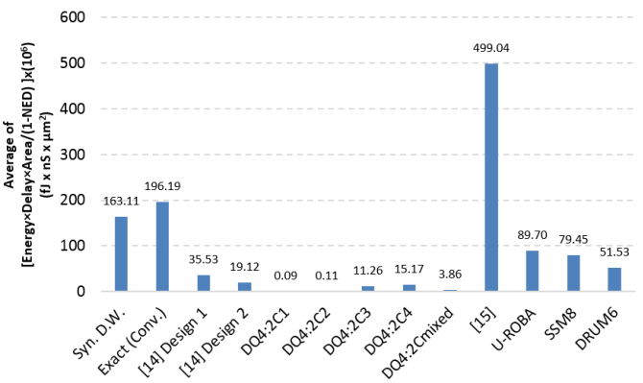
Block Diagram

Slide 10
SOFTWARE REQUIREMENTS:
Operating System : Windows 10
Platform : DOT NET TECHNOLOGY
Front End : ASP.Net 4.0
Back End : SQL SERVER 2014

Slide 11
HARDWARE REQUIREMENTS:
Keyboard
Mouse
Hard disk 500GB
Ram 4 Gb

Slide 12
CONCLUSION
In this paper, we presented four DQ4:2Cs, which had the flexibility of switching between the exact and approximate operating modes. In the approximate mode, these compressors provided higher speeds and lower power consumptions at the cost of lower accuracy. Each of these compressors had its own level of accuracy in the approximate mode as well as different delays and powers in the approximate and exact modes. These compressors were employed in the structure of a 32-bit Dadda multiplier to provide a configurable multiplier whose accuracy (as well as its power and speed) could be changed dynamically during the runtime. Our studies revealed that for the 32-bit multiplication, the proposed compressors yielded, on average, 46% and 68% lower delay and power consumption in the approximate mode compared with those of the recently suggested approximate compressors. Also, utilizing the proposed compressors in 32-bit Dadda multiplier provided, on average, about 33% lower NED compared with the state-of-the-art compressor-based approximate multipliers. When comparing with noncompressor-based approximate multipliers, the errors of the proposed multipliers were higher while the design parameters were considerably better. Finally, our studies showed that the multipliers realized based on the suggested compressors have, on average, about 93% smaller FOM value compared with the considered approximate multipliers.

Slide 13
REFERENCE
[1] P. Kulkarni, P. Gupta, and M. Ercegovac, “Trading accuracy for power with an underdesigned multiplier architecture,” in Proc. 24th Int. Conf. VLSI Design, Jan. 2011, pp. 346–351.
[2] D. Baran, M. Aktan, and V. G. Oklobdzija, “Multiplier structures for low power applications in deep-CMOS,” in Proc. IEEE Int. Symp. Circuits Syst. (ISCAS), May 2011, pp. 1061–1064.
[3] S. Ghosh, D. Mohapatra, G. Karakonstantis, and K. Roy, “Voltage scalable high-speed robust hybrid arithmetic units using adaptive clocking,” IEEE Trans. Very Large Scale Integr. (VLSI) Syst., vol. 18, no. 9, pp. 1301–1309, Sep. 2010.
[4] O. Akbari, M. Kamal, A. Afzali-Kusha, and M. Pedram, “RAP-CLA: A reconfigurable approximate carry look-ahead adder,” IEEE Trans. Circuits Syst. II, Express Briefs, doi: 10.1109/TCSII.2016.2633307.
[5] A. Sampson et al., “EnerJ: Approximate data types for safe and general low-power computation,” in Proc. 32nd ACM SIGPLAN Conf. Program. Lang. Design Implement. (PLDI), 2011, pp. 164–174.

Slide 14
[6] A. Raha, H. Jayakumar, and V. Raghunathan, “Input-based dynamic reconfiguration of approximate arithmetic units for video encoding,” IEEE Trans. Very Large Scale Integr. (VLSI) Syst., vol. 24, no. 3, pp. 846–857, May 2015.
[7] J. Joven et al., “QoS-driven reconfigurable parallel computing for NoC-based clustered MPSoCs,” IEEE Trans. Ind. Informat., vol. 9, no. 3, pp. 1613–1624, Aug. 2013.
[8] R. Ye, T. Wang, F. Yuan, R. Kumar, and Q. Xu, “On reconfigurationoriented approximate adder design and its application,” in Proc. IEEE/ACM Int. Conf. Comput. Aided Design (ICCAD), Nov. 2013, pp. 48–54.
[9] M. Shafique, W. Ahmad, R. Hafiz, and J. Henkel, “A low latency generic accuracy configurable adder,” in Proc. 52nd ACM/EDAC/IEEE Design Autom. Conf. (DAC), Jun. 2015, pp. 1–6.
[10] S. Narayanamoorthy, H. A. Moghaddam, Z. Liu, T. Park, and N. S. Kim, “Energy-efficient approximate multiplication for digital signal processing and classification applications,” IEEE Trans. Very Large Scale Integr. (VLSI) Syst., vol. 23, no. 6, pp. 1180–1184, Jun. 2015.

