Slide 1
A Floating-Point Fused Dot-Product Unit

Slide 2
Abstract
A floating-point fused dot-product unit is presented that performs single-precision floating-point multiplication and addition operations on two pairs of data in a time that is only 150% the time required for a conventional floating-point multiplication. When placed and routed in a 45nm process, the fused dot-product unit occupied about 70% of the area needed to implement a parallel dot-product unit using conventional floating-point adders and multipliers. The speed of the fused dot-product is 27% faster than the speed of the conventional parallel approach. The numerical result of the fused unit is more accurate because one rounding operation is needed versus at least three for other approaches.

Slide 3
Existing System
An 8-bit multiplication computed on a 32-bit Booth multiplier would result in unnecessary switching activity and power loss. Several works investigated this word length optimization.
Each pair of incoming operands is routed to the smallest multiplier that can compute the result to take advantage of the lower energy consumption of the smaller circuit.
This ensemble of point systems is reported to consume the least power but this came at the cost of increased chip area given the used ensemble structure.
When adjusting the voltage, the actual performance of the multiplier running under scaled voltage has to be characterized to guarantee a fail-safe operation.

Slide 4
Disadvantage of Existing System
More power consumption
Requirement of area
Complex structure
Less flexibility

Slide 5
PROPOSED SYSTEM :
The proposed designs are implemented for single precision and synthesized with a 45nm standard cell library.
The proposed dual-path design reduces the latency by 35% compared to the traditional floating-point fused dot product unit.
The proposed dual-path floating-point fused dot product unit is split into three stages.
The proposed system reduces the shift amount and normalization is applied to reduce the size of significant and addition and LZA reduces the reduction tree.
The proposed MBE multiplier combines the advantages of both of these two approaches to produce a very regular partial product array.

Slide 6
ADVANTAGE
A high performance 45 nm process was used for the implementation with a standard cell library designed for high speed applications.
FMA units are utilized in embedded signal processing and graphics applications, used to perform division, argument reduction, and this is why the FMA has become an integral unit of many commercial processors such as those of IBM, HP and Intel.
To operations performed by a FMA, in many DSP algorithms and in other fields calculating the sum of the products of two sets of operands (dot-product) is a frequently used operation.
Both Fused FDP and FAS unit is more efficient than the older designs. FAS are more sense only rounding is performed over 3 rounding in parallel approaches.

Slide 7
TITLE | AUTHOR | DESCRIPTION
Second-generation RISC floating point with multiply-add fused | E. Hokenek, R. K. Montoye and P. W. Cook, | While the cycle time (40 ns) is competitive with other CMOS RISC systems, the floating-point performance stretches to the range of bipolar RISC systems.
A radix-16 FFT algorithm suitable for multiply-add instruction based on Goedecker method | D. Takahashi, | The proposed radix-16 FFT algorithm requires fewer floating-point instructions than the conventional radix-16 FFT algorithm on processors that have a multiply-add instruction.

Slide 8
TITLE | AUTHOR | DESCRIPTION
Order-configurable programmable power-efficient FIR filters | C. Xu, C. Y. Wang and K. K. Parhi, | We present a novel VLSI implementation of an order-configurable, coefficient-programmable, and power-efficient FIR filter architecture.
An Enhanced Floating Point Coprocessor for Embedded Signal Processing and Graphics Applications | C. Hinds, | There has been a marked interest in enhancing general purpose microprocessors to accommodate signal processing, primarily to improve audio and video compression routines and speech recognition algorithms.

Slide 9
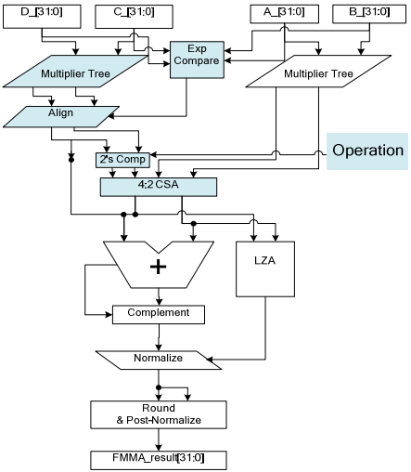
Block Diagram

Slide 10
SOFTWARE REQUIREMENTS:
Operating System : Windows 10
Platform : DOT NET TECHNOLOGY
Front End : ASP.Net 4.0
Back End : SQL SERVER 2014

Slide 11
HARDWARE REQUIREMENTS:
Keyboard
Mouse
Hard disk 500GB
Ram 4 Gb

Slide 12
CONCLUSION
The area and latency of the two conventional approaches (ignoring the multiplexers and register) and the FDP unit are compared and plotted. The fused dot product is intermediate in area between the conventional serial and the conventional parallel approaches. Its latency is about 80% of that of the conventional parallel approach and about half that of the conventional serial approach.

Slide 13
REFERENCE
[1] E. Hokenek, R. K. Montoye and P. W. Cook, “Second-generation RISC floating point with multiply-add fused,” IEEE Journal of SolidState Circuits, vol. 25, pp. 1207-1213, 1990.
[2] D. Takahashi, “A radix-16 FFT algorithm suitable for multiply-add instruction based on Goedecker method,” Proceedings 2003 International Conference on Multimedia and Expo, vol. 2, July 2003, pp. II-845-II-848.
[3] C. Xu, C. Y. Wang and K. K. Parhi, “Order-configurable programmable power-efficient FIR filters,” Proceedings 3rd International Conference on High Performance Computing, December 1996, pp. 357-361.
[4] C. Hinds, “An Enhanced Floating Point Coprocessor for Embedded Signal Processing and Graphics Applications,” Conference Record of the Thirty-Third Asilomar Conference on Signals, Systems, and Computers, pp. 147-151, 1999.
[5] A. D. Robison, “N-Bit Unsigned Division Via N-Bit Multiply-Add,” Proceedings of the 17th IEEE Symposium On Computer Arithmetic, pp. 131-139, 2005.

Slide 14
[6] R.-C. Li, S. Boldo and M. Daumas, “Theorems on Efficient Argument Reductions,” Proceedings of the 16th IEEE Symposium on Computer Arithmetic, pp. 129-136, 2003.
[7] F. P. O’Connell and S. W. White, “POWER3: The Next Generation of PowerPC Processors,” IBM Journal of Research and Development, vol. 44, pp. 873-884, 2000.
[8] A. Kumar, “The HP PA-8000 RISC CPU,” IEEE Micro Magazine, vol. 17, Issue 2, pp. 27-32, April, 1997
[9] B. Greer, J. Harrison, G. Henry, W. Li and P. Tang, “Scientific Computing on the Itanium Processor,” Proceedings of the ACM/IEEE SC2001 Conference, pp. 1-8, 2001.
[10] M. P. Farmwald, On the Design of High Performance Digital Arithmetic Units, Ph.D. Thesis, Stanford University, 1981.

