Slide 1
Towards Efficient Modular Adders based on Reversible Circuits

Slide 2
Abstract
Reversible logic is a computing paradigm that has attracted significant attention in recent years due to its properties that lead to ultra-low power and reliable circuits. Reversible circuits are fundamental, for example, for quantum computing. Since addition is a fundamental operation, designing efficient adders is a cornerstone in the research of reversible circuits. Residue Number Systems (RNS) has been as a powerful tool to provide parallel and fault-tolerant implementations of computations where additions and multiplications are dominant. In this paper, for the first time in the literature, we propose the combination of RNS and reversible logic. The parallelism of RNS is leveraged to increase the performance of reversible computational circuits. Being the most fundamental part in any RNS, in this work we propose the implementation of modular adders, namely modulo 2n-1 adders, using reversible logic. Analysis and comparison with traditional logic show that modulo adders can be designed using reversible gates with minimum overhead in comparison to regular reversible adders.

Slide 3
Existing System
In the existing system of modulo adder uses the Universal gates concept and it consumes more area.
With existent analog to digital converters (ADC) that directly convert analog inputs to residues encoded in the TC format, engineers and researchers are increasingly interested in modular adders for TC.
In the coding, when numbers, letters or words are represented by a specific group of symbols, it is said that the number, letter or word is being encoded. The group of symbols is called as a code.
The digital data is represented, stored and transmitted as group of binary bits. This group is also called as binary code. The binary code is represented by the number as well as alphanumeric letter.

Slide 4
Disadvantage of Existing System
The proposed modular adders, based on the thermometer and one-hot coding result in average improvements for delay, the circuit area, and energy consumption.
However, TGs have the problem of voltage drop and high internal capacitances, due to the direct exposure of the junction capacitors to the signals which are passing TGs.
It should be noted that some multi-input gates can be implemented using tree structures of 2-input gates without impacting the delay.
Modular addition is the most important and frequent operation applied on the components of RNS, including arithmetic units in the channels as well as forward and reverse converters.

Slide 5
PROPOSED SYSTEM :
It is demonstrated that the purposed PERES full adder is superior to the current partners in writing in terms of waste yields.
The proposed adders are designed using novel digital circuits supported on specific features of OHC and TC.
In the first level of the proposed OHR-based adder, NAND and NOR gates can be used instead of AND and OR gates.
Although the representation of numbers with the OHC requires one more bit than with the TC, the delay and the occupied area of the proposed OHR adder design are better than those of the proposed TCR adder design, while the energy consumption is very close for the two approaches.

Slide 6
ADVANTAGE
In this paper, we propose the joint usage of these two unconventional computing approaches, Residue Number System and Reversible Computing, to achieve ultra-efficient computing paradigm for the emerging applications.
RNS is used nowadays to achieve also energy-efficient and high-performance implementation of various emerging applications, such as deep neural networks, communication networks and cloud storage.
Researchers in academia and industry believe that Moore’s law is ending, and even newly delivered deep-submicron transistors are not significantly more efficient than their previous generations.
This number system has been applied to achieve parallel and efficient implementations for asymmetric cryptographic and digital signal processing (DSP).

Slide 7
TITLE | AUTHOR | DESCRIPTION
Rebooting Computing: The Road Ahead | T.M. Conte, E.P. DeBenedictis, P.A. Gargini, and E. Track, | The signs have been there some time: exponential performance scaling stalled a decade ago at the transistor level, although multicore architectures temporarily concealed the effects from end users.
Residue Number Systems: A New Paradigm to Datapath Optimization for Low-Power and High-Performance Digital Signal Processing Applications | C.H. Chang, A.S.Molahosseini, A.A.Emrani Zarandi, and T.F.Tay, | The rigidity of instruction set architectures of the market-dominant computers and microprocessors then has been the main barrier to sustain the development of RNS-based applications.

Slide 8
TITLE | AUTHOR | DESCRIPTION
Combining Residue Arithmetic to Design Efficient Cryptographic Circuits and Systems | L. Sousa, S. Antão, and P. Martins, | In particular, public-key cryptography enables the asymmetrical ciphering of data along with the authentication of the parties that are attempting to share data.
The Opportunities and Controversies of Reversible Computing | E.P. DeBenedictis, J.K. Mee, and M.P. Frank, | Some scientists argue that alternative approaches could greatly reduce energy consumption.

Slide 9
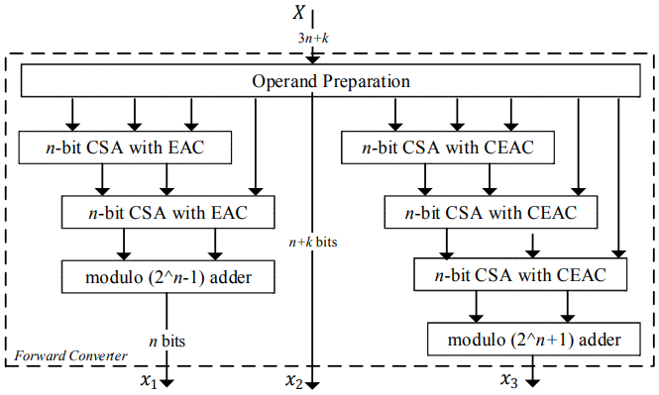
Block Diagram

Slide 10
SOFTWARE REQUIREMENTS:
Operating System : Windows 10
Platform : DOT NET TECHNOLOGY
Front End : ASP.Net 4.0
Back End : SQL SERVER 2014

Slide 11
HARDWARE REQUIREMENTS:
Keyboard
Mouse
Hard disk 500GB
Ram 4 Gb

Slide 12
CONCLUSION
This work presents the reversible design of modular adders, a basic and fundamental element of RNS-based architectures. It is shown that a modulo 2n -1 parallel-prefix adder can be designed using small overheads over regular prefix adders. The next steps, which should be considered for future work, are reformulating the RNS operations, such as reverse conversion, sign detection and scaling, to adapt them to be implemented with reversible gates. They can benefit from the efficient proposed reversible-based modular adders. It is expected that this paper opens a new and substantial field of research to join modular arithmetic and reversible computing, resulting in efficient computational architectures for the post-Moore era.

Slide 13
REFERENCE
[1] T.M. Conte, E.P. DeBenedictis, P.A. Gargini, and E. Track, “Rebooting Computing: The Road Ahead,” Computer, vol. 50, no. 1, pp. 20-29, 2017.
[2] M. Alioto (Ed.), Enabling the Internet of Things: From Integrated Circuits to Integrated Systems, Springer , 2017.
[3] A.S.Molahosseini, L.Sousa and C.H. Chang (Eds.), Embedded Systems Design with Special Arithmetic and Number Systems,Springer, 2017.
[4] C.H. Chang, A.S.Molahosseini, A.A.Emrani Zarandi, and T.F.Tay, “Residue Number Systems: A New Paradigm to Datapath Optimization for Low-Power and High-Performance Digital Signal Processing Applications,” IEEE Circuits and Systems Magazine, vol. 15, no. 4, pp. 26-44, 2015.
[5] L. Sousa, S. Antão, and P. Martins, “Combining Residue Arithmetic to Design Efficient Cryptographic Circuits and Systems,” IEEE Circuits and Systems Magazine, vol. 16, no. 4, pp. 6-32, 2016.

Slide 14
[6] E.P. DeBenedictis, J.K. Mee, and M.P. Frank, “The Opportunities and Controversies of Reversible Computing,” Computer, vol. 50, no. 6, pp. 76-80, 2017.
[7] R. Chaves and L. Sousa, “Improving RNS multiplication with more balanced moduli sets and enhanced modular arithmetic structures,”IET Computers & Digital Techniques, vol. 1, n. 5, pp. 472-480, 2007.
[8] A. Hiasat, “An Efficient Reverse Converter for the Three-Moduli Set (2n+1-1, 2n , 2n -1),” IEEE Transactions on Circuits and Systems-II, vol. 64, no. 8, 2017.
[9] A.S. Molahosseini, K. Navi, C. Dadkhah, O. Kavehei, S. Timarchi, "Efficient reverse converter designs for the new 4-moduli sets {2n –1, 2n , 2n +1, 22n+1–1} and {2n –1, 2n +1, 22n , 22n +1} based on new CRTs," IEEE Transactions on Circuits and Systems-I, vol. 57, no. 4, pp. 823-835, 2010.
[10] P. Patronik and S.J. Piestrak, "Design of Reverse Converters for General RNS Moduli Sets {2k , 2n -1, 2n +1, 2n+1-1} and {2k , 2n -1, 2n +1, 2n-1-1} (n even)," IEEE Transactions on Circuits and Systems-I, vol. 61, no. 6, pp. 1687-1700, 2014.

