Slide 1
Low Power Near Threshold 10T SRAM Bit Cells with Enhanced Data Independent Read Port Leakage for Array Augmentation in 32nm CMOS

Slide 2
Abstract
The conventional six-transistor static random access memory (SRAM) cell allows high density and fast differential sensing but suffers from half-select and read-disturb issues. Although the conventional eight-transistor SRAM cell solves the read-disturb issue, it still suffers from low array efficiency due to deterioration of read bit-line (RBL) swing and Ion/Ioff ratio with increase in the number of cells per column. Previous approaches to solve these issues have been afflicted by low performance, datadependent leakage, large area, and high energy per access.

Slide 3
Therefore, in this paper, we present three iterations of SRAM bit cells with nMOS-only based read ports aimed to greatly reduce data dependent read port leakage to enable 1k cells/RBL, improve read performance, and reduce area and power over conventional and 10T cell-based works. We compare the proposed work with other works by recording metrics from the simulation of a 128-kb SRAM constructed with divided-wordline-decoding architecture and a 32-bit word size. Apart from large improvements observed over conventional cells, up to 100-mV improvement in read-access performance, up to 19.8% saving in energy per access, and up to 19.5% saving in the area are also observed over other 10T cells, thereby enlarging the design and application gamut for memory designers in low-power sensors and battery-enabled devices.

Slide 4
Existing System
A couple of options exist in order to enhance the strength of the access-devices relative to the load-devices.
Although a variety of techniques, including parallelism and pipelining, exist in order to improve the performance of general logic (and promote voltage scaling), SRAM design is highly constrained by its structure and need to maximize density, hence requiring very different approaches.
In all, a tight coupling exists between energy, performance, and density, and although their various interactions raise several limitations, they also increase the options for addressing target objectives.

Slide 5
Disadvantage of Existing System
Multiple supply line assist can also be used to improve read and write half-select stability issues in SRAMs.
These issues have included the implementation of assist techniques, novel cell design, architectural improvements, or technological developments.
Half-select and read-disturb issues in SRAMs can be mitigated by optimization of word-line voltage level.
A process variation tolerant selective precharge assist has also been used to decrease bit-line voltage level using charge sharing to improve half-select disturb issues.

Slide 6
PROPOSED SYSTEM :
A sense-amplifier is proposed that provides regenerative small-signal sensing.
Due to the promise of single-ended bit-cells (e.g. 8T) for ultra-low-voltage, lowenergy applications, the sense-amplifier proposed provides variation resilient single-ended sensing.
To overcome these limitations, alternate bit-cell topologies have been proposed that attempt to improve the low-voltage trade-offs and provide some additional voltage scalability.
The target technology used to demonstrate the proposed techniques is 45nm LP CMOS, which highlights the variability associated with density maximization.

Slide 7
ADVANTAGE
Many techniques have been proposed to improve the single ended read sensing performance, the area overhead still remains large.
Although these approaches have been successful at this task, these still suffer from large area or varying data-dependent performance.
With a unique topology in each of the three cells’ read port, we obtain improved read access performance, low energy per access, and low area respectively, thereby enlarging the design and application gamut for memory designers in low power sensors and battery enabled devices.
This form of hierarchical sensing does not compare to differential sensing in terms of both performance and array efficiency.

Slide 8
TITLE | AUTHOR | DESCRIPTION
Analysis of GeOI FinFET 6T SRAM cells with variation-tolerant WLUD read-assist and TVC write-assist | V. P.-H. Hu, M.-L. Fan, P. Su, and C.-T. Chuang, | This paper analyzes the impacts of read-assist and write-assist circuits on GeOI FinFET 6T SRAM cells considering intrinsic random variations, process corner, and temperature variation.
A 65-nm SoC embedded 6T-SRAM designed for manufacturability with read and write operation stabilizing circuits | S. Ohbayashi et al., | In the sub-100-nm CMOS generation, a large local Vth variability degrades the 6T-SRAM cell stability, so that we have to consider this local variability as well as the global variability to achieve high-yield SRAM products.

Slide 9
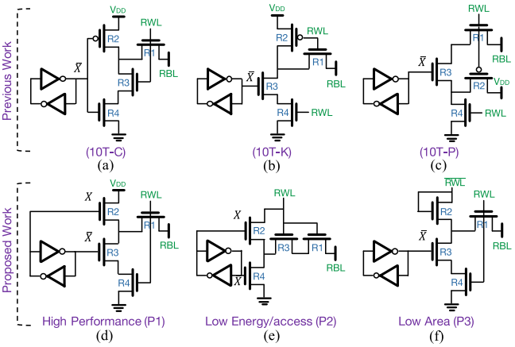
Block Diagram

Slide 10
SOFTWARE REQUIREMENTS:
Operating System : Windows 10
Platform : DOT NET TECHNOLOGY
Front End : ASP.Net 4.0
Back End : SQL SERVER 2014

Slide 11
HARDWARE REQUIREMENTS:
Keyboard
Mouse
Hard disk 500GB
Ram 4 Gb

Slide 12
CONCLUSION
In this work, we presented three niche-specific read ports with enhanced data-independent read port leakage for SRAM cells aimed at high performance, low power and low area respectively. All three proposed read ports did not implement any pMOS, thereby leading to smaller n-well size, which in turn led to smaller vertical sizing and shorter bit-lines in the thin-form layouts. This reduced the area per cell and energy per access. Each of the SRAM cells with the proposed read ports improved the effective read bit-line voltage swing and enabled 1k cells per read bit-line, allowing great potential for area saving in terms of sharing peripheral circuitry. With a unique topology in each of the three cells’ read port, we obtain a best-case access Vmin of 483mV for the 10T-P1 cell, an Emin of 7.19pJ/acc for the 10T-P2 cell, and a low area of 0.55728μm2 for the 10T-P3 cell. In comparison to conventional cells, this translates to up to 180mV improvement in read access performance and up to four times reduction in energy per access at their respective Vmin. When compared to previous 10T cell-based works, about 100mV improvement in read access performance, up to 19.8% saving in energy per access, and up to 19.5% saving in area can be observed, thereby enlarging the design and application gamut for memory designers in low power sensors and battery enabled devices.

Slide 13
REFERENCE
[1] B. H. Calhoun and A. P. Chandrakasan, “A 256-kb 65-nm sub-threshold SRAM design for ultra-low-voltage operation,” IEEE J. Solid-State Circuits, vol. 42, no. 3, pp. 680–688, Mar. 2007.
[2] G. Pasandi and S. M. Fakhraie, “A 256-kb 9T near-threshold SRAM with 1 k cells per bitline and enhanced write and read operations,” IEEE Trans. Very Large Scale Integr. (VLSI) Syst., vol. 23, no. 11, pp. 2438–2446, Nov. 2015.
[3] T.-H. Kim, J. Liu, J. Keane, and C. H. Kim, “A 0.2 V, 480 kb subthreshold SRAM with 1 k cells per bitline for ultra-low-voltage computing,” IEEE J. Solid-State Circuits, vol. 43, no. 2, pp. 518–529, Feb. 2008.
[4] V. P.-H. Hu, M.-L. Fan, P. Su, and C.-T. Chuang, “Analysis of GeOI FinFET 6T SRAM cells with variation-tolerant WLUD read-assist and TVC write-assist,” IEEE Trans. Electron Devices, vol. 62, no. 6, pp. 1710–1715, Jun. 2015.
[5] S. Ohbayashi et al., “A 65-nm SoC embedded 6T-SRAM designed for manufacturability with read and write operation stabilizing circuits,” IEEE J. Solid-State Circuits, vol. 42, no. 4, pp. 820–829, Apr. 2007.

Slide 14
[6] M. E. Sinangil, H. Mair, and A. P. Chandrakasan, “A 28 nm high-density 6T SRAM with optimized peripheral-assist circuits for operation down to 0.6 V,” in IEEE Int. Solid-State Circuits Conf. (ISSCC) Dig. Tech. Papers, Feb. 2011, pp. 260–262.
[7] M. Yabuuchi, K. Nii, Y. Tsukamoto, S. Ohbayashi, Y. Nakase, and H. Shinohara, “A 45 nm 0.6 V cross-point 8T SRAM with negative biased read/write assist,” in Proc. IEEE Symp. VLSI Circuits, Jun. 2009, pp. 158–159.
[8] B. Zimmer et al., “SRAM assist techniques for operation in a wide voltage range in 28-nm CMOS,” IEEE Trans. Circuits Syst. II, Exp. Briefs, vol. 59, no. 12, pp. 853–857, Dec. 2012.
[9] H. Pilo et al., “A 64 Mb SRAM in 32 nm high-k metal-gate SOI technology with 0.7 V operation enabled by stability, write-ability and read-ability enhancements,” IEEE J. Solid-State Circuits, vol. 47, no. 1, pp. 97–106, Jan. 2012.
[10] A. J. Bhavnagarwala et al., “A sub-600-mV, fluctuation tolerant 65-nm CMOS SRAM array with dynamic cell biasing,” IEEE J. Solid-State Circuits, vol. 43, no. 4, pp. 946–955, Apr. 2008.

