Slide 1
SMART ENERGY METER WITH POWER THEFT DETECTION AND CONTROL SYSTEM

Slide 2
Abstract
Electrical energy is very important for everyday life and a spine for day today’s life. Power is the basic necessity for the economic development of a country. That power should be handled in an efficient manner to meet the power requirement. Detecting and locating theft in the power line is very necessary task for the healthy operation and maintenance of the power system. In electrical power line, theft often occur many times making the power system unreliable.

Slide 3
Existing System
This design incorporates effective solutions for problems faced by India’s electricity distribution system such as power theft. Microcontroller trips the output using relay.
In existing system, a microcontroller is interfaced with an energy circuit, Zigbee Communication link, & a contractor to make or break power line.

Slide 4
Disadvantage of Existing System
Angle of viewing is very limited
External light is a must for display
Cannot be used under wide range of temperature

Slide 5
PROPOSED SYSTEM :
They have proposed the power should be handled in an efficient manner to meet the power requirement.
The power theft and low voltage in distribution line for better reliability and optimum operation of the system is presented.
Wireless data transmitting and receiving technique is used by zigbee communication.

Slide 6
ADVANTAGE
Consume much lesser energy (i.e. low power) when compared to LEDs
Utilizes the light available outside and no generation of light
Since reflectivity is highly sensitive to temperature, used as temperature measuring sensor •
Very cheap

Slide 7
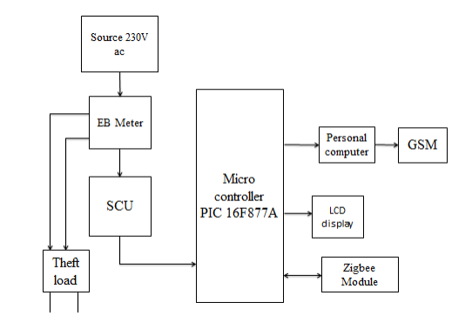
Block Diagram

Slide 8
SOFTWARE REQUIREMENTS:
Operating System : Windows 10
Platform : DOT NET TECHNOLOGY
Front End : ASP.Net 4.0
Back End : SQL SERVER 2014

Slide 9
HARDWARE REQUIREMENTS:
Keyboard
Mouse
Hard disk 500GB
Ram 4 Gb

Slide 10
CONCLUTION
The project model reduces the manual manipulation work and theft. Use of GSM in our system provides the numerous advantages of wireless network systems.
The project model proposed in this paper was tested in a simulated environment and the results shows that the system helps to identify electricity theft.

