Slide 1
Seizure detection using wearable sensors and machine learning:
Setting a benchmark

Slide 2
Abstract
Tracking seizures is crucial for epilepsy monitoring and treatment evaluation. Current epilepsy care relies on caretaker seizure diaries, but clinical seizure monitoring may miss seizures.
Wearable devices may be better tolerated and more suitable for long-term ambulatory monitoring.
This study evaluates the seizure detection performance of custom-developed machine learning (ML) algorithms across a broad spectrum of epileptic seizures utilizing wrist-and ankle-worn multisignal biosensors.

Slide 3
The sensor recorded body temperature, electrodermal activity, accelerometry (ACC), and photoplethysmography, which provides blood volume pulse (BVP).
We used electroencephalographic seizure onset and offset as determined by a board-certified epileptologist as a standard comparison.
Automatic seizure detection using ML from multimodal wearable sensor data is feasible across a broad spectrum of epileptic seizures.

Slide 4
Existing System
Epilepsy manifests through seizures which occurs uncontrollably. Several types of seizures exist based on semiology, symptomatic experience and electrophysiological signatures.
Many challenges exist in designing a reliable system for forecasting seizures from noninvasively recorded data. Training, testing, and validating a forecasting algorithm requires ultra-long duration recordings with an adequate number of seizures.
Self-reported seizure diaries are the most accessible validation, but the poor reliability of such diaries is widely recognized.

Slide 5
Disadvantage of Existing System
To demonstrate the impact of introducing self-awareness in wearable technologies, we consider the epileptic seizure detection problem, as a case study.
A machine learning algorithm, which is particularly selected and trained for the target problem, is used to extract the model and detect possible bio-medical abnormalities or pathologies.
We investigate if this self-aware technique has any negative impact in terms of classification and seizure detection performance.

Slide 6
PROPOSED SYSTEM :
We propose a new generation of self-aware wearable systems to cope with the stringout energy constraints of these bio-medical systems, while at the same time enhancing the detection quality they provide.
In particular, to reduce the energy without sacrificing quality of detection, we propose a two-mode classifier.
We also observe that while this approach improves both sensitivity and specificity, the latter changes more significantly, which indicates that the true positive is increased significantly due to our proposed model refinement.

Slide 7
ADVANTAGE
The main challenge in wearable systems is to increase the battery lifetime, while maintaining the machine-learning performance of the system.
Self-awareness is perhaps the key to design intelligent systems that can continuously monitor their own performance, adapt to changes, and improve autonomously.
The high performance of SVM in terms of the accuracy of detecting seizures, SVM is also suitable to be implemented on resource-constrained embedded systems

Slide 8
TITLE | AUTHOR | DESCRIPTION
The epidemiology of epilepsy | Beghi E. | While all people with epilepsy experience seizures, not all individuals with seizures have epilepsy.
Diagnostic challenges in epilepsy: seizure under-reporting and seizure detection | Elger CE, Hoppe C. | As therapeutic interventions focus on reduction or elimination of seizures, the accurate documentation of seizure occurrence is essential.

Slide 9
TITLE | AUTHOR | DESCRIPTION
Epilepsy: accuracy of patient seizure counts. | Hoppe C, Poepel A, Elger CE. | Patients Consecutive sample of 91 adult inpatients with focal epilepsies undergoing video-electroencephalographic monitoring.
Wearable seizure detection devices in refractory epilepsy | Verdru J, Van Paesschen W. | This article provides an up-to-date overview and comparison between wearable seizure detection devices (WSDDs), taking into account the newly proposed standards for testing and clinical validation of devices.

Slide 10
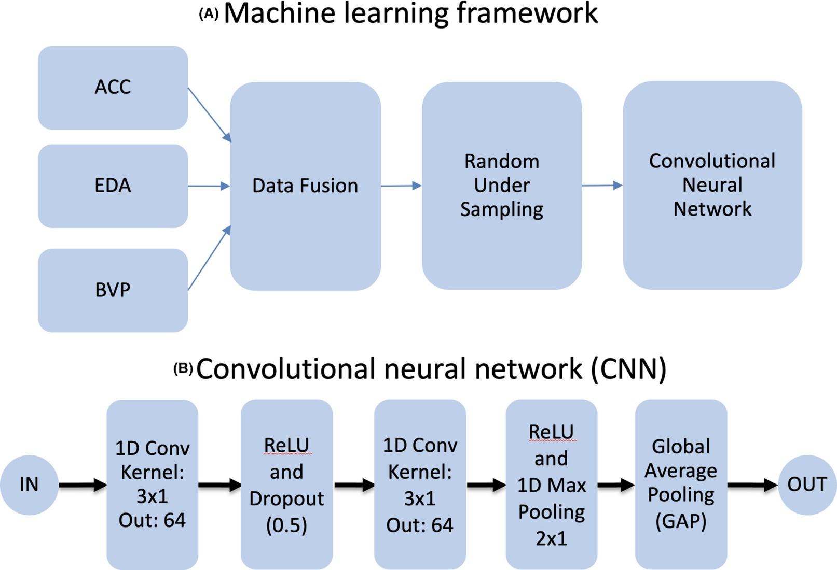
Block Diagram

Slide 11
SOFTWARE REQUIREMENTS:
Operating System : Windows 10
Platform : DOT NET TECHNOLOGY
Front End : ASP.Net 4.0
Back End : SQL SERVER 2014

Slide 12
HARDWARE REQUIREMENTS:
Keyboard
Mouse
Hard disk 500GB
Ram 4 Gb

Slide 13
CONCLUSION
Automatic epileptic seizure detection of a broad variety of seizure types using ML and wearable data is feasible.
Preliminary results show better than chance seizure detection across a range of nine seizure types.
Future improvements may consider clinical chronoepileptological variables, such as seizure duration and etiology or syndrome, as well as alternative data balancing, pre-and post processing, fusion, and ensemble learning methods.

Slide 14
Thus, although our findings suggest feasibility, future adjustments may further improve detection performance.

Slide 15
REFERENCE
1. Beghi E. The epidemiology of epilepsy. Neuroepidemiology. 2020;54(2):185–91.
2. Sander JW. The epidemiology of epilepsy revisited. Curr Opin Neurol. 2003;16(2):165–70.
3. Elger CE, Hoppe C. Diagnostic challenges in epilepsy: seizure under-reporting and seizure detection. Lancet Neurol. 2018;17(3):279–88.
4. Hoppe C, Poepel A, Elger CE. Epilepsy: accuracy of patient seizure counts. Arch Neurol. 2007;64(11):1595–9.

Slide 16
5. Voelker R. Smart watch detects seizures. JAMA. 2018;319(11):1086.
6. Poh MZ, Swenson NC, Picard RW. A wearable sensor for unobtrusive, long-term assessment of electrodermal activity. IEEE Trans Biomed Eng. 2010;57(5):1243–52.
7. Harrer S, Shah P, Antony B, Hu J. Artificial intelligence for clinical trial design. Trends Pharmacol Sci. 2019;40(8):577–91.
8. Allen J. Photoplethysmography and its application in clinical physiological measurement. Physiol Meas. 2007;28(3):R1–39.

