Slide 1
ONLINE PLANT SALES APPLICATION

Slide 2
Abstract
As getting the information from various research papers and other sources we analysis that many peoples want to buy a plants and they directly concerned to nursery but sometimes people doesn’t know specific information about particular plant items as well seller is not technically skilled.
Customer doesn’t compare plants pricing with different shopkeeper as well as in nursery there is no facility for online payment only cash may consumed.
So, in this case e-nursery is platform where customer can compare plants pricing and make online payment easily.

Slide 3
Customer service is extremely important.
We want each customer to have a pleasant shopping experience, and it is the intention of our staff to answer questions with expertise and to offer advice when we feel it is needed.
Retain customers to generate repeat purchases and make referrals. Continue to expand daily sales by adding to the variety of plants we sell.
Communicate with our customers through creative advertising

Slide 4
Existing System
The body of existing literature examining the impact of social‐media marketing on firm performance in the agri‐ food sector is relatively underdeveloped.
The existing studies addressing new‐media marketing in agriculture have mostly relied on qualitative analysis.
Within the scope of the phytosanitary area, Internet trade in plants provides potential pathways for the importation of regulated articles and for the spread of pests not covered by existing pest risk analysis schemes used by most countries.

Slide 5
Disadvantage of Existing System
Many people want to buy plants and they directly concerned to the nursery and buy the plants but sometimes people doesn’t know specific information about particular plant items as well as seller which are not technically skilled.
Customer does not compare plant price with other shopkeepers at the same time. In nursery there is no facility for online payment only cash may be consumed.
Limited customers reached to the nursery because sometime customer need to travel for long distance as nursery is far from their home.

Slide 6
PROPOSED SYSTEM :
Some produce bulk stock, whether seedlings or grafted, of particular varieties for purposes such as fruit trees for orchards, or timber trees for forestry.
Collecting the information from various research papers and other sources .
We analysis that many peoples want to buy plants and they have to directly concern with the nursery.
Sometimes people do not know specific information about particular plant items as well as seller is not technically skilled.

Slide 7
ADVANTAGE
Due to their size and resources, larger firms could be better positioned to take advantage of the traditional advertising outlets in ways that the smaller more resource‐constrained firms were unable to afford.
While useful for assessing customer perceptions and attitudes, this approach does not provide sufficient insights about the actual purchasing decision, the adoption drivers, and the resulting impact on firm performance.
This paper utilizes binary logit and interval censored regression to examine the use and the impact of social‐media marketing in the green industry.

Slide 8
Literature survey
TITLE | AUTHOR | DESCRIPTION
E-commerce: business, technology, society | Laudon, K. C., and Traver, C. G. (2013). | A growing perception of online risk supports a growing lack of trust in e-commerce firms and transactions.
The effects of e-commerce drivers on export marketing strategy | Gregory, G., Karavdic, M., and Zou, S. (2007). | This study develops and tests a theoretical model to delineate how e-commerce drivers affect export marketing strategy.

Slide 9
TITLE | AUTHOR | DESCRIPTION
E-commerce: the role of familiarity and trust | Gefen, D. (2000). | This study examines this intriguing idea in the context of the E-commerce involved in inquiring about and purchasing books on the Internet.
Mail order, the internet, and invasive aquatic weeds | Kay, S. H., and Hoyle, S. T. (2001). | The objective of this study was to examine mail order and the internet as sources for sale of invasive aquatic weeds, with primary emphasis on the Internet.

Slide 10
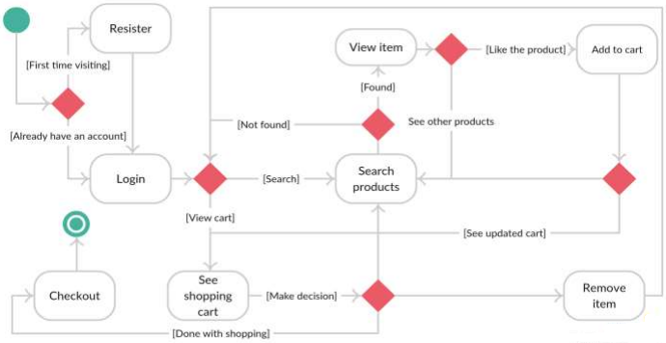
System Architecture

Slide 11
SOFTWARE REQUIREMENTS:
Operating System : Windows 10
Platform : DOT NET TECHNOLOGY
Front End : ASP.Net 4.0
Back End : SQL SERVER 2014

Slide 12
HARDWARE REQUIREMENTS:
Keyboard
Mouse
Hard disk 500GB
Ram 4 Gb

Slide 13
CONCLUSION
Today's technology has been greatly developed and facilitates the work we live in, especially in the field of business, buying and selling and shopping online, we don't need to be tired anymore to go to the seller's shop, we just need to open the cell phone, connect to an internet connection, open the seller's website and buy whatever we want.
With e-commerce buyers will have facilities that make it easy to buy and know the description of goods without the need to ask directly to the person, the quality of sales services and sales transactions are becoming more practical and make it easier for consumers in transfers to be the reason for using e-commerce in the ornamental plant business.

Slide 14
REFERENCE
[1] Laudon, K. C., and Traver, C. G. (2013). E-commerce: business, technology, society. Harlow.
[2] Daniel, E., Wilson, H., and Myers, A. (2002). Adoption of e-commerce by SMEs in the UK: towards a stage model. International Small Business Journal, 20(3), 253-270.
[3] Kotler, P., and Keller, K. L. (2006). Marketing Management (12e) New Jersey. In Conference Proceedings-Academic.

Slide 15
[4] Gregory, G., Karavdic, M., and Zou, S. (2007). The effects of e-commerce drivers on export marketing strategy. Journal of International Marketing, 15(2), 30-57.
[5] Gefen, D. (2000). E-commerce: the role of familiarity and trust. Omega, 28(6), 725-737.
[6] McKnight, D. H., Choudhury, V., and Kacmar, C. (2002). Developing and validating trust measures for e-commerce: An integrative typology. Information systems research, 13(3), 334- 359.

Slide 16
[7] Kay, S. H., and Hoyle, S. T. (2001). Mail order, the internet, and invasive aquatic weeds. Journal of Aquatic Plant Management, 39(1), 88-91
[8] Soegoto, E. S., and Rafi, M. S. F. (2018, August). Internet role in improving business transaction. In IOP Conference Series: Materials Science and Engineering. 407(1), 012059. IOP Publishing.
[9] Bowen, G. A. (2009). Document analysis as a qualitative research method. Qualitative research journal, 9(2), 27-40.

Slide 17
[10] Gordijn, J., and Akkermans, J. M. (2003). Value-based requirements engineering: exploring innovative e-commerce ideas. Requirements engineering, 8(2), 114-134

