Slide 1
ONLINE E-COMMERCE PRODUCT RECOMMENDER SYSTEM

Slide 2
Abstract
Internet is speeding up and modifying the manner in which daily tasks such as online shopping, paying utility bills, watching new movies, communicating, etc., are accomplished. As an example, in older shopping methods, products were mass produced for a single market and audience but that approach is no longer viable. Markets based on long product and development cycles can no longer survive. To stay competitive, markets need to provide different products and services to different customers with different needs. The shift to online shopping has made it incumbent on producers and retailers to customize for customers' needs while providing more options than were possible before. This, however, poses a problem for customers who must now analyze every offering in order to determine what they actually need and will benefit from. To aid customers in this scenario, we discuss about common recommender systems techniques that have been employed and their associated trade-offs.

Slide 3
Existing System
In this paper we review existing e-commerce implementations according to how they are presented to consumers.
Most of the Web stores we review consider the algorithms they use to be proprietary.
Many of these algorithms could be used while still presenting the same interface to the user. While digital cash has been used for some applications, it is still not widely accepted. Also, today's delivery services require an address to which merchandise can be shipped.
It is conceivable that privacy concerns may result in the reemergence of digital cash or "single-use" credit card numbers and the creation of trusted delivery services that accept deliveries to a one-time pseudonym, but these services do not yet exist.

Slide 4
Disadvantage of Existing System
The lack of confidence is the trend toward consolidation in the industry, which means that using personal information "within the company" may include sharing it with a variety of unexpected sites.
Scalability in recommender systems includes both very large problem sizes and real-time latency requirements.
For instance, a recommender system connected to a large Web site must produce each recommendation within a few tens of milliseconds while serving hundreds or thousands of consumers simultaneously.

Slide 5
PROPOSED SYSTEM :
In this paper, we research these two challenges together, by studying new and existing algorithms that have the potential to improve both scalability and quality of recommender systems.
There has been little work on experimental validation of recommender systems against a set of real- world datasets
The focus of this paper is two-fold. First, we provide a systematic experimental evaluation of dicerent techniques for recommender systems, and second, we present new algorithms that are particularly suited for sparse data sets, such as those that are common in E- commerce applications of recommender technology.

Slide 6
ADVANTAGE
An analysis of the effectiveness of recommender systems on actual customer data from an e- commerce site.
A comparison of the performance of several dicerent recommender algorithms, including original collaborative clutering algorithms, algorithms based on dimensionality reduction, and lassi al data mining algorithms.
A new approach to forming recommendations that has online eÆ ien y advantages versus previously studied algorithms, and that also has quality advantages in the presence of very sparse datasets, such as is common with E-commerce purchase data.

Slide 7
TITLE | AUTHOR | DESCRIPTION
Using Collaborative Filtering to Weave an Infonnation Tapestry | D. Goldberg, D. Nichols, B. Oki and D. Terry, | Tapestry was designed to support both content-based filtering and collaborative filtering, which entails people collaborating to help each other perform filtering by recording their reactions to documents they read.
A Survey of Recommendation Systems in Electronic Commerce | c.-P. Wei. M. Shaw and R. Easley. | Recommender systems provide great opportunities to businesses, therefore research on developing new recommender system techniques and methods have been receiving increasing attention. This paper reviews recent developments in recommender systems in the domain of ecommerce.

Slide 8
TITLE | AUTHOR | DESCRIPTION
Recommender systems in ecommerce | B. Schafer, J. Konstan and J. Riedl, | In this paper we present an explanation of how recommender systems help E-commerce sites increase sales, and analyze six sites that use recommender systems including several sites that use more than one recommender system.
Analysis of recommendation algorithms for e-commerce | B. Sarwar, G. Karypis, J. Konstan and J. Rieldl, | In this paper, we investigate several techniques for analyzing large-s ale purchase and preference data for the purpose of producing useful recommendations to customers.

Slide 9
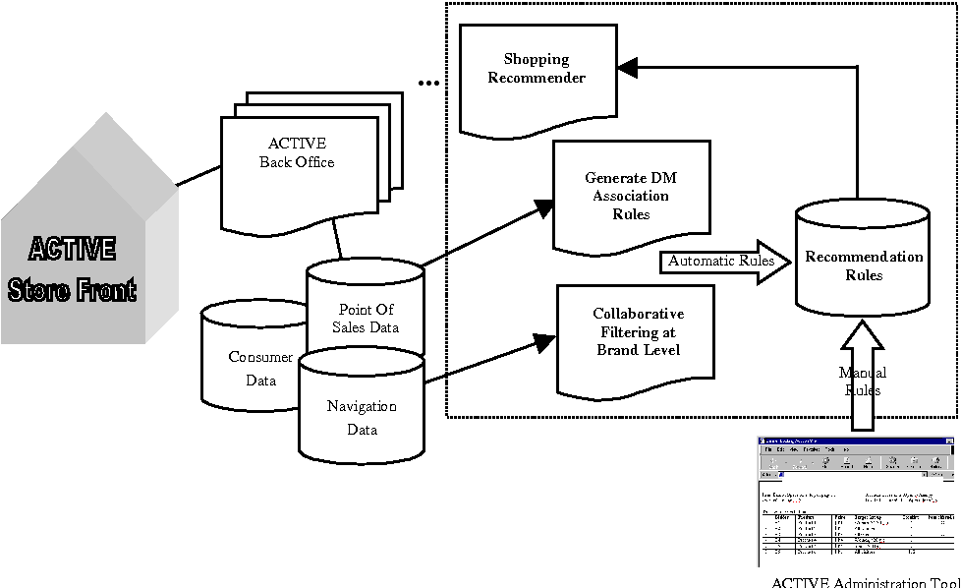
Block Diagram

Slide 10
SOFTWARE REQUIREMENTS:
Operating System : Windows 10
Platform : DOT NET TECHNOLOGY
Front End : ASP.Net 4.0
Back End : SQL SERVER 2014

Slide 11
HARDWARE REQUIREMENTS:
Keyboard
Mouse
Hard disk 500GB
Ram 4 Gb

Slide 12
CONCLUTION
Recommender systems allow e-commerce sites to be highly customizable for the user and buyer. They allow companies to 5 better understand their users, provide personalized stores, and in turn increase customer satisfaction and loyalty. They are implemented by utilizing various existing data mining tools and adapting them to current needs. Popular approaches include using association rules, collaborative filtering and content-based filtering and hybrid filtering. Recommendations using association rules are generated based on previous transactions the user has already displayed interest in. Collaborative filtering allows the active user to get recommendation based on products that users with similar interest have purchased and rated positively, and by using the active user's previous ratings and transaction history to build a model that provides a new set of similar products. Content based filtering compares the user's personal profile and preferences with the database to find products that are of interest and align with the active user and present them. Recommendations can range from being personalized to community driven and allow for a wide range of possibilities. The recommendations are also being refreshed due to the nature of changing search history, ratings, and arrival of new products. This also poses many challenges which include cold start, handling anonymous users, creating a social recommender system that can accommodate more than one active user, handling various different data sources and scalability with increased data.

Slide 13
REFERENCE
[I] D. Goldberg, D. Nichols, B. Oki and D. Terry, "Using Collaborative Filtering to Weave an Infonnation Tapestry." in ACM. New York. 1992.
[2] c.-P. Wei. M. Shaw and R. Easley. "A Survey of Recommendation Systems in Electronic Commerce," National Sun Yat-Sen University, Kaohsiung" 2001.
[3] B. Schafer, J. Konstan and J. Riedl, "Recommender systems in ecommerce," in ACM, New York City, 1999
[4] B. Sarwar, G. Karypis, J. Konstan and J. Rieldl, "Analysis of recommendation algorithms for e-commerce," in ACM, New York, 2000.
[5] J. Pine, Mass Customization, Boston: Harvard Business School Press, 1993.

Slide 14
[6] G. Adomavicius and A. Tuzhilin, "Toward the next generation of recommender systems: a survey of the state-of-the-art and possible extensions," Knowledge and Data Engineering, iEEE Transactions, vol. 17, no. 6, pp. 734-749,2005.
[7] M. Claypool, P. Le, M. Waseda and D. Brown, "Implicit Interest Indicators," in ACM, New York, 2001.
[8] A. N. Regi and R. Sandra, "A Survey on Recommendation Techniques in E-Commerce," vol. 2, no. 12,2013.
[9] R. J. Brachman, T. Khabaza, W. Kloesgen, G. Piatetsky-Shapiro and E. Simoudis, "Mining business databases," in ACM, New York, 1996.
[10] B. Schafer, J. Konstan and J. Riedl, "E-Commerce Recommendation Applications," in Applications of Data Mining to Electronic Commerce, Minneapolis, Springer US, 2001, pp. 115-153.

