Slide 1
IOT BASED FAULT DETECTION OF UNDERGROUND CABLES THROUGH NODE MCU MODULE

Slide 2
Abstract
In the downtowns, underground cables are used rather than of overhead transmission lines.
It is hard to go through the specific spot of the shortcomings. As India become prominent as a progression country, civilized field is too boosting every day.
The underground lines are beat under the same circumstances its uses is additionally growing a result of its clear advantages such as lower line losses, lower maintenance cost and they are less powerless to the effects of serious climate.

Slide 3
As it isn't clear it move extreme to identify propel area of the shortcoming.
In this proposed work we are trying to rectify this problem by proposing a method which is good enough to the digital world.
In this paper we have used IOT based technique with Google database for the fault detection with the help of Node MCU Wifi Module.
It is totally based on IOT.

Slide 4
We used here Node MCU which connects arduino sensors to Internet.
We had created a Hot spot through router for communication.
We connected each MCU Module with transformer and used Google data base to checking the status of transformers.
The accuracy and efficiency of our proposed method is more as compare to the other techniques.

Slide 5
Existing System
The IoT allows objects to be sensed or controlled remotely across existing network infrastructure, creating opportunities for more direct integration of the physical world into computer-based systems, and resulting in improved efficiency, accuracy and economic benefit in addition to reduced human intervention.
Due to safety reasons and high power requirements in densely populated areas, use of underground cable has seen a sharp hike.
This paper deals with the method to locate faults and identify the phase line in damaged cables.

Slide 6
Disadvantage of Existing System
In this paper we have study few techniques to minimize the various problems related to the underground cables but these techniques are not very efficient to detect the problem.
The call for consistent assistance has caused the improvement of procedure of discovering issues.
To decide the area of the issue, a heartbeat is useful to the transmission line. Contingent upon the greatness and the stage point, we can settle on the situation of the deficit.

Slide 7
PROPOSED SYSTEM :
The proposed system is an IoT enabled underground cable fault detection system.
The power supply is provided using step-down transformer, rectifier, and regulator.
The current sensing circuit of the cable provides the magnitude of voltage drop across the resistors to the microcontroller and based on the voltage the fault distance is located.

Slide 8
ADVANTAGE
The benefits of accurate location of fault are fast repair to revive back the power system, it improves the system performance, it reduce the operating expense and the time to locate the faults in the field.
Developing efficient scheduling techniques for charging and discharging of electric vehicles can potentially lead to reduce emissions, shave peak load, and increase the used percentage of generated renewable.
It also uses the surveillance data to predict future activities to be prepared in advance for a more convenient, comfortable, secure, and efficient living environment.

Slide 9
TITLE | AUTHOR | DESCRIPTION
Identification of underground cable fault location and development | M. R. Hans, S. C. Kor, and A. S. Patil, | In this paper we present two methods which will be very useful to identify the exact distance of fault of underground system from base station.
Accurate Fault Location in the Power Transmission Line Using Support Vector Machine Approach | R. Salat and S. Osowski, | The paper presents a new approach to the location of fault in the high-voltage power transmission line, relying on the application of the support vector machine and frequency characteristics of the measured one-terminal voltage and current transient signals of the system.

Slide 10
TITLE | AUTHOR | DESCRIPTION
Extended Fault-Location Formulation for Power Distribution Systems | R. Salim, M. Resener, A. Filomena, K. R. C. D. Oliveira, and A. Bretas, | The majority of distribution feeders are characterized by having several laterals, nonsymmetrical lines, highly unbalanced operation, and time-varying loads.
A line to ground fault location algorithm for underground cable system | M.-S. Choi, D.-S. Lee, and X. Yang, | The proposed method firstly makes voltage and current equations using analysis of distributed parameter circuit for each of cores and sheathes respectively, and then establishes an equation of the fault distance according to the analysis of the fault conditions.

Slide 11
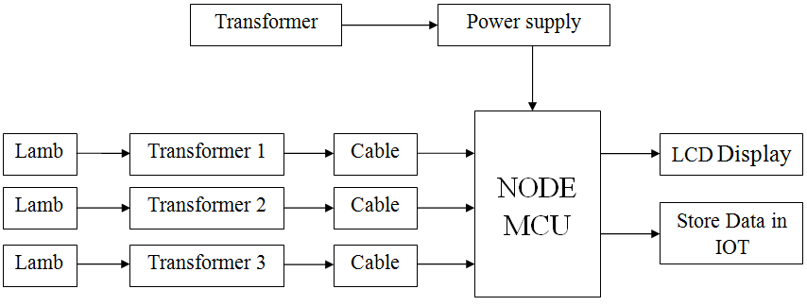
Block Diagram

Slide 12
SOFTWARE REQUIREMENTS:
Operating System : Windows 10
Platform : DOT NET TECHNOLOGY
Front End : ASP.Net 4.0
Back End : SQL SERVER 2014

Slide 13
HARDWARE REQUIREMENTS:
Keyboard
Mouse
Hard disk 500GB
Ram 4 Gb

Slide 14
CONCLUSION
In the proposed effort the difficulty of detecting the fault in underground lines is done on the basis of Node MCU Wifi Module.
We projected an IOT based model for healthier recognition of fault in the cables.
We proposed a method to detect the fault place from the underground cables through Node MCU Wifi module.
This is provided that best outcome and accuracy compare then other methods.

Slide 15
This technique is also given that a very fast speed of operation, which is very essential for the continuity and stability of power quality.
In the future we can use this technique for detection of faults in power lines/cables as well as for transformers by connecting various sensors.
And here the average accuracy of our proposed system in Y B Phase for LL fault respectivelly, are 94.53% and 98.63%.

Slide 16
REFERENCE
[1] M. R. Hans, S. C. Kor, and A. S. Patil, “Identification of underground cable fault location and development,” 2017 International Conference on Data Management, Analytics and Innovation (ICDMAI), 2017.
[2] R. Salat and S. Osowski, “Accurate Fault Location in the Power Transmission Line Using Support Vector Machine Approach,” IEEE Transactions on Power Systems, vol. 19, no. 2, pp. 979–986, 2004.
[3] R. Salim, M. Resener, A. Filomena, K. R. C. D. Oliveira, and A. Bretas, “Extended Fault-Location Formulation for Power Distribution Systems,” IEEE Transactions on Power Delivery, vol. 24, no. 2, pp. 508–516, 2009.

Slide 17
[4] M.-S. Choi, D.-S. Lee, and X. Yang, “A line to ground fault location algorithm for underground cable system,” KIEE Trans. Power Eng., pp. 267–273, Jun. 2005.
[5] HeenaSharma, M.T.Deshpande, RahulPande “Different types of fault Analysis and Techniques of Fault Location Using PSCAD”,Internation Journal of Emerging Technology and Advanced Engineering(2250- 2459)May2013.
[6] Willaim R.Stagi, “Cable injection technology,” IEEE Latin American Conference., 2007.

Slide 18
[7] Mahmoud Gilany, Doaa khalil Ibrahim, and El Sayed Tag Eldin, “Travelling wave-based fault location scheme for multiend-aged underground cable system,” IEEE Trans. On Power Delivery, Vol 22 No.1, January 2007.
[8] C. K. Jung, J. B. Lee, X. H. Wang and Y. H. Song, “A study on fault location algorithm on underground power cable system, Proceedings of IEEE Power engineering society general meeting, pp 2165-2171, 2005.
[9] C. F. Jensen, “Fault in Transmission Cables and Current Fault Location Methods,” Springer Theses Online Location of Faults on AC Cables in Underground Transmission Systems, pp. 7–18, 2014.

Slide 19
[10] T. S. Sidhu and Z. Xu, “Detection of Incipient Faults in Distribution Underground Cables,” IEEE Transactions on Power Delivery, vol. 25, no. 3, pp. 1363–1371, 2010.

