Slide 1
ANALYSIS OF BIO PLASTIC DERIVED FROM FISH SCALE FOR WRAPPING CANDIES

Slide 2
Abstract
Despite disadvantages of plastic materials such as environmental pollution, toxic material accumulation, reasons such as elasticity, easy shape and cheap materials have been preferred. However, environmental pollution has increased due to the ease of transportation, single use in daily life and intensive use. Because of this, bioplastics have emerged as a solution and are thought to be more beneficial to the environment. Bioplastics are a form of plastic derived from renewable biomass sources, such as vegetable oil, corn starch, pea starch or microorganisms, instead of fossil fuel plastic derived from petroleum. Recently, bioplastic production of fish wastes has been started. With the recycling of wastes, instead of leaving these crustacean products to the environment, new products have been started to be evaluated by chemical or biological methods. Thus, the process called recycle of waste become environmental friendly, economical, healthy. Also its reduces the usage o petroleneum derived product by using bioplastics instead of plastic. For all of that reasons bioplastic usage increased in our life.

Slide 3
Existing System
The “Bio-based packaging catalogue” (Molenveld and Van den Oever, 2015) answers many of these questions by giving background information regarding bio-based plastics but also by showcasing existing examples of bio-based packaging products.
The catalogue also shows that bio-based and biodegradable plastics are a large family of materials with widely varying properties, as are fossil-based plastics.
To efficiently and clearly discuss the suitability of using bio-based plastics as food packaging material, in this chapter most attention will be given to the 3 most commonly used bio-based plastics with unique properties.

Slide 4
Disadvantage of Existing System
Natural organisms have a very difficult time breaking down the synthetic chemical bonds in plastic, creating the tremendous problem of the material’s persistence.
The increased presence of plastic on the ocean surface has resulted in more serious problems.
Most of the plastic debris that reaches the ocean remains floating for years as it does not decompose quickly, it leads to the dropping of oxygen level in the water, severely affecting the survival of marine species.

Slide 5
PROPOSED SYSTEM :
The VA estimates that about 0.4 million tonnes of food waste could be diverted from incineration to composting.
Targeted promotion of compostable bags may stimulate consumers to dispose more food waste in the green bin instead of in the grey bin (ISWA, 2015), or may stimulate them to stop using noncompostable plastic to collect food waste for disposal in the green bin (estimated 0.3% of 1.3 million tonnes corresponds to 4 ktonnes/a).
Unclear communication, however, may result in people using non-compostable bags for this purpose, thus increasing the amount of this plastic in the organic waste stream.

Slide 6
ADVANTAGE
Many of the techniques we utilize in our designs involve targeted use of plastic products.
Their durability and low maintenance reduce material replacement, their light weight reduces shipping energy, their formulation into glue products allows for the creation of engineered lumber and sheet products from recycled wood, and their formulation into superior insulation and sealant products improves the energy performance of our structures.
The Central Pollution Control Board has prepared a performance evaluation report (Programme Objective Series: PROBES/122/2008-2009) titled Performance Evaluation of Polymer Coated Bitumen Built Roads to evaluate the performance of certain roads

Slide 7
TITTLE | AUTHOR | DESCRIPTION
Effect of polymer mixture on bioplastic development from fish waste. | FledaMariaPaixaoXavierNeves,etal.,2018. | The good chemical interaction between the bio polymers allowed the formation of a resistant and flexible film, with low permeability to water vapor, besides being visually clear and transparent desired characteristics in food packaging.
Preparation and properties of wheat gluten based bioplastics with fish scale. | SupakornThammahiws,2017. | There was a good dispersion of the fish scale powder embedded within the wheat gluten matrix. In addition of the fish scale caused a weight loss and the surface of the wheat gluten based bio plastic after 120 h of accelerated weathering were different from the neat wheat gluten bioplastic.

Slide 8
TITTLE | AUTHOR | DESCRIPTION
Natural Biopolymer-Based Nanocomposite Films for Packaging Applications | Rhim J-W, Ng PKW. | Polymer nanocomposites, especially natural biopolymer-layered silicate nanocomposites, exhibit markedly improved packaging properties due to their nanometer size dispersion.
Mechanical, Barrier and Morphological Properties of Biodegradable Films Based on Muscle and Waste Proteins from the Whitemouth Croaker (Micropogonias furnieri) | Zavareze E da R, Halal SLME, Silva RM e, Dias ARG, Prentice‐ Hernández C. | Protein isolate was obtained from croaker residue and myofibrillar proteins were obtained from croaker muscle.

Slide 9
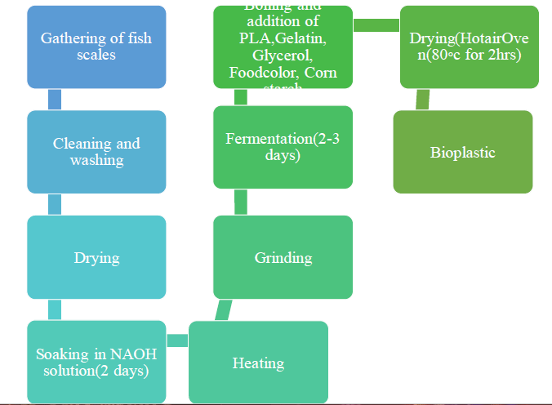
Block Diagram

Slide 10
SOFTWARE REQUIREMENTS:
Operating System : Windows 10
Platform : DOT NET TECHNOLOGY
Front End : ASP.Net 4.0
Back End : SQL SERVER 2014

Slide 11
HARDWARE REQUIREMENTS:
Keyboard
Mouse
Hard disk 500GB
Ram 4 Gb

Slide 12
CONCLUTION
The use of plastic will continue as long as there is life. This use has a negative environmental impact. As a result of many researches, bioplastics were produced from fish wastes that replaced plastic. Chitin and chitosan in fish wastes play an important role in making bioplastics. Thus, massive waste generated during seafood processing can be properly managed in order to obtain renewable and biodegradable raw materials. This management implies the use of environmentally friendly and cost-effective processes for the extraction of materials to ensure that the innovative biorefinery practices designed to add value to by-products contributes to the sustainable development of materials. Adoption of technical, environmental, economical, and social considerations is needed to ensure that well intended initiatives to instigate a circular economy have positive impacts on the development of active food packaging, thereby contributing to food security and nutrition. Enzymes use in daily life is predicted to increase because of the complete and efficient degradation by microbial enzymes over synthetic polymers.

Slide 13
REFERENCE
BRZOSTOWICZ, P.C., ROUVIERE, P.E. (2002). Genes and enzymes for the production of adipic acid intermediates. U.S. Patent No 6,365,376.
CHİARATHANAKRİT, C., RİYAJAN, S. A., & KAEWTATİP, K. (2018). Transforming fish scale waste into an efficient filler for starch foam. Carbohydrate polymers, 188, 48-53.
DE LA CABA, K., GUERRERO, P., TRUNG, T. S., CRUZ, M., KERRY, J. P., FLUHR, J., ...& BURT, S. (2018). From seafood waste to active seafood packaging: An emerging opportunity of the circular economy. Journal of Cleaner Production.
ILES, A., & MARTİN, A. N. (2013). Expanding bioplastics production: sustainable business innovation in the chemical industry. Journal of Cleaner Production, 45, 38-49.
JENKİNS, D., & WANNER, J. (EDS.). (2014). Activated sludge-100 years and counting. IWA publishing.

Slide 14
LECETA, I., URANGA, J., ARANA, P., CABEZUDO, S., DE LA CABA, K., & GUERRERO, P. (2015).Valorisation of fishery industry wastes to manufacture sustainable packaging films: modelling moisture-sorption behaviour. Journal of Cleaner Production, 91, 36-42.
MONTE, M. L., MORENO, M. L., SENNA, J., ARRİECHE, L. S., & PİNTO, L. A. (2018). Moisture sorption isotherms of chitosan-glycerol films: Thermodynamic properties and microstructure. Food bioscience, 22, 170-177.
SARANYA, N., & THAYUMANAVAN, T. (2014). Propertıes of purıfıed chıtınase produced by pseudomonas putıda. International Journal of Pharmacology and Biological Sciences, 8(2), 65.
SİNHA, R., & CHAUHAN, G. (2016). Generalized model for predicting methane conversion to syngas in membrane reactor. International Journal of Engineering, Science and Technology, 8(4), 8-15.
SOAREZ A.,BATARLO J.A.C. (2009).Bio-Plastics-From-Fish-Scales.

