Slide 1
AFFINITY PROPAGATION BASED SMART DATA ANALYTICS IN 5G NETWORK

Slide 2
Abstract
Network embedding assigns nodes in a network to low dimensional representations and effectively preserves the network structure. Recently, a significant amount of progresses have been made toward this emerging network analysis paradigm. In this survey, we focus on categorizing and then reviewing the current development on network embedding methods, and point out its future research directions. We first summarize the motivation of network embedding. We discuss the classical graph embedding algorithms on cognitive radio environment and their relationship with network embedding. Afterwards and primarily, we provide a comprehensive overview of a large number of network embedding methods in a systematic manner, covering the structure- and property-preserving network embedding methods, the network embedding methods with side information and the advanced information preserving network embedding methods. Moreover, several evaluation approaches for network embedding and some useful online resources, including the network data sets and software, are reviewed, too. Finally, we discuss the framework of exploiting these network embedding methods to build an effective system and point out some potential future directions.

Slide 3
Existing System
The existent adaptation mechanisms system are usually reactive, they solely react when a tangle happens.
This for the most part limits the network ability to produce intelligent and efficient solutions, also with regard to inexperienced networking and advantageous business models.
Cognitive Radio Networks (CRNs) give the rise of spectrum utilization by using unused or less used spectrum.
Unauthorized users have access to licensed spectrum, below the condition that the interference perceived by the authorized users is lowest.

Slide 4
Disadvantage of Existing System
High end-to-End delay and reduce network life time .
The network situation is outlined as wireless detector network with 30 nodes at random deployed within the space of 500 m X 500 m. 250 m is that the transmission vary of every of the detector nodes within the network.
Increase communication time go on between the supply node causing the packet and therefore the destination node receiving the packet.
Node Pairing and Embedding is not possible and run time.
If we regard network embedding as a way of network representation learning, the formation of the representation space can be further optimized and confined towards different target problems.
Taking the network node classification problem as an example, if we have the labels of some network nodes, we can design a solution with network structure as input, node labels as supervised information, and embedding representation as latent middle layer, and the resulted network embedding is specific for node classification.

Slide 5
PROPOSED SYSTEM :
The most effective way of spectrum sensing is to directly detect the primary Rx, because it is the Rx of a PU system that should be protected. In general, the PU systems can be divided into the following two categories:
1) One-way communication systems and
2) Two-way communication systems.
One-way communication systems have only one direction communication from the primary Tx to the primary Rx, such as TV and radio broadcasts. The only way of detecting this kind of Rx’s is to sense the leakage signals from active Rx’s.
Two-way communication systems have bidirectional communications, and there are interactions between the Tx and the Rx, which can be used for spectrum sensing. Next, we will introduce the sensing methods for the two kinds of systems, respectively.

Slide 6
ADVANTAGE
High tolerance of delays
Large volume of CR device cost economies
Low power is required
very low mobility required
No network of CR base stations required

Slide 7
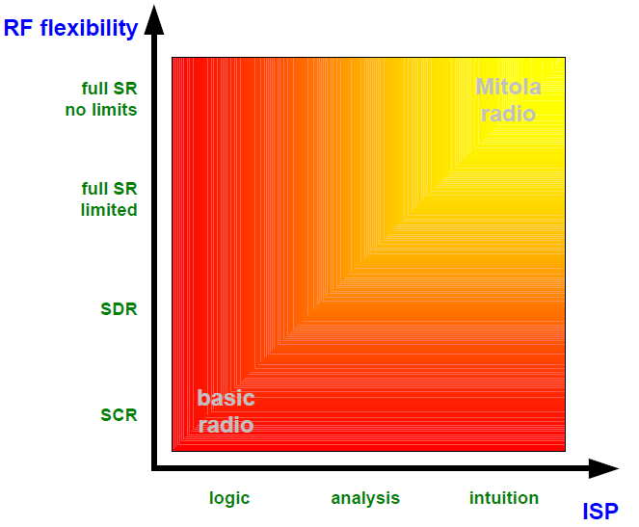
Block Diagram

Slide 8
SOFTWARE REQUIREMENTS:
Operating System : Windows 10
Platform : DOT NET TECHNOLOGY
Front End : ASP.Net 4.0
Back End : SQL SERVER 2014

Slide 9
HARDWARE REQUIREMENTS:
Keyboard
Mouse
Hard disk 500GB
Ram 4 Gb

Slide 10
CONCLUTION
GSM results show high variability dependant on the assumed level of occupancy, but may be suited to ‘quiet hours’ types of CR services. Currently 2G users will create a high level of occupancy that may leave little room for CR. However, if the level of migration to 3G services continues, the GSM band may show lower occupancy levels and therefore be better suited to a range of CR services. Should GSM usage lessen to the point where operators want to re-farm the GSM bands to 3G services, then results for CR akin to the one simulated for the UMTS expansion band scenario The UMTS Expansion bands showed an increased call volume over the GSM band in all instances. This is perhaps intuitive due to the decreased occupancy of these bands but illustrates a wide variation between bands that could be explored further with available data from other bands. If the CR operates across bands, then taking several bands together will offer a larger additional call volume than the sum of the call volumes achieved by the consideration of isolated bands - this is due to the non-linearity of the BHT formula, where larger number of lines permits a higher percentage of traffic volume than a smaller number of lines. The DECT band was found to be not worthwhile for CR considerations, since in DECT a combined OFDMA / TDD scheme will show large parts of the spectrum occupied even for a low duty cycle, i.e. a low occupancy.

Slide 11
REFERENCE
[1] Jai Sukh Paul Singh, Jasvir Singh, A.S. Kang, “Cognitive Radio: State of Research Domain in Next Generation Wireless Networks - A Critical Analysis”, International Journal of Computer Applications (0975 – 8887) Volume 74– No.10, July 2013.
[2]Blaine Chamberlain And Geogette Jordan“ Applications of Wireless Sensors in Monitoring Indoor Air Quality in the Classroom Environment”, Research Experiences for Teachers in Sensor Networks, Summer Internship 2012,University of North Texas,NSF-1132585.
[3] X. Mao, X. Miao, Y. He, X.-Y. Li, and Y. Liu, “Urban CO2 monitoring with sensors,”in Proc. IEEE INFOCOM, Mar. 2012, pp. 1611–1619.
[4] Zhou Hongqing and Yang Chunying, ``A Mobile Ad Hoc Networks Algorithm Improved AODV Protocol’’, 2011 International Conference on Power Electronics and Engineering Application (PEEA 2011).

Slide 12
[5] Nor Surayati Mohamad Usop, Azizol Abdullah and Ahmad Faisal Amri Abidin,“Performance Evaluation of AODV, DSDV & DSR Routing Protocol in Grid Environment”, IJCSNS International Journal of Computer Science and Network Security, VOL.9 No.7, July 2009.
[6]Ozgur B. Akan Osman B. Karli Ozgur Ergul “Cognitive radio sensor networks” ,Next generation Wireless Communications Laboratory (NWCL), Department of Electrical and Electronics Engineering.
[7] Deepak Kumar Patel, Rakesh Kumar, A.K.Daniel, “Performance Analysis and Behavioural Study of Proactive and Reactive routing protocols in MANET ”, International Journal of Advanced Research in Computer Science and Software Engineering, vol. 2, April 2013.
[8]P. Spachos and D. Hantzinakos, “Scalable dynamic routing protocol for cognitive radio sensor networks,” IEEE Sensors J., vol. 14, no. 7, pp. 2257–2266, Jul. 2014.
[9] PetrosSpachos and DimitriosHatzinakos,” Real-time Indoor Carbon dioxide Monitoring through Cognitive Wireless Sensor Networks”, IEEE SENSOR JOURNAL, vol.16, no. 2, January 15, 2016.

