Slide 1
Home Outlet and LED Array Lamp Controlled by a Smartphone with a Hand Gesture Recognition

Slide 2
Abstract
In this paper, we design a home outlet and a LED array lamp controlled by hand gesture recognition with a smart phone that has a system composed of two parts: a smart phone's application and a wireless remote control unit (WRCU). The application can read the accelerometer and gyroscope in a smart phone by means of hand gesture recognition and send a control command to the wireless remote control unit. The wireless remote control unit can decode the received message and echo the corresponding action. This design incorporates a LED array lamp as the home outlet used to control both the on/off function and the dimming function.

Slide 3
Existing System
An alternative to VGR techniques is a sensor-based gestures recognition (SGR) technique, which carries out continuous gesture recognition from the data produced by sensors.
Dynamic hand gestures are those gestures which involve movement of body parts like waving of hand while static hand gestures include single formation without movement.
The LSTM has been successfully applied to various applications, such as speech recognition, image caption generation, and machine translation.
A simple gesturespotting scheme is then carried out to find the maximum a posteriori (MAP) solution for the final classification, given the observed output path.

Slide 4
Disadvantage of Existing System
It tries to deploy a well-known machine learning algorithm to solve the problem of gesture recognition.
When implementing the recognition system using background subtraction, we encountered several drawbacks and accuracy issues.
The LSTM algorithms can also operate along for solving SGR recognition problems.
Although the algorithms have been found to be effective, many techniques have a common drawback that they are designed only for a single continuous gesture.

Slide 5
PROPOSED SYSTEM :
In this paper we proposed the hand gestures can be used to automate home applications and also control documents in the system.
A novel method to recognize hand gestures for human computer interaction, using computer vision and image processing techniques, is proposed in this paper.
The proposed method can successfully replace such devices (e.g. keyboard or mouse) needed for interacting with a personal computer.
We intend to make decisions on the methods and algorithms that we have considered to use during the implementation phase of our proposed system.

Slide 6
ADVANTAGE
In this paper, we have designed a robust marker- less hand gesture recognition system which can efficiently track both static and dynamic hand gestures.
Cost efficient models like have implemented their systems using simple web cameras.
In our system, we use the webcam inbuilt which is cost efficient to recognize both static and dynamic gestures.
The camera module identifies the different cameras and markers that can be used. The detection module deals with the pre-processing of image and feature extraction.
We used a webcam available in the laptop without the use of any additional cameras by making the system cost effective.

Slide 7
TITLE | AUTHOR | DESCRIPTION
A gesture-based remote control for finger disabled people | Y. Murata, N. Sato, T. Takayama and S. Onodera, | A remote control is presented that enables finger disabled people to easily control various types of devices and appliances.
User-dependent gesture recognition on android handheld device | T. Marasovic and V. Papic, | This spurred the research on new forms of communication between man and machines based on the movements or “gestures” performed by the user when holding the device.

Slide 8
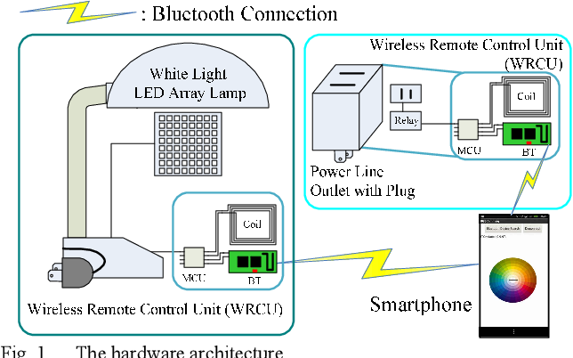
Block Diagram

Slide 9
SOFTWARE REQUIREMENTS:
Operating System : Windows 10
Platform : DOT NET TECHNOLOGY
Front End : ASP.Net 4.0
Back End : SQL SERVER 2014

Slide 10
HARDWARE REQUIREMENTS:
Keyboard
Mouse
Hard disk 500GB
Ram 4 Gb

Slide 11
CONCLUTION
We were able to create a robust gesture recognition system that did not utilize any markers, hence making it more user friendly and low cost. In this gesture recognition system, we have aimed to provide gestures, covering almost all aspects of HCI such as system functionalities, launching of applications and opening some popular websites. In future we would like to improve the accuracy further and add more gestures to implement more functions. Finally, we target to extend our domain scenarios and apply our tracking mechanism into a variety of hardware including digital TV and mobile devices. We also aim to extend this mechanism to a range of users including disabled users.

Slide 12
REFERENCE
1. Y. Murata, N. Sato, T. Takayama and S. Onodera, "A gesture-based remote control for finger disabled people", IEEE 1st Global Conference on Consumer Electronics (GCCE), pp. 406-410, Oct. 2012.
2. Jia Liu, Chaowei Wang, Juyi Qiao, Weidong Wang and Yinghai Zhang, "A machine-to-machine application: Body posture recognition on smartphones for intelligent remote control", IEEE 2nd International Conference on Cloud Computing and Intelligent Systems (CCIS), pp. 884-888, 2012, Oct. 2012.
3. T. Marasovic and V. Papic, "User-dependent gesture recognition on android handheld device", 22nd International Conference on Software Telecommunications and Computer Networks (SoftCOM), pp. 398-402, 2014, Sept. 2014.

