Slide 1
New Generation ATM Terminal Services

Slide 2
Abstract
This paper aims at realization of the Automated Teller Machine network all around the globe using IPv6, thereby reducing the complexity and total number of transactions involved in the entire process of cash withdrawal. But the major challenge involved in connecting ATM network to public domain is the security. A Near-Field Communication (NFC) is proposed to be used where in the user, after inserting ATM Card, would communicate via only their NFC enabled mobile phones. Reserving NFC spectrum band to the government is proposed to be made mandatory for ensuring no eavesdropping. The proposed technique would help in achieving a unified interface for ATM terminals among all the financial institutions.

Slide 3
A prior establishment of session is made between a trusted third party application and the ATM terminals, wherein the ATM card is checked for its validity and after this validation, session is established between the ATM terminal and the financial institution's server. Then server sends registered mobile number of the swiped ATM card to the terminal, wherein the terminal invokes NFC with that mobile number. Thereafter all the communication is between mobile and the server via the ATM terminals ensuring authenticity and confidentiality. Using this technique, an ATM terminal can connect to any bank server in the world, directly, reducing huge network traffic and providing scope to include other non-financial services as offerings.

Slide 4
Existing System
Existing ATMs are convenient and easy to use for most consumers.
Existing ATMs typically provide instructions on an ATM display screen that are read by a user to provide for interactive operation of the ATM.
Having read the display screen instructions, a user is able to use and operate the ATM via data and information entered on a keypad.
However, the drawback in the existing system is that the user should carry their ATM card without fail.
But in many cases, we forget it. So only we designed a system which helps us to use the ATM machine without the ATM card.

Slide 5
Disadvantage of Existing System
In order to serve people conveniently, it is need to monitor the ATM equipment to guarantee its normal operation, and deal with the unexpected problems in time.
Although it is undoubtedly cheaper to use commercial off-the-shelf hardware, it does make ATMs vulnerable to the same sort of problems exhibited by conventional computers.
Some ATMs may be stocked and wholly owned by outside companies, which can further complicate this problem when it happens.
ATMs rely on authorization of a financial transaction by the card issuer or other authorizing institution via the communications network.

Slide 6
PROPOSED SYSTEM :
We propose Secure-PIN Authentication-as-a-Service (SEPIA), a secure obfuscated PIN authentication protocol for ATM and other point-of-service terminals using cloud-connected personal mobile and wearable devices.
Various ATM machines produced by different manufacturers and proposed a common code for very similar malfunctions made by the machine.
The aim of our work is to use embedded ATM camera to perform face detection with the help new computer vision framework.
In this, high quality image has important role in recognition process. Face image is used for authentication purpose.

Slide 7
ADVANTAGE
Automated teller machines (ATMs) are well acknowledged devices stereotypically used by folks to cart out a variability of personal and business economic transactions and banking tasks.
Banking facilities are widely used by people for their economies activities.
The combination of GSM and RFID technology is also used which makes the system secure than only RFID technology.
Transaction is used because each customer has unique fingerprints. So this system provides more secure transaction than GSM.
Remote Key Loading techniques may be used to ensure the secrecy of the initialization of the encryption keys in the ATM.
Encryption of personal information, required by law in many jurisdictions, is used to prevent fraud.

Slide 8
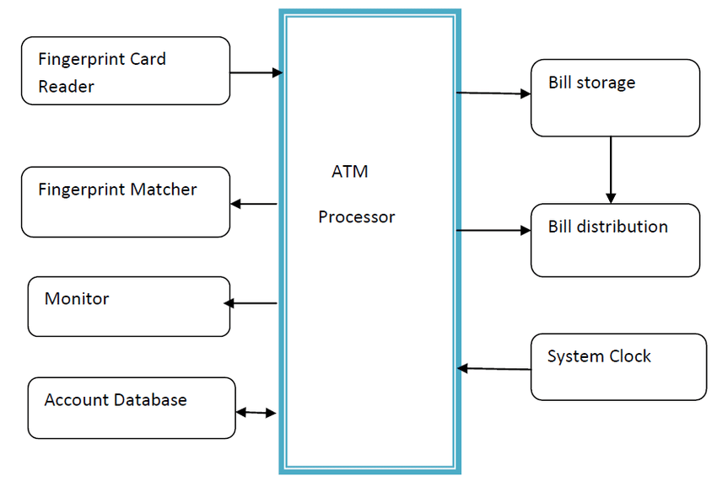
Block Diagram

Slide 9
SOFTWARE REQUIREMENTS:
Operating System : Windows 10
Platform : DOT NET TECHNOLOGY
Front End : ASP.Net 4.0
Back End : SQL SERVER 2014

Slide 10
HARDWARE REQUIREMENTS:
Keyboard
Mouse
Hard disk 500GB
Ram 4 Gb

Slide 11
CONCLUTION
ATM model which provides security by using Facial verification software adding up facial recognition systems to the identity confirmation process used in ATMs can reduce forced transactions to a great extent and provide hard-secure authentication. As facial recognition technique seems more challenging as compared to other biometrics, thus more efficient algorithm can be developed. The inability to detect face when beard and aging can be rectified and eliminated or reduced. Instead of face recognition retinal or iris recognition can be used if the cost is reduced.

Slide 12
REFERENCE
1.K. Malladi and S. Sridharan, "Online Franchise Capturing using IPv6 through Automated Teller Machines", the Proceedings of International Conference on Recent Trends in Information Technology (ICRTIT) IEEE, pp. 562-568, 2013.
2.G Mujtaba, "Adaptive Automated Teller Machine Part-II", ICICT, July 2011.
3.G Mujtaba, "Adaptive Automated Teller Machine Part-I", ICICT, July 2010.
4.K. Malladi and S. Sridharan, "Contemplate for Online Plebiscite Capturing Using ATM Terminals", International Journal of Advanced Research in Computer Science and Software Engineering, vol. 3, no. 4, pp. 540-544, April 2013.
5."e-voting system", Gujarat State Election Commission, 2010, [online] Available: http://sec.gujarat.gov.in/e-voting-system.html.

Slide 13
6.T. Kohno, A. Stubblefield, A. D. Rubin and D. S. Wallach, "Analysis of an electronic voting system", Security and Privacy 2004. Proceedings. 2004 IEEE Symposium on. IEEE, pp. 27-40, 2004.
7.D. E. Jones, "The case of the Diebold ftp site", July 2003, [online] Available: http://www.cs.uiowa.edu/jones/voting/dieboldftp.html.
8.B. Harris, D. Allen and L. Alexander, Black box voting: Ballot tampering in the 21st century, Talion Pub., 2004.
9.A. D. Rubin, "Security considerations for remote electronic voting", Communications of the ACM, vol. 45, no. 12, pp. 39-44, 2002.
10.K. Malladi and S. Sridharan, "Implementing the atm based voting services - the restful way", Proceedings of 2013 Student Research Symposium, 2013.

