Slide 1
Embedded Automatic Vehicle Control System Using Voice Recognition On ARM7 Processor

Slide 2
Abstract
The proposed work is focused on automatic speed control of vehicles by detecting the accident prone zone. In this work we are using RF for indicating the speed limit areas. The RF receiver is placed inside the vehicle. The speed is calculated by the help of vehicle speedometer in the vehicle. The controller compares the speed with standard speed limit, if it exceeds the limit the controller alerts the driver and control is taken automatically. These data are given by the controller to the people through GSM module, and the data are analysed using python software. The waveform corresponding to the data received is plotted between speed and time. The designed experimental module is simpler and since the software used for data analysing is free open source Python, the overall system is cost effective.

Slide 3
Existing System
The voice recognition module converts the analog signal into digital signal and the signal is transferred to the ARM-7 controller.
If the car has been trained before, the exist speech model will load in the recognizer.
Speech recognition system actually is a process which creates a voice model and determine whether the voice feature is matching with the existing model.
A condensed mic is used to give input command to the system through the voice recognisation module.
The operator gives voice as input in order to perform the to the desired task.

Slide 4
Disadvantage of Existing System
In a practical sense, speech recognition solves problems, improves productivity, and changes the way we run our lives.
The large and advantageous development community of Hawkboard developers can often solve a problem faster than the technical support of TI can do, although most community efforts are currently still aimed towards the Embedded Linux ARM part of the system.
It also has a large number of applications in voice dialing, intelligent device control, data entry, etc.
The ASR system can only operate stable in silent environment. In noisy circumstance, the accuracy of the system would degrade.

Slide 5
PROPOSED SYSTEM :
This proposed work has an aim to control the speed of any vehicles automatically in cities and also in restricted areas such as schools, parks, hospitals and in speed limited areas.
The driver need not control the speed during driving and the controls are done automatically by the use of proposed embedded system.
The proposed model works with RF communication between the speed sign post and the vehicle controller system.
Our purposes more suitable is a different interesting approach to development boards and follows the idea of keeping the board as simple as possible and supplying only the most needed peripheral hardware mounted on the board itself.

Slide 6
ADVANTAGE
The DC motor used here is an indication of vehicle speed.
Due to the accident cases reported daily on the major roads in all parts of the developed and developing countries, more attention is needed in the designing of an efficient car driving aiding system.
We can modify the system with efficient braking system in association with air flow control to the carburettor.
Advanced image processing algorithms and libraries could be used so that the system can be used efficiently even during unfavourable lighting conditions and during the night time as well.
The RF module is used to give an indication that the vehicle is travelling at normal speed or in an speed restricted zone.

Slide 7
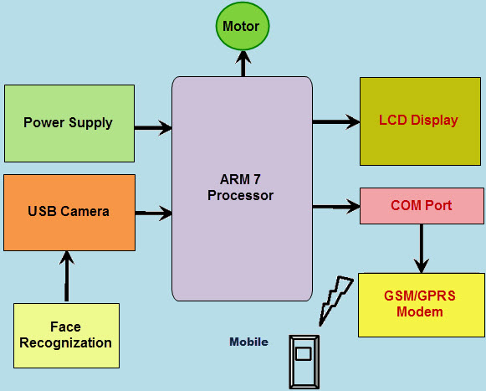
Block Diagram

Slide 8
SOFTWARE REQUIREMENTS:
Operating System : Windows 10
Platform : DOT NET TECHNOLOGY
Front End : ASP.Net 4.0
Back End : SQL SERVER 2014

Slide 9
HARDWARE REQUIREMENTS:
Keyboard
Mouse
Hard disk 500GB
Ram 4 Gb

Slide 10
CONCLUTION
We conclude that this work is very easy to implement on current system, low cost and durable, ensures maximum safety to passengers and public, the driver gets enough information about road safety. The system is enhanced by automatic speed control when the vehicles get any hazard signal from outside environment. These collision avoidance systems are designed to minimize or avoid collisions, rather than simply minimise harm to passengers during collisions.

Slide 11
REFERENCE
1.http://journalistsresource.org/studies/environment/transportation/road-safetymotor - vehicle- accidents-surveyingglobal-us-data#
2. http://www.answers.com/topic/collisio n-avoidance-systems
3. http://www.consumerreports.org/cro/n ews/2013/04/study-reveals-which-carcrash-avoidance-technology-can-be-aproven lifesaver/index.htm
4. http://phys.org/news/2012-07-crashavoidance.html
5. Autoweb.com.au: Honda Develops New Collision Avoidance Safety System. 2003.

Slide 12
6. https://www.analyticsvidhya.com/blog/ 2016/01/complete-tutorial-learn-datascience- python-scratch-2/
7. https://pythonprogramming.net/dataanalysis-tutorials/
8. MICROCHIP/PIC16F877A Datasheet, http://www.alldatasheet.com/data sheet pdf/pdf/82338/MICRO CHIP/PIC16F877A.html
9. J. David and N. Cheek, “Fundamentals of ultrasonic waves”, CRC Press, Florida, USA, 2002, ISBN 0-8493- 0130-0.
10. Ankita Mishra, Jyoti Solanki “Design of RF based speed control system for vehicles,” International Journal of Advanced Research in Computer and Communication Engineering, Vol. 1, No 8, 2012.

